Slide 1
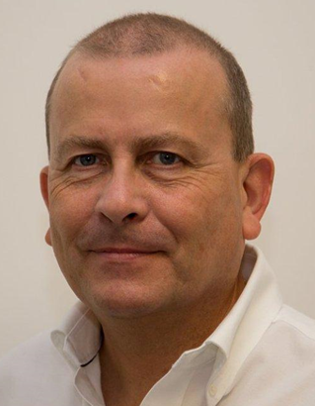
EEED Day 1 Safety Induction 2016
Andy Paice
Department Facilities Manager
and Safety Officer

Slide 2
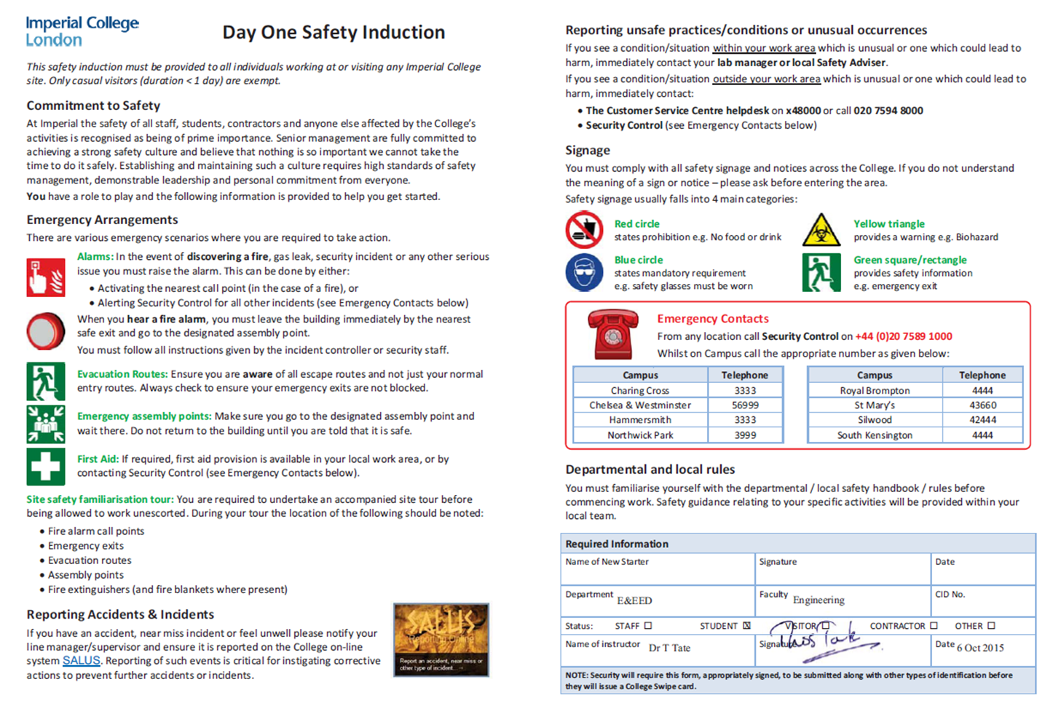
Issue of College ID Cards
Induction form from Department or Halls warden.
ID cards will only be issued with a completed form.

Slide 3
Help! - Emergencies
College Emergency 4444 from any internal phone
Or 0207 589 1000 from external phone (eg mobile – save it now!)
DO NOT CALL 999 or 111.
Report any accident or near miss – see safety department website using the SALUS form.

Slide 4
Safety Guidance…
If you have any concerns, tell someone!
  Member of staff – Security – UG office –
  Andy Paice (ME!!)…
For Example!!!
Building faults, Spillages, Trip hazards, Strange smells / noises / suspicious people…

Slide 5
Alarms
Fire / Smoke / Security issue.
VERY LOUD sounders.
Get out.
Use stairs, NOT lift!
Go to assembly point (F) By the Queens Tower.
(NOT level 2 walkway!!)
  Be aware that there may be emergency services in the roads and other “unusual hazards”
NB – Fire alarm tested on Wednesday mornings (3 seconds maximum)

Slide 6
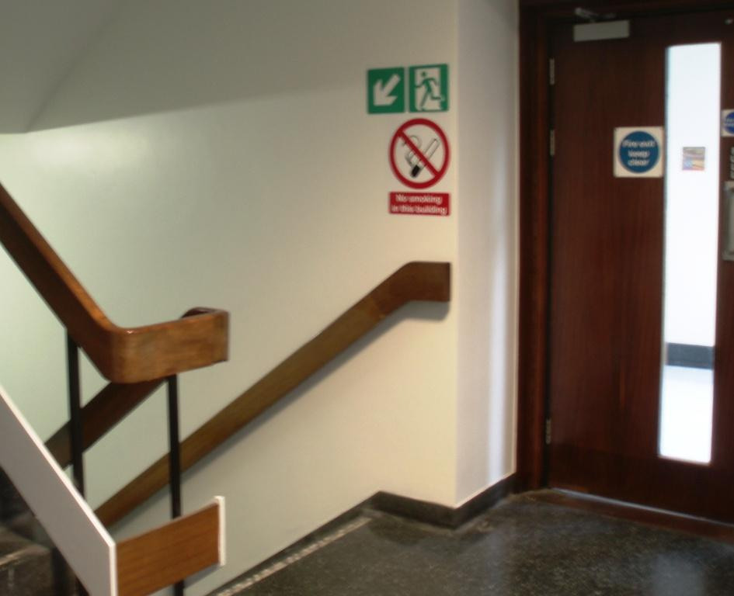
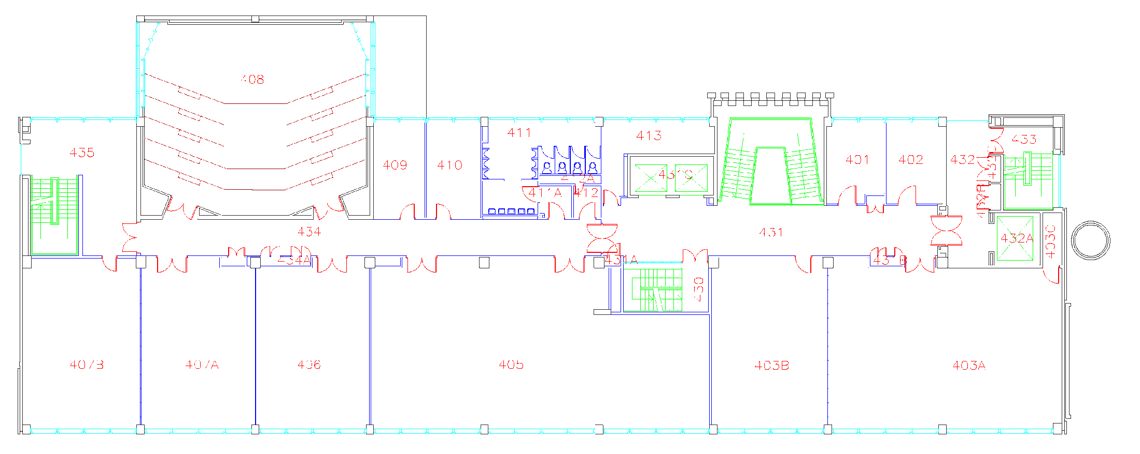
Exits from the building
(e.g. level 4)
Do Not use lifts!
South stairs
North stairs
Central stairs
Do Not use lifts!
Always follow the green walking man signs.

Slide 7

PEEPS
Personal Emergency Evacuation Plan
Temporary or Permanent disability
Contact Andy Paice.

Slide 8
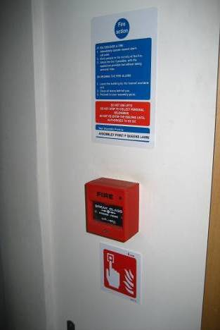
If YOU find a fire
Get out, warning others as you go
Close all doors behind you.
Activate the nearest red fire alarm button.
NEVER use the lift.
Go to the fire assembly point.
Tell the person in charge what you found.
DO NOT re-enter the building until you have been told.

Slide 9
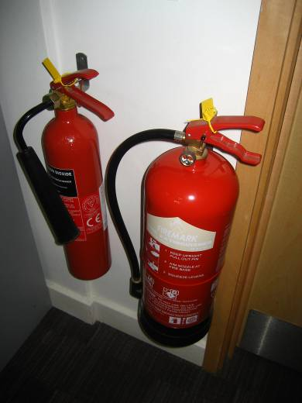
Fighting a fire
DON’T. Let the place burn.
Do not put yourself or any one else in DANGER.
You are not here to fight fires, but if you are confident and have been trained, sound the alarm first and then attempt to extinguish the fire. If you can’t put it out with one extinguisher, STOP AND GET OUT.

Slide 10
Help! - First aid
First aid contact information is displayed on posters by the lifts
Or ring Security on 4444 as all security staff have first aid training.

Slide 11
Working hours and access
Normal hours:
  Monday – Friday, 07.00 – 17.30
Outside these times (swipe card access 17.30 – midnight), maintain contact!
Access to laboratory and workshop equipment is restricted. Lone working is not allowed in these areas.

Slide 12
Hazardous areas / procedures
No one may use laboratory or workshop equipment without permission, and UG students must be supervised.
Departmental Safety Officer:
  Mr Andy Paice. Room 201 Ext 46190 a.paice@imperial.ac.uk
Departmental Chemical Safety:
  Dr Zahid Durrani. Room 704 Ext 46232.
Departmental Laser Safety:
  Prof Andrew Holmes. Room 701 Ext 46239.

Slide 13
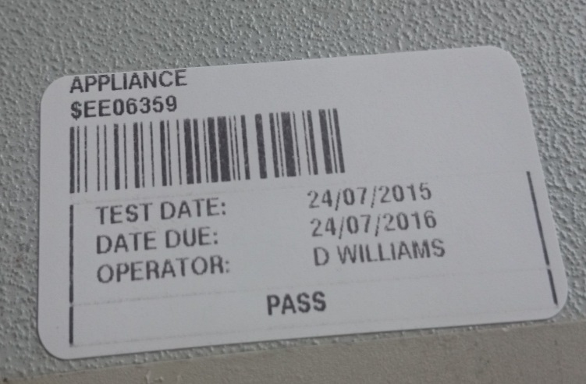
Departmental policy on electrical equipment
All mains-powered electrical equipment should have an up-to-date test label. If there is no label, or if it is out of date, you may not use the equipment – contact the Technical Support Group (see intranet) to arrange suitable testing.
Any electrical devices that you bring into the College will have to be tested. (e.g. Laptop and mobile phone chargers).

Slide 14
One more form to fill in…
Agree to safety document
  You will soon receive an email with a web URL linking to the Departmental safety statement: do what it says…

Slide 15
Information and notices
Departmental safety noticeboard located in level 1 corridor
Departmental safety committee meets three times a year: If you have anything you would like to raise at these meetings you should discuss with your UG Rep.
College and departmental safety information: http://www3.imperial.ac.uk/electricalengineering/internal

