Slide 1
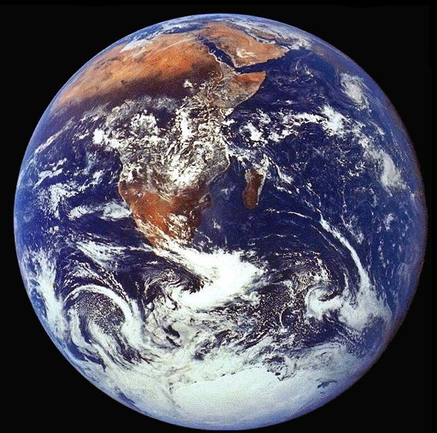
Energy and the Environment:
An Earth Sciences perspective
Chemical & nuclear energy
  Nucleosynthesis, origin of the elements and the Earth
Geothermal and fossil energy
  Plate tectonics
  Evolution of life
Solar energy
  Radiative balance and climate
Looking Forward – Energy and the Environment
Dr. Yves Plancherel
yves.plancherel@earth.ox.ac.uk
Mathematical Institute, Oxford, June 6th, 2017

Slide 2
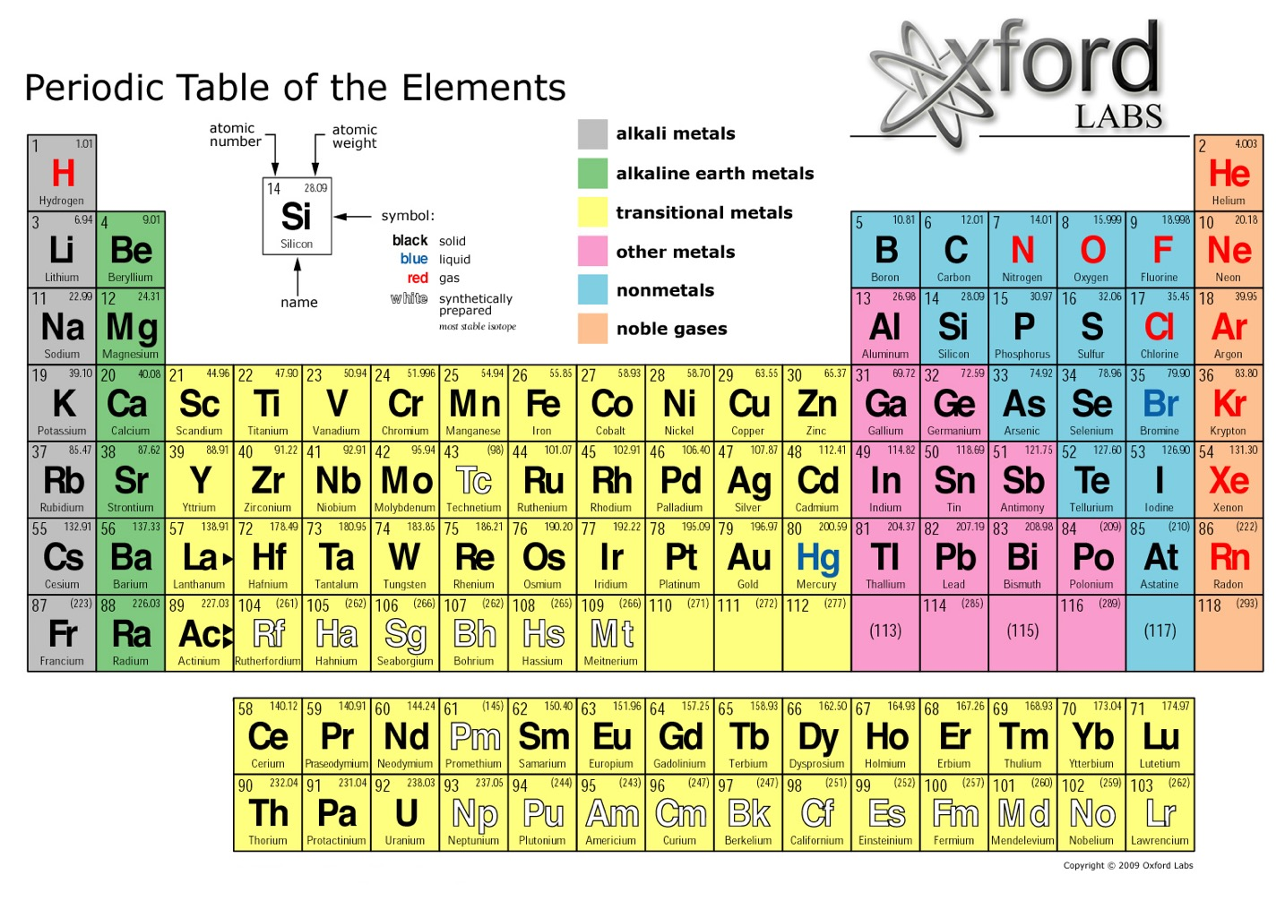
http://oxford-labs.com/wp-content/uploads/2009/04/periodic-table.jpg

Slide 3

...and it all started with the Big Bang!
(13.77 ± 0.059 Ga)
Notes:
From https://map.gsfc.nasa.gov/universe/uni_age.html.
Age of Universe estimated by
Looking for the oldest stars in globular clusters (11-18 Ba)
Age of stars depends on star (large stars more shiny, but burn faster)
Star clusters form at the about the same time
Luminosity of stars are related to size, which links to lifetime of burn
Maximum luminosity in star cluster puts lower limit on age
Measuring the rate of expansion of the universe and extrapolate backwards (12-14 Ba)
From Cosmic Microwave background measured by WMAP

Slide 4
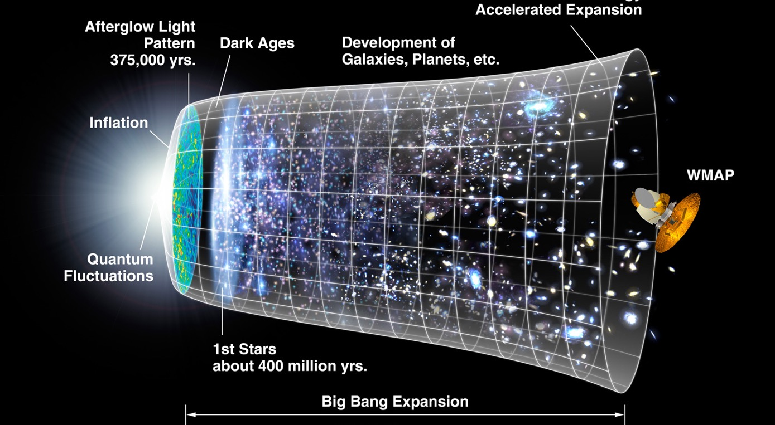
Where do elements come from?
Nucleosynthesis
https://map.gsfc.nasa.gov/media/060915/index.html

Slide 5
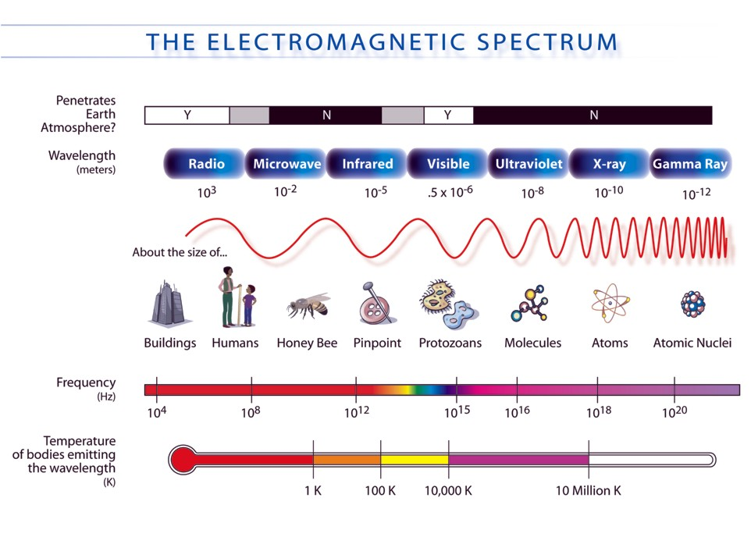
http://mynasadata.larc.nasa.gov/science-processes/electromagnetic-diagram /
Notes:
was the first artificial Earth satellite. It was a 58 cm (23 in) diameter polished metal sphere, with four external radio antennas to broadcast radio pulses.
Sputnik itself provided scientists with valuable information. The density of the upper atmosphere could be deduced from its drag on the orbit, and the propagation of its radio signals gave information about the ionosphere.

Slide 6
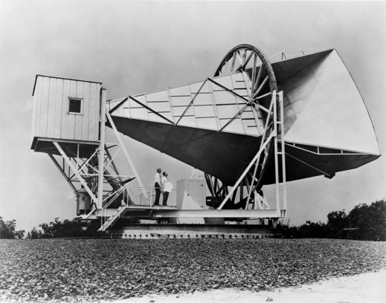
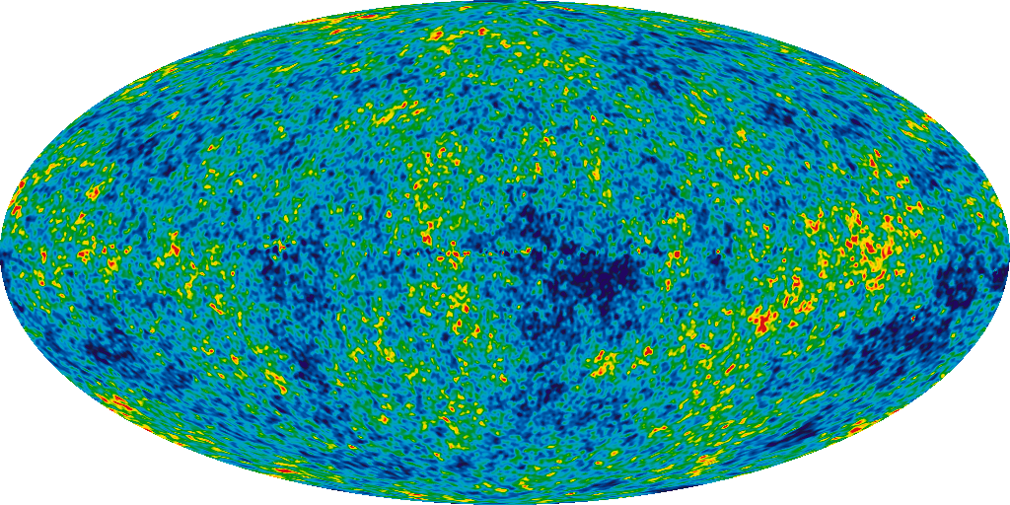
The Cosmic Microwave Background
Temperature anomalies around a very constant 2.725±0.002ºK temperature background
CMB provides a picture of the Universe when it was 380 000 years old!
Penzias and Wilson
(Nobel Prize 1978)
https://map.gsfc.nasa.gov/media/121238/index.html
Notes:
This light was emitted by hydrogen gas 375,000 years after the Big Bang, before stars and galaxies formed.
The CMB light shows tiny variations in the early gas density (1 in 100,000). This pattern is like a fingerprint. It is unique to the amount of the ingredients making up our universe. The "ripples" of microwave light are shaped by sound waves in the hydrogen gas. The sound waves are shaped by the Matter and Density of the universe. From the size of the temperature "ripples" that create the sky pattern, scientists can compute a unique signature called the "Power Spectrum". This provides the information needed to calculate the age, shape, and composition of our universe.

Slide 7
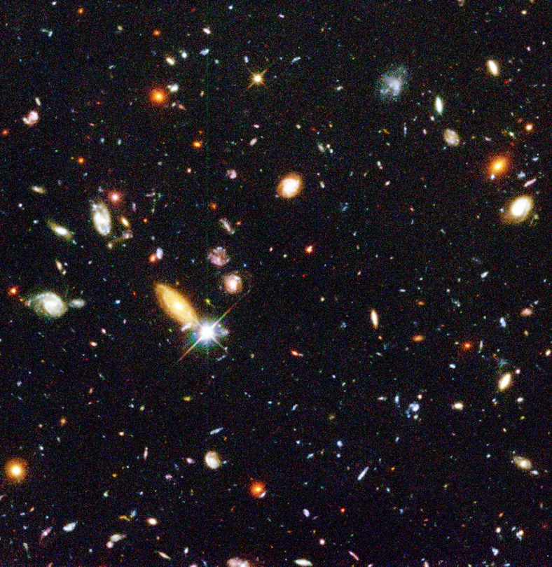
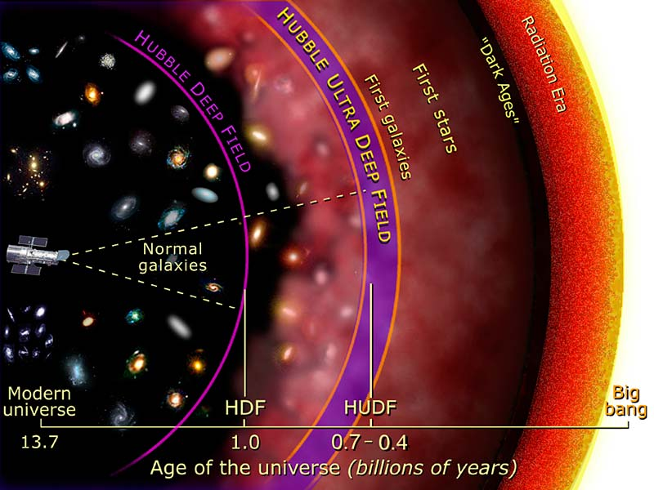
Accretion of galaxies (>13.2Ga)
Example: Hubble extreme deep field
http://hubblesite.org/image/385/news_release/1996-01
Notes:
Several hundred never before seen galaxies are visible in this "deepest-ever" view of the universe, called the Hubble Deep Field (HDF), made with NASA's Hubble Space Telescope. Besides the classical spiral and elliptical shaped galaxies, there is a bewildering variety of other galaxy shapes and colors that are important clues to understanding the evolution of the universe. Some of the galaxies may have formed less that one billion years after the Big Bang.
Representing a narrow "keyhole" view all the way to the visible horizon of the universe, the HDF image covers a speck of sky 1/30th the diameter of the full Moon (about 25% of the entire HDF is shown here). This is so narrow, just a few foreground stars in our Milky Way galaxy are visible and are vastly outnumbered by the menagerie of far more distant galaxies, some nearly as faint as 30th magnitude, or nearly four billion times fainter than the limits of human vision. (The relatively bright object with diffraction spikes just left of center may be a 20th magnitude star.) Though the field is a very small sample of sky area it is considered representative of the typical distribution of galaxies in space because the universe, statistically, looks the same in all directions.
The image was assembled from many separate exposures (342 frames total were taken, 276 have been fully processed to date and used for this picture) with the Wide Field and Planetary Camera 2 (WFPC2), for ten consecutive days between December 18 to 28, 1995. This picture is from one of three wide-field CCD (Charged Coupled Device) detectors on the WFPC2.
This "true-color" view was assembled from separate images were taken in blue, red, and infrared light. By combining these separate images into a single color picture, astronomers will be able to infer – at least statistically – the distance, age, and composition of galaxies in the field. Bluer objects contain young stars and/or are relatively close, while redder objects contain older stellar populations and/or farther away.
This material was presented to the 187th meeting of the American Astronomical Society in San Antonio, Texas on January 15, 1996.

Slide 8
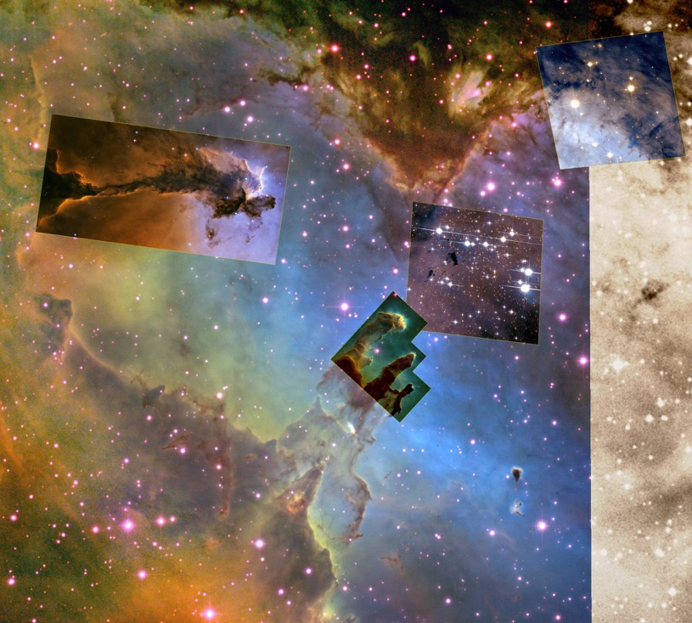
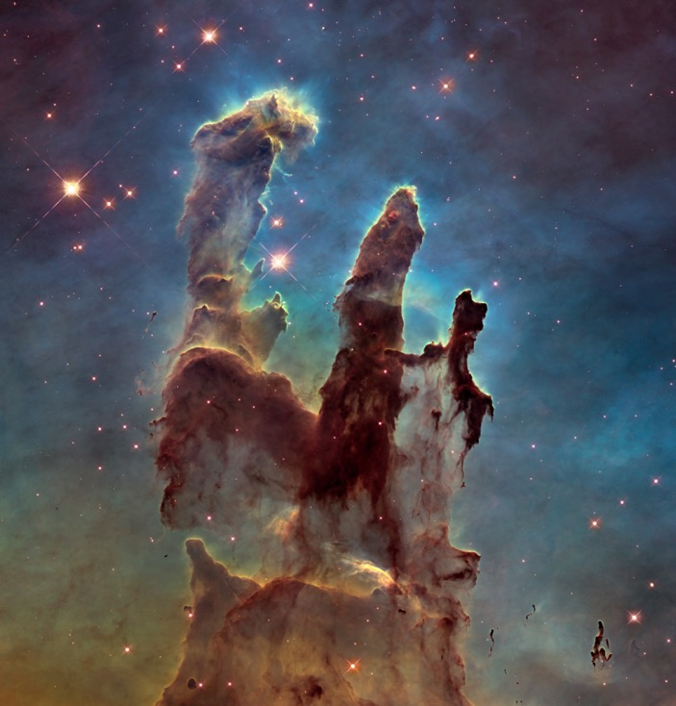
Accretion of stars from gas and dust in galaxies
Example: Eagle Nebula, Pillars or creation.
http://hubblesite.org/image/353/news_release/1995-44
https://map.gsfc.nasa.gov/universe/rel_stars.html
https://en.wikipedia.org/wiki/Eagle_Nebula
Notes:
This eerie, dark structure, resembling an imaginary sea serpent's head, is a column of cool molecular hydrogen gas (two atoms of hydrogen in each molecule) and dust that is an incubator for new stars. The stars are embedded inside finger-like protrusions extending from the top of the nebula. Each "fingertip" is somewhat larger than our own solar system.
The pillar is slowly eroding away by the ultraviolet light from nearby hot stars, a process called "photoevaporation". As it does, small globules of especially dense gas buried within the cloud is uncovered. These globules have been dubbed "EGGs" - an acronym for "Evaporating Gaseous Globules". The shadows of the EGGs protect gas behind them, resulting in the finger-like structures at the top of the cloud.
Forming inside at least some of the EGGs are embryonic stars - stars that abruptly stop growing when the EGGs are uncovered and they are separated from the larger reservoir of gas from which they were drawing mass. Eventually the stars emerge, as the EGGs themselves succumb to photoevaporation.
The stellar EGGS are found, appropriately enough, in the "Eagle Nebula" (also called M16 - the 16th object in Charles Messier's 18th century catalog of "fuzzy" permanent objects in the sky), a nearby star-forming region 6,500 light-years away in the constellation Serpens.
The picture was taken on April 1, 1995 with the Hubble Space Telescope Wide Field and Planetary Camera 2. The color image is constructed from three separate images taken in the light of emission from different types of atoms. Red shows emission from singly-ionized sulfur atoms. Green shows emission from hydrogen. Blue shows light emitted by doubly- ionized oxygen atoms.

Slide 9
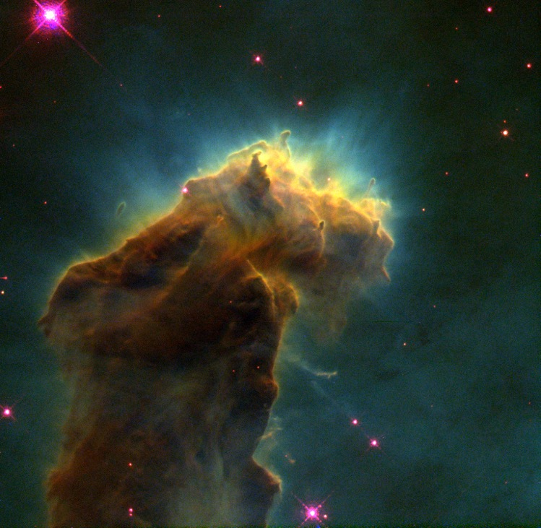
Accretion of stars from gas and dust in galaxies
Example: Eagle Nebula, Pillars or creation.
EGGs
Evaporating Gaseous Globules (EGGs)
http://hubblesite.org/image/353/news_release/1995-44
https://map.gsfc.nasa.gov/universe/rel_stars.html
https://en.wikipedia.org/wiki/Eagle_Nebula
Notes:
This eerie, dark structure, resembling an imaginary sea serpent's head, is a column of cool molecular hydrogen gas (two atoms of hydrogen in each molecule) and dust that is an incubator for new stars. The stars are embedded inside finger-like protrusions extending from the top of the nebula. Each "fingertip" is somewhat larger than our own solar system.
The pillar is slowly eroding away by the ultraviolet light from nearby hot stars, a process called "photoevaporation". As it does, small globules of especially dense gas buried within the cloud is uncovered. These globules have been dubbed "EGGs" - an acronym for "Evaporating Gaseous Globules". The shadows of the EGGs protect gas behind them, resulting in the finger-like structures at the top of the cloud.
Forming inside at least some of the EGGs are embryonic stars - stars that abruptly stop growing when the EGGs are uncovered and they are separated from the larger reservoir of gas from which they were drawing mass. Eventually the stars emerge, as the EGGs themselves succumb to photoevaporation.
The stellar EGGS are found, appropriately enough, in the "Eagle Nebula" (also called M16 - the 16th object in Charles Messier's 18th century catalog of "fuzzy" permanent objects in the sky), a nearby star-forming region 6,500 light-years away in the constellation Serpens.
The picture was taken on April 1, 1995 with the Hubble Space Telescope Wide Field and Planetary Camera 2. The color image is constructed from three separate images taken in the light of emission from different types of atoms. Red shows emission from singly-ionized sulfur atoms. Green shows emission from hydrogen. Blue shows light emitted by doubly- ionized oxygen atoms.

Slide 10
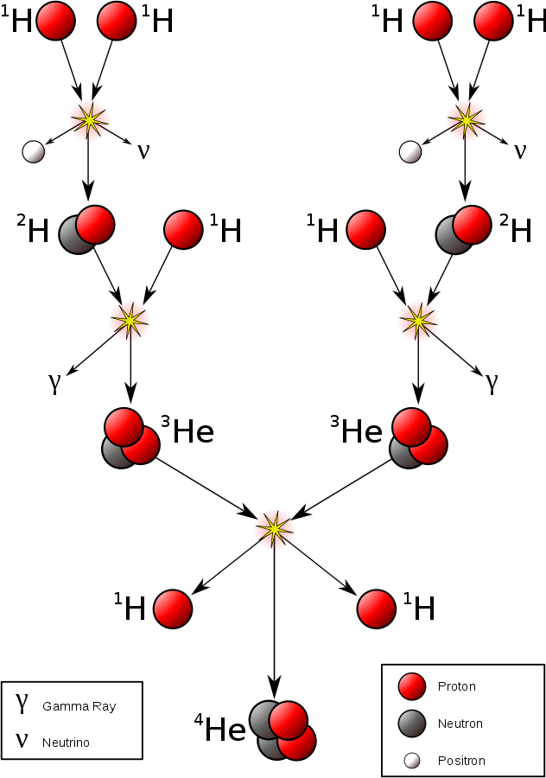
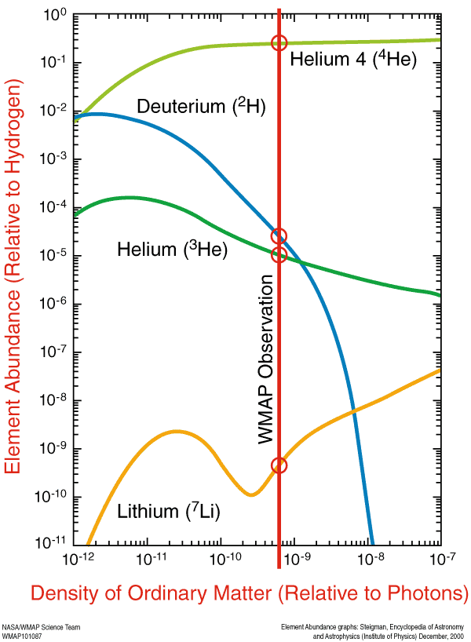
Hydrogen burning by nuclear fusion
74% H
25% He
<1% other
https://en.wikipedia.org/wiki/Stellar_nucleosynthesis
https://map.gsfc.nasa.gov/media/080998/index.html
Notes:
The predicted abundance of deuterium, helium and lithium depends on the density of ordinary matter in the early universe, as shown in the figure at left. These results indicate that the yield of helium is relatively insensitive to the abundance of ordinary matter, above a certain threshold. We generically expect about 24% of the ordinary matter in the universe to be helium produced in the Big Bang. This is in very good agreement with observations and is another major triumph for the Big Bang theory.

Slide 11
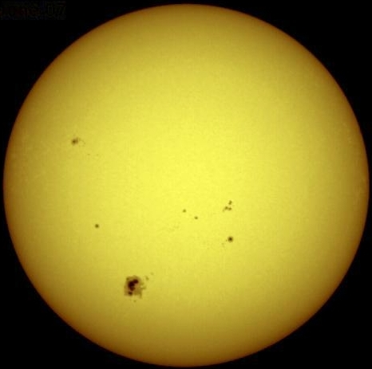
Hydrogen burning by nuclear fusion
The Sun
Formation of neutron + bigger building blocks
https://en.wikipedia.org/wiki/Stellar_nucleosynthesis
https://map.gsfc.nasa.gov/media/080998/index.html

Slide 12
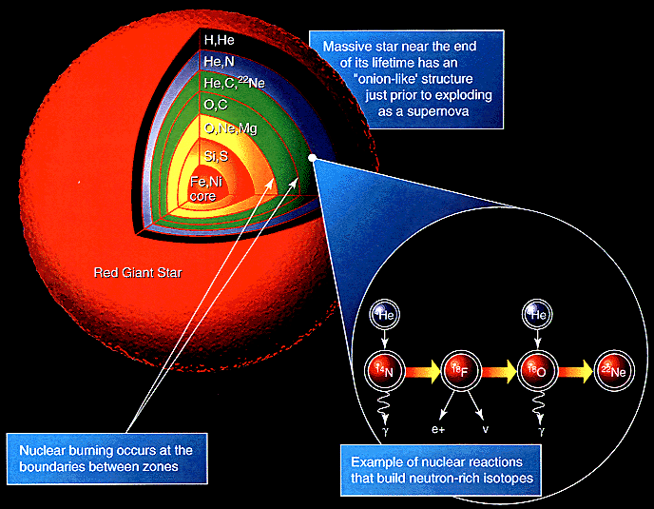
1 billion K needed
Sequence only proceeds if start is large enough
Gravity (IN)
Radiation (OUT)
Electron (OUT)
https://en.wikipedia.org/wiki/Stellar_nucleosynthesis

Slide 13
Death of main sequence stars like our sun
(NGC 6543: The cat’s eye nebula)
White Dwarf at the center, surrounded by Nebula
No fusion, residual heat, mostly C, O
Supported by electron degeneracy pressure
http://hubblesite.org/news_release/news/1995-01
Notes:
Meanwhile, the core of the star collapses under gravity's pull until it reaches a high enough density to start burning helium to carbon. The helium burning phase will last about 100 million years, until the helium is exhausted in the core and the star becomes a red supergiant. At this stage, the Sun will have an outer envelope extending out towards Jupiter. During this brief phase of its existence, which lasts only a few tens of thousands of years, the Sun will lose mass in a powerful wind. Eventually, the Sun will lose all of the mass in its envelope and leave behind a hot core of carbon embedded in a nebula of expelled gas. Radiation from this hot core will ionize the nebula, producing a striking "planetary nebula", much like the nebulae seen around the remnants of other stars. The carbon core will eventually cool and become a white dwarf, the dense dim remnant of a once bright star.
This Hubble telescope image shows one of the most complex planetary nebulae ever seen, NGC 6543, nicknamed the "Cat's Eye Nebula." Hubble reveals surprisingly intricate structures including concentric gas shells, jets of high-speed gas, and unusual shock-induced knots of gas. Estimated to be 1,000 years old, the nebula is a visual "fossil record" of the dynamics and late evolution of a dying star.
A preliminary interpretation suggests that the object might be a double-star system. The dynamical effects of two stars orbiting one another most easily explains the intricate structures, which are much more complicated than features seen in most planetary nebulae. The two stars are too close together to be individually resolved by Hubble and instead appear as a single point of light at the center of the nebula.

Slide 14
Sequence proceeds if start is large enough
Gravity (IN)
Radiation (OUT)
Electron (OUT)
https://en.wikipedia.org/wiki/Stellar_nucleosynthesis

Slide 15
http://oxford-labs.com/wp-content/uploads/2009/04/periodic-table.jpg

Slide 16
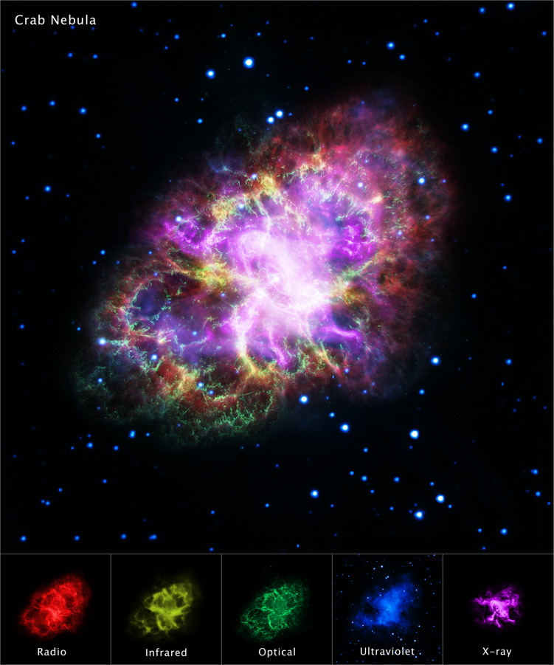
Stars 10-40X our sun produce supernovas
If star is large enough...
It can overcome electron degeneracy pressure
The Crab nebula
A supernova seen in year 1054!
6500 light years away (within our Milky Way)
Cloud is 10 light years across!
Results in a neutron star/pulsar at the center
Supported by neutron degeneracy pressure
(Very big stars can form black holes)
http://hubblesite.org/image/4028/news
Notes:
Composite image from the Crab Nebula This picture is a composite of multiple wavelenght, including optical, x-ray, infrared. http://chandra.harvard.edu/photo/2017/crab/

Slide 17
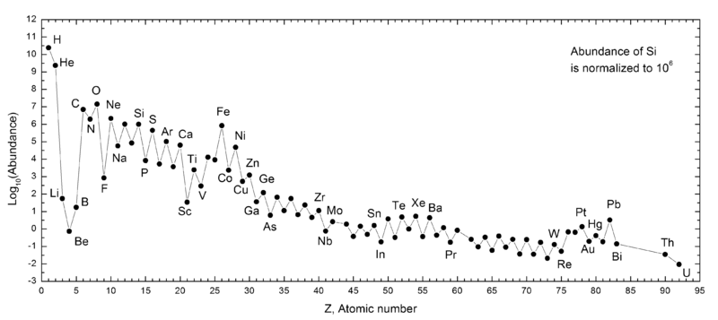
Summary: Abundance of the elements in the Solar system
Release energy
(nuclear fusion)
Need energy input to form
(supernova)
Big
Bang
Stars like
our sun
Stars bigger than our sun
(but not too big...otherwise they form black holes)
https://en.wikipedia.org/wiki/Nucleosynthesis
https://en.wikipedia.org/wiki/Chemical_element
Notes:
r-process and s-process produce elements heavier than iron
Ni-62 has actually great binding energy than Fe-58 and Fe-56

Slide 18
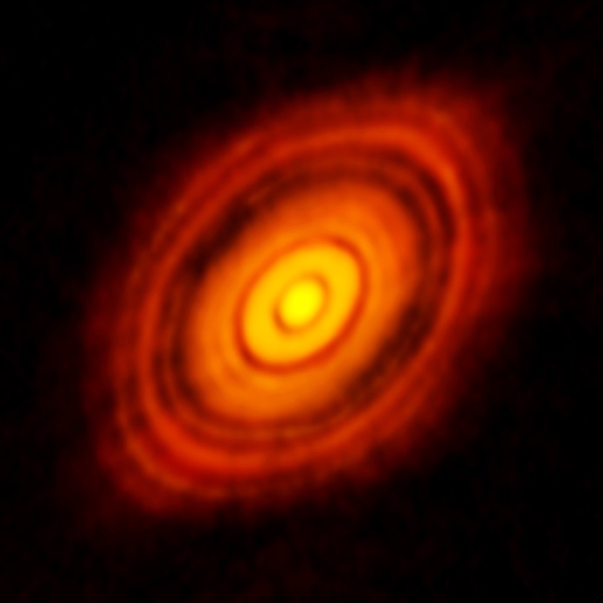
Accretion of planets from Planetary Nebula
HL Tauri
450 light years from Earth
T Tauri Star is a young Sun ~ 100Ka
Surrounded by protoplanetary disks
https://en.wikipedia.org/wiki/Accretion_%28astrophysics%29
https://en.wikipedia.org/wiki/HL_Tauri

Slide 19
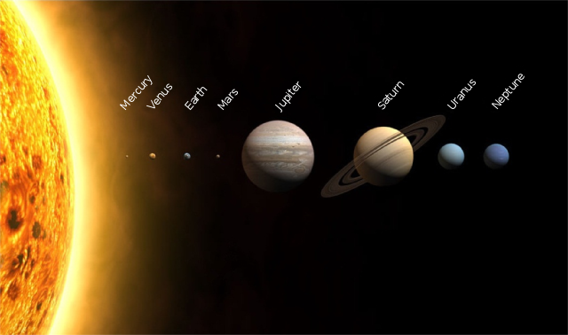
Formation of Earth and the solar system
https://en.wikipedia.org/wiki/Solar_System
Notes:
From condensates of solar nebular gases about 4.5 billion years ago
We can estimate the composition of the nebular gas by measuring the composition of meteorites (planets are too fractionated)
Radiogenic heat production + primordial heat = 47 TW (10¹²W = 10 billion 100W light bulbs)
Vs 173000 TW from solar radiation
Mass of the Earth is about 6x10^24 kg
Average density of Earth is 5515 kg/m3, average crust is 3000 kg/m3, so density of inner core must be somewhere around 13000 kg/m3

Slide 20
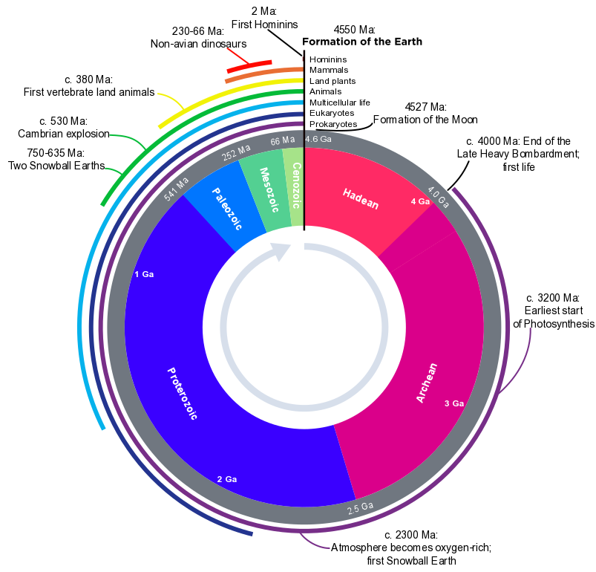
Earth evolution
(~4.5-4.6 Ga)
Early Earth was hot! Magma Ocean?
Heat from kinetic energy of collisions
Solar nebula was richer in radioactive elements than today (they have decayed away)
Faint Young Sun (~70% of today)

Slide 21
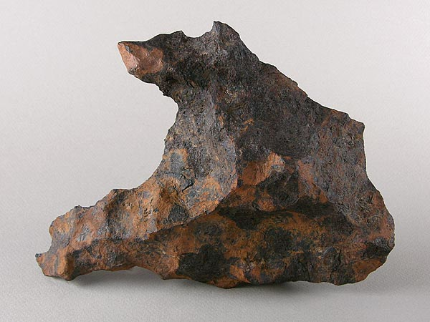
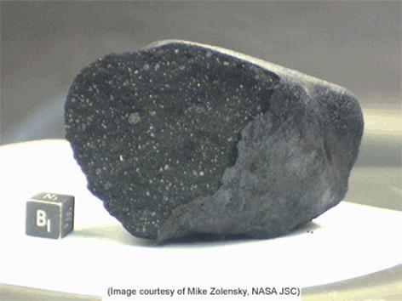
4.5Ga as the age of the Earth...some evidence
Lake Tagish Meteorite
One of the most primitive solar system material ever studied
(fell on iced lake in Canada in 2000)
Canyon Diablo Meteorite
Pb dated to 4.55 ± 0.07 Ga
(fell 50000 years ago)
http://www.lpi.usra.edu/lunar/samples/atlas/detail/?mission=Apollo%2016&sample=67215

Slide 22
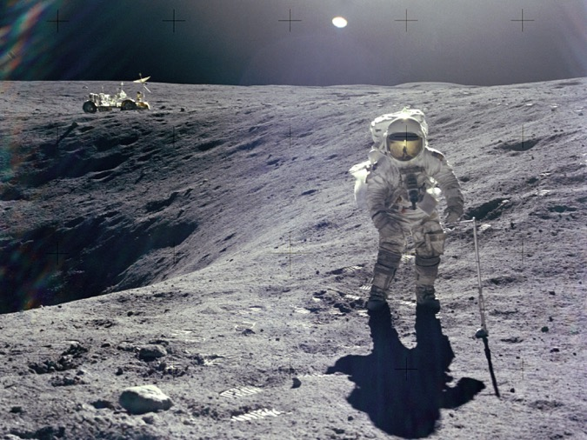
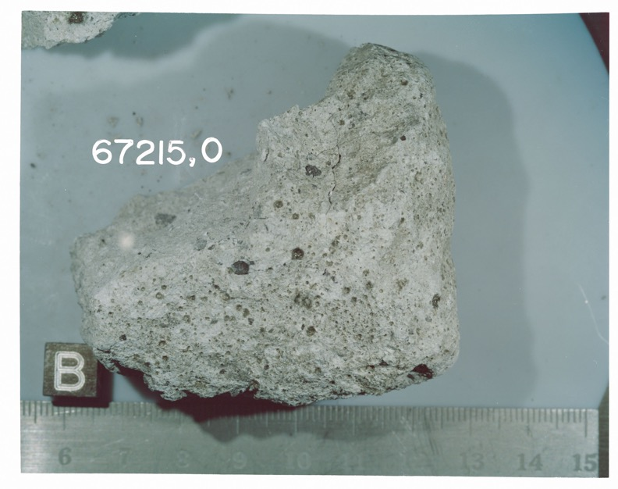
4.5Ga as the age of the Earth...some evidence
Sample 67215, Apollo 16
(4.44+/-0.11 Ga)
100 Ma younger than oldest meteorites
http://www.lpi.usra.edu/lunar/samples/atlas/detail/?mission=Apollo%2016&sample=67215

Slide 23
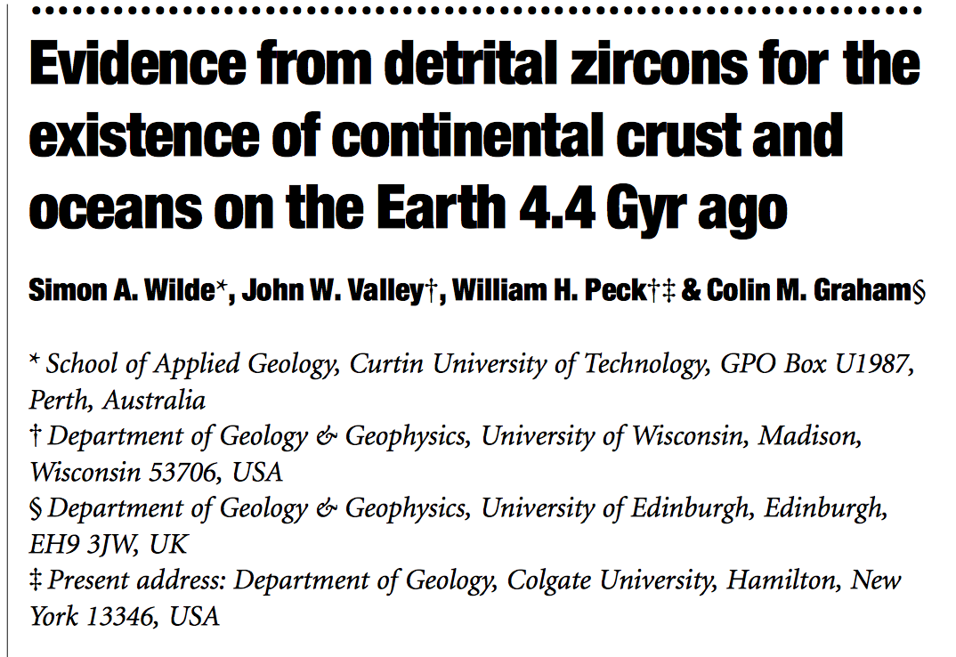
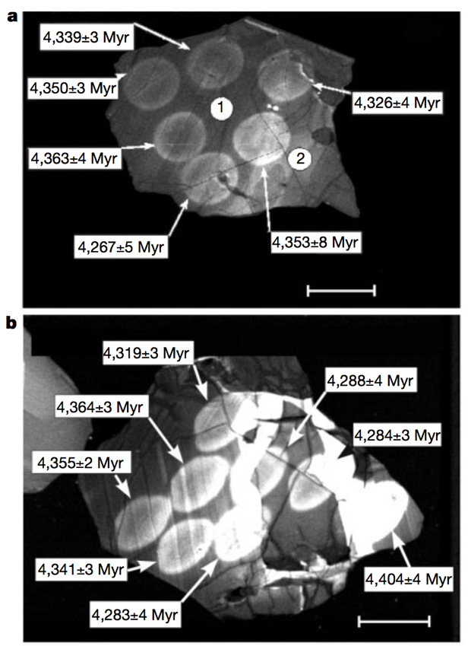
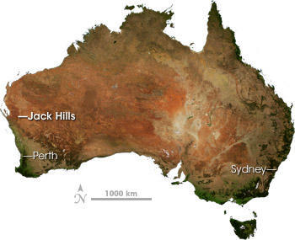
4.5Ga as the age of the Earth...some evidence
U/Pb dating
Jack Hills
Western Australia
Wilde et al. (2001). Nature, 409:175-178

Slide 24
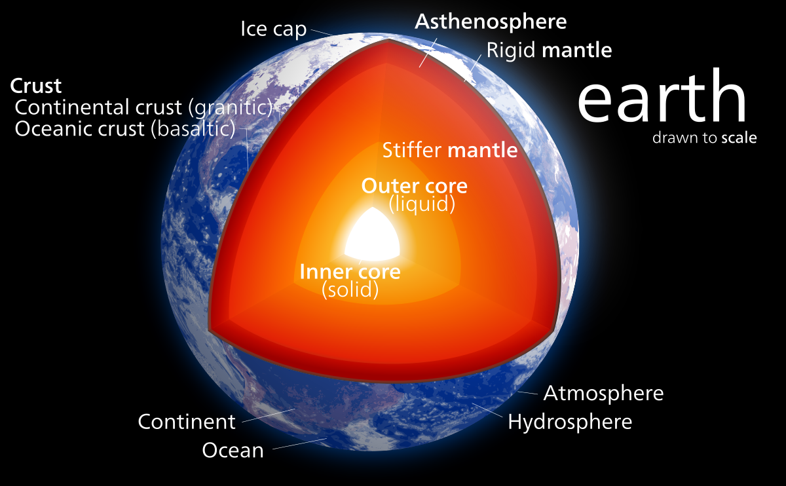

Slide 25
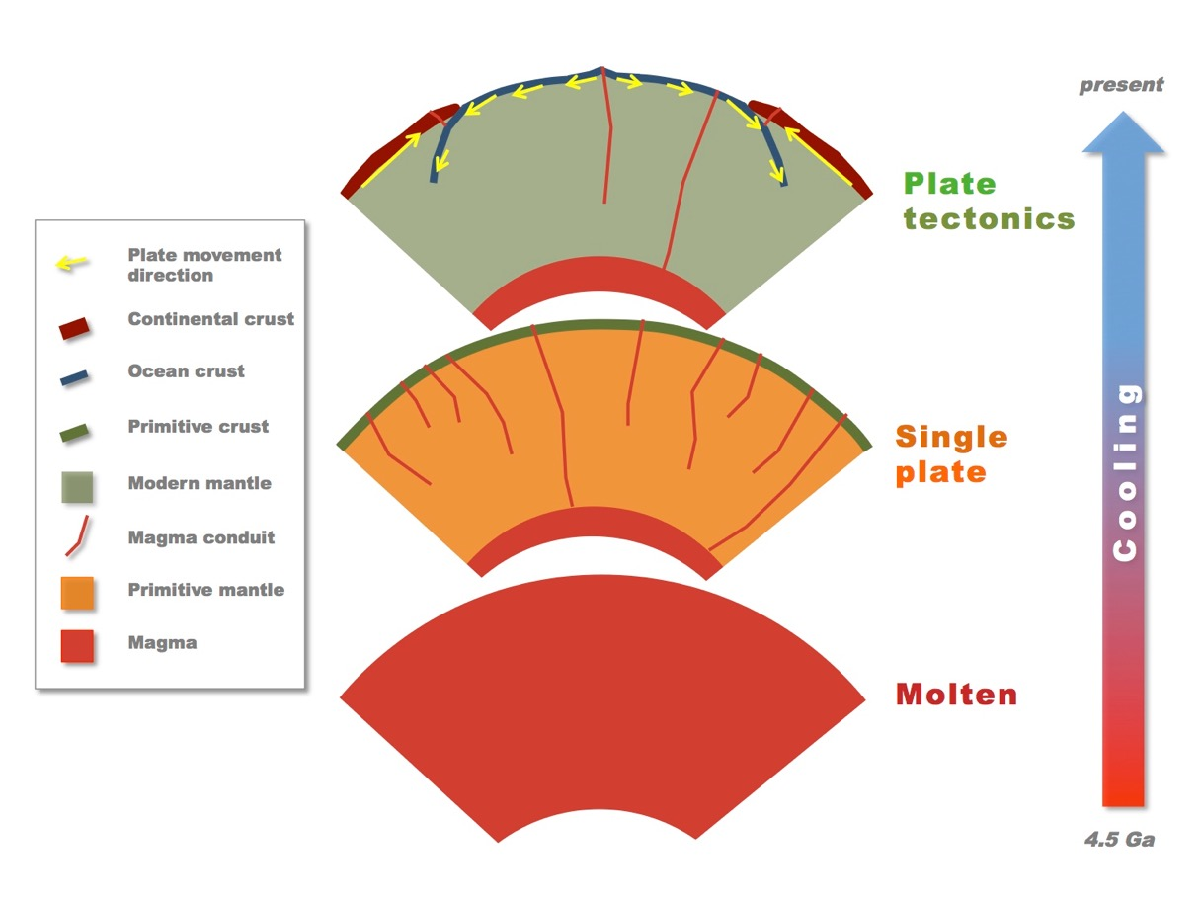
From Hadean Earth to Plate Tectonics
Differentiation of the crust into oceanic and continental crust
>3.5 Ga (?)
https://en.wikipedia.org/wiki/Earth%27s_internal_heat_budget

Slide 26
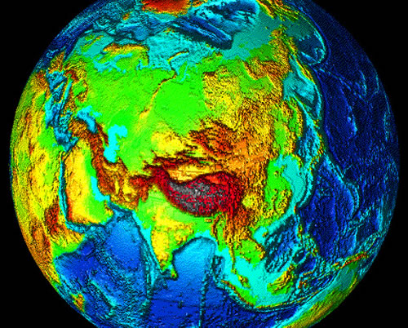
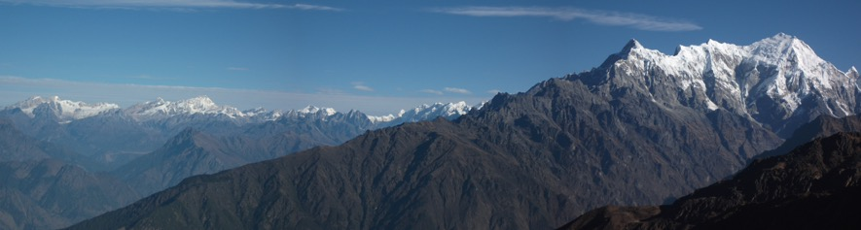
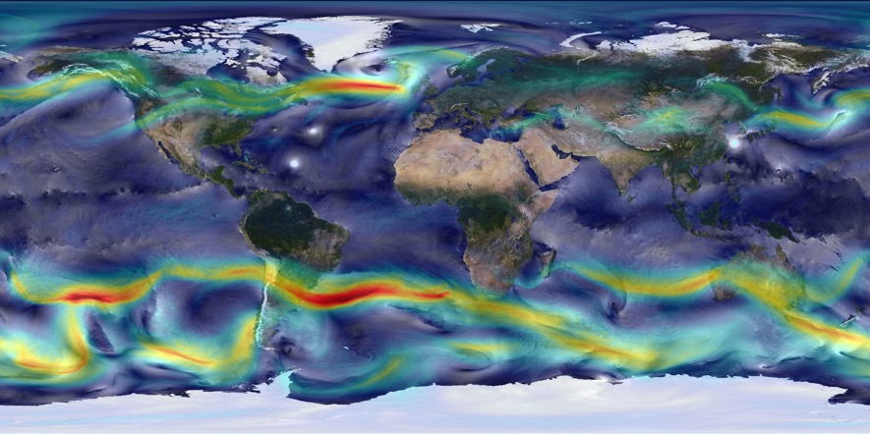
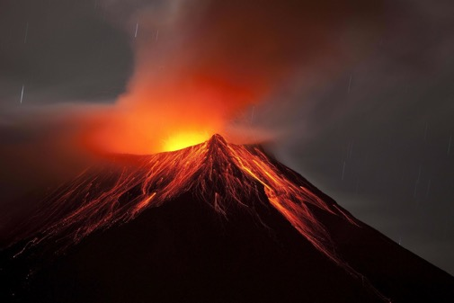
From tectonics to topography to climate
Topography
Mountains
Winds affected by mountains and land-sea contrast
Volcanoes + gases

Slide 27
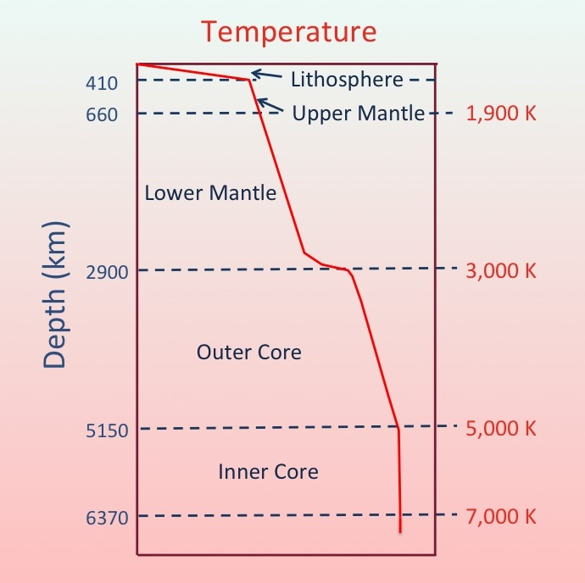
Structure of Earth: Planetary Differentiation
(gravitational, thermal, chemical)
H₂O, H₂S, CO₂, N₂
O, Si, Al, Na, Ca, K, Fe
+
radioactive
elements
U, Th, K
(hydrated rocks) H₂O
O, Mg, Si
84% of
Earth’s volume
Fe, Ni
Core:
Mostly primordial
heat.
5-15TW
T of sun ~ 5800K
https://en.wikipedia.org/wiki/Geothermal_gradient

Slide 28
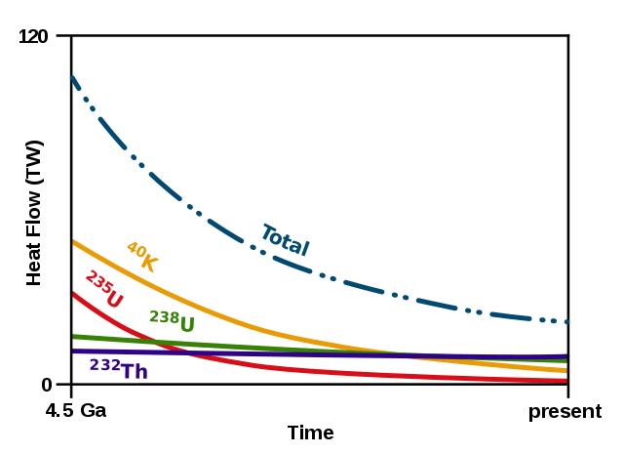
Radioactive heat production through time
Shoter lived isotopes also contributed very early on, but are since depleted, for example ²⁶Al
Nuclear fission of heavy elements
47TW
https://en.wikipedia.org/wiki/Earth%27s_internal_heat_budget

Slide 29
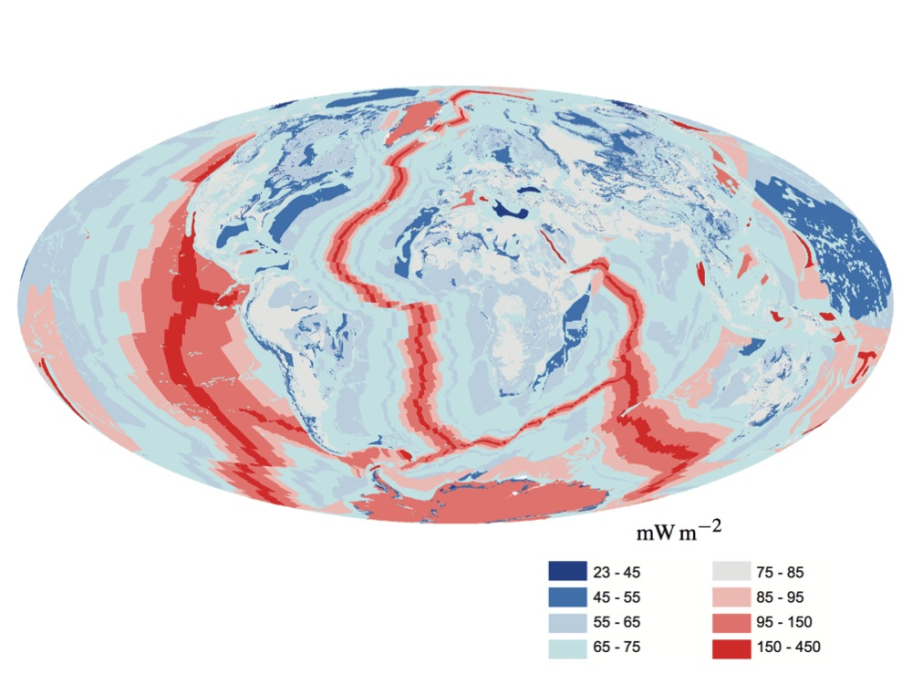
Geothermal heat flux
(45-90% from radioactivity of U, Th, K + primordial heat + other)
Flux was likely 2x higher 3Gy ago
Globally: 47 TW
(>2x total human consumption)
Only 0.03% of energy budget;
another 173000 TW from sun!
Notes:
Global geothermal heat flux is 44.2 TW. This is more than 2X global human energy consumption
About 65 mW/m2 over continents and 101 mW/m2 over ocean crust.
Only about 0.03% of incoming solar radiations!

Slide 30
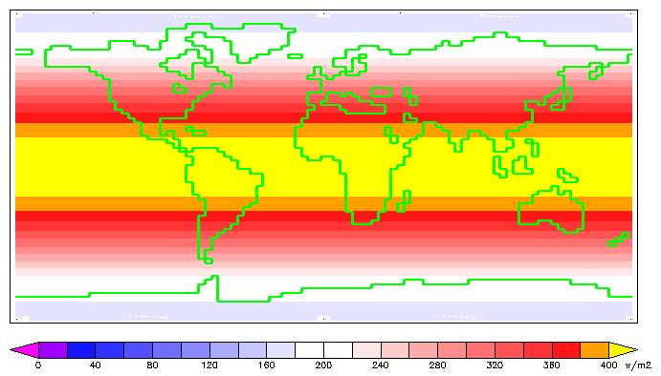
Incoming solar radiation
(top of the atmosphere)
https://en.wikipedia.org/wiki/Solar_irradiance

Slide 31
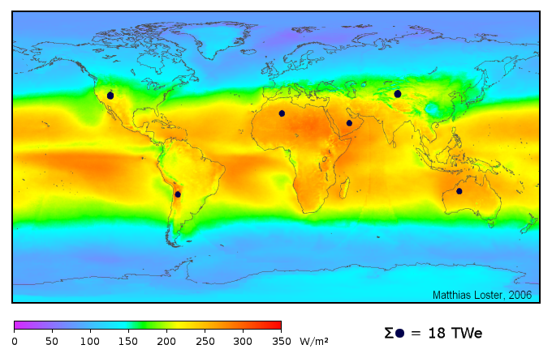
Solar energy flux at the surface
(average insolation) ... we have an atmosphere
Total area needed to match human consumption
https://en.wikipedia.org/wiki/Solar_energy

Slide 32
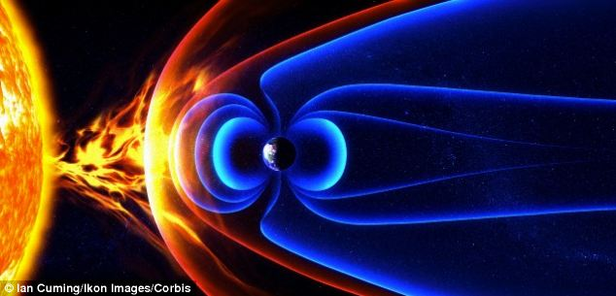
Why we can have an atmosphere?
Rotation of the liquid Earth’s iron core:
The geodynamo and the magnetosphere
The Iron core likely differentiated within 500Ma after accretion
Without an electromagnetic shield, we would loose our atmosphere faster
It protects us from solar wind and harmful radiations
Mars/Moon don’t currently have one – Did they have one in the past?
Notes:
The magnetosphere is part of why we can have and keep our atmosphere!

Slide 33
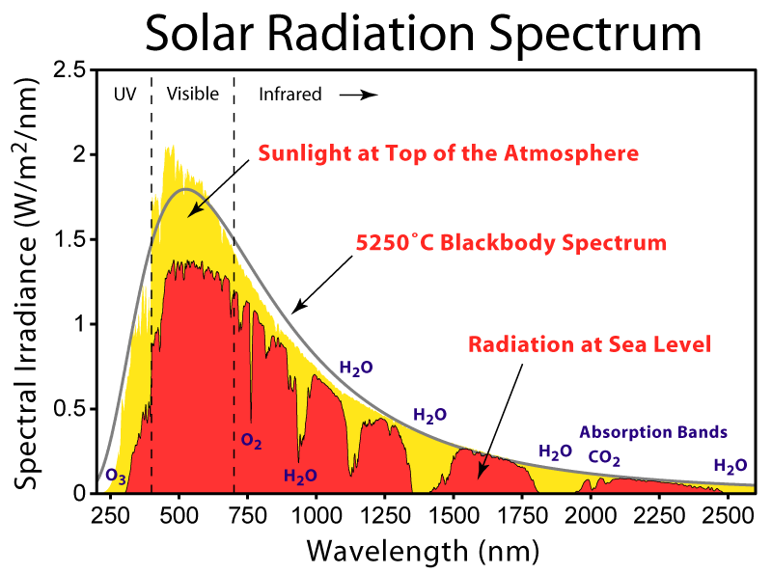
https://en.wikipedia.org/wiki/Solar_irradiance
Notes:
Arrows point to an optically continuous K-feldspar grain separated by quartz-filled fractures in orthogneiss (82MW0017). K-feldspar is stained green in this image, and sodic perthite appears orange. Click here for a zip file with full resolution image.kfs: K-feldspar qtz: quartz
Feldspars (KAlSi₃O₈ – NaAlSi₃O₈ – CaAl₂Si₂O₈) are a group of rock-forming tectosilicate minerals that make up as much as 60% of the Earth's crust.
Quartz is the second most abundant mineral in the Earth's continental crust, after feldspar. It is made up of a continuous framework of SiO₄ silicon–oxygen tetrahedra, with each oxygen being shared between two tetrahedra, giving an overall formula SiO₂.
When placed between two polarizing filters set at right angles to each other, the optical properties of the minerals in the thin section alter the colour and intensity of the light as seen by the viewer. As different minerals have different optical properties, most rock forming minerals can be easily identified. Plagioclase for example can be seen in the photo on the right as a clear mineral with multiple parallel twinning planes. The large blue-green minerals are clinopyroxene with some exsolution of orthopyroxene.Thin sections are prepared in order to investigate the optical properties of the minerals in the rock. This work is a part of petrology and helps to reveal the origin and evolution of the parent rock.

Slide 34
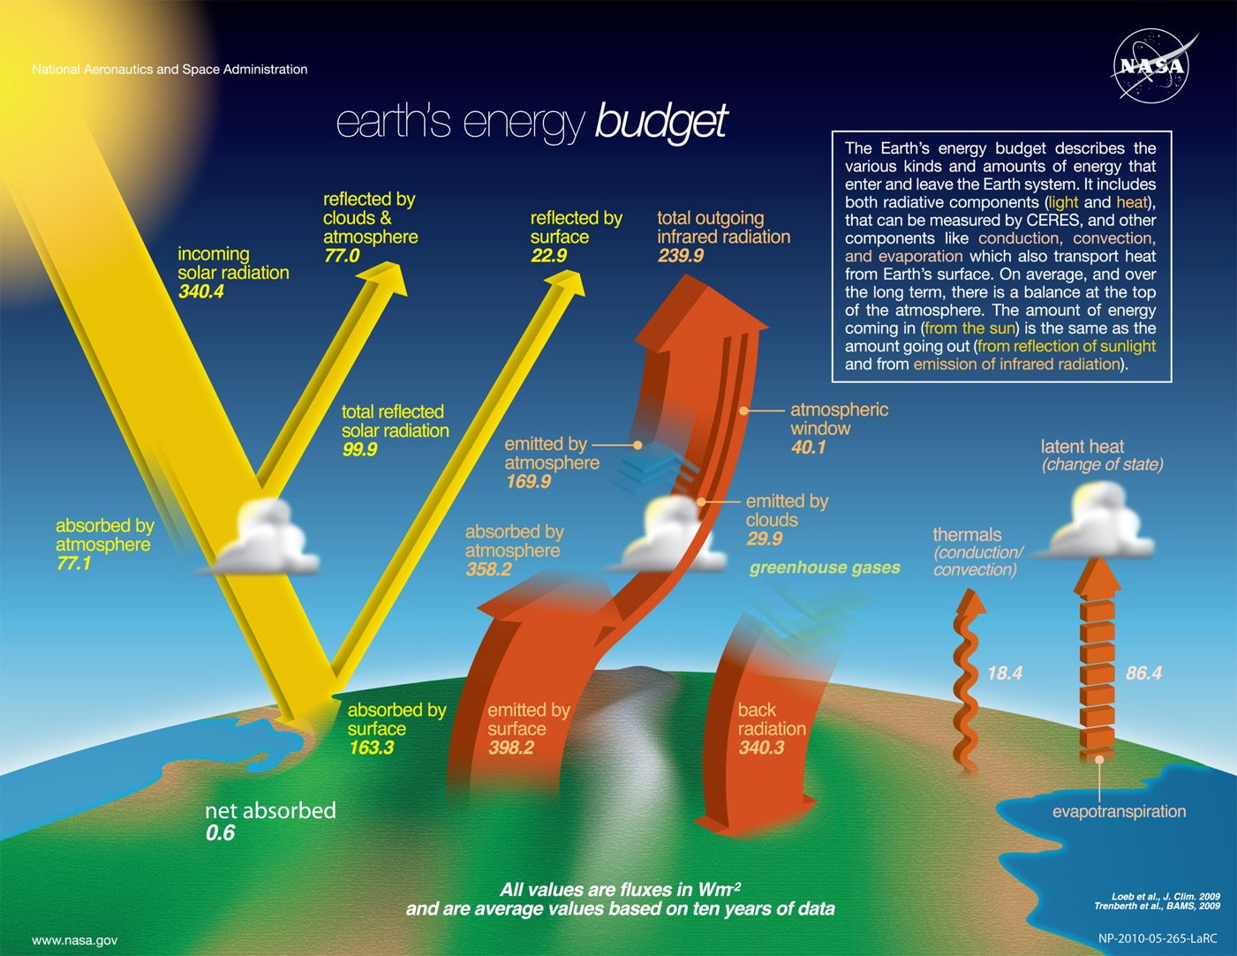
Notes:
Arrows point to an optically continuous K-feldspar grain separated by quartz-filled fractures in orthogneiss (82MW0017). K-feldspar is stained green in this image, and sodic perthite appears orange. Click here for a zip file with full resolution image.kfs: K-feldspar qtz: quartz
Feldspars (KAlSi₃O₈ – NaAlSi₃O₈ – CaAl₂Si₂O₈) are a group of rock-forming tectosilicate minerals that make up as much as 60% of the Earth's crust.
Quartz is the second most abundant mineral in the Earth's continental crust, after feldspar. It is made up of a continuous framework of SiO₄ silicon–oxygen tetrahedra, with each oxygen being shared between two tetrahedra, giving an overall formula SiO₂.
When placed between two polarizing filters set at right angles to each other, the optical properties of the minerals in the thin section alter the colour and intensity of the light as seen by the viewer. As different minerals have different optical properties, most rock forming minerals can be easily identified. Plagioclase for example can be seen in the photo on the right as a clear mineral with multiple parallel twinning planes. The large blue-green minerals are clinopyroxene with some exsolution of orthopyroxene.Thin sections are prepared in order to investigate the optical properties of the minerals in the rock. This work is a part of petrology and helps to reveal the origin and evolution of the parent rock.

Slide 35
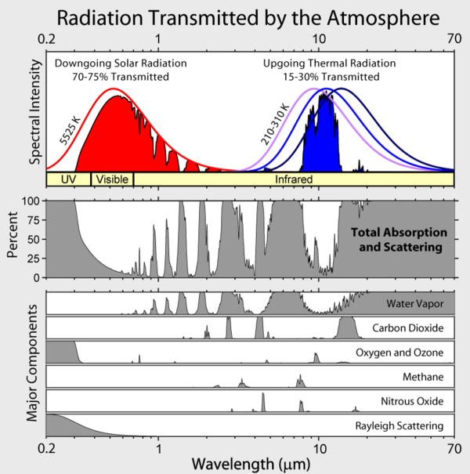

Slide 36
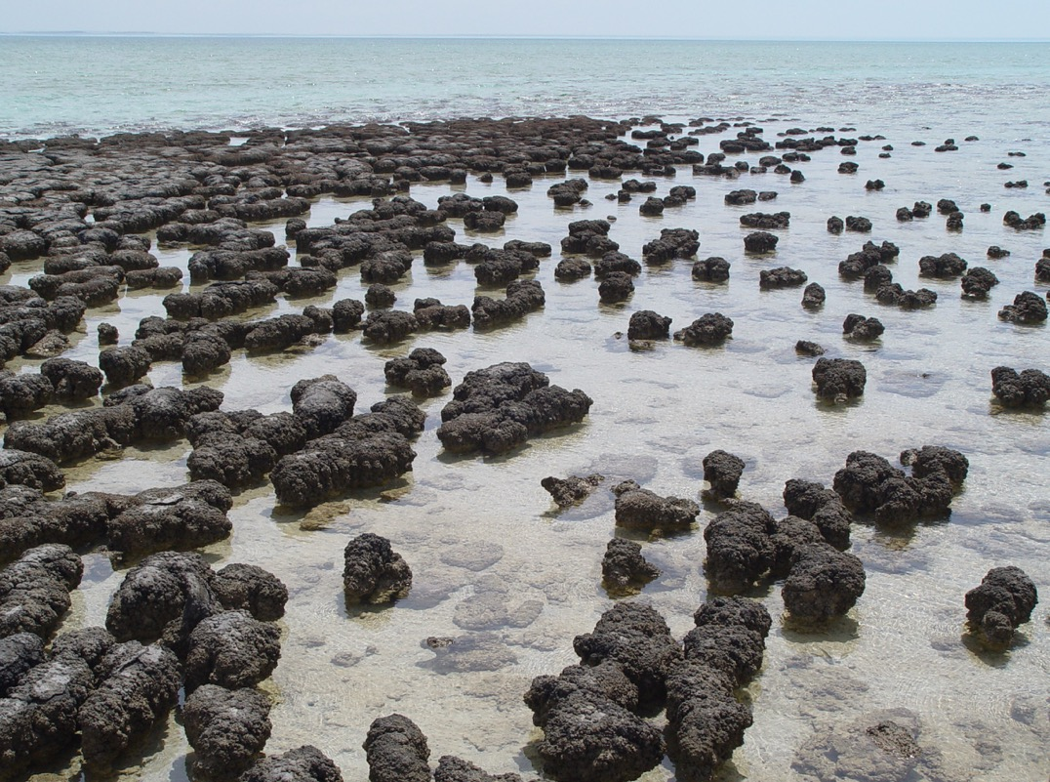
Photosynthesis and the rise of oxygen
(cyanobacteria, e.g. stromatolites)
...also means appearance of Ozone layer!
https://en.wikipedia.org/wiki/Stromatolite
Notes:
Stromatolites, Shark Bay, Australia

Slide 37

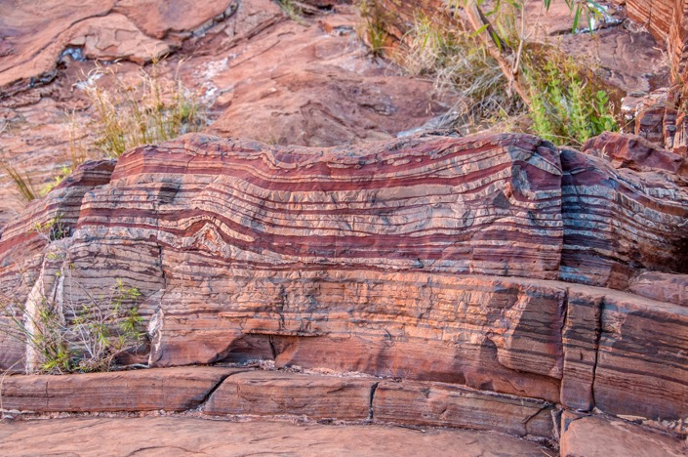
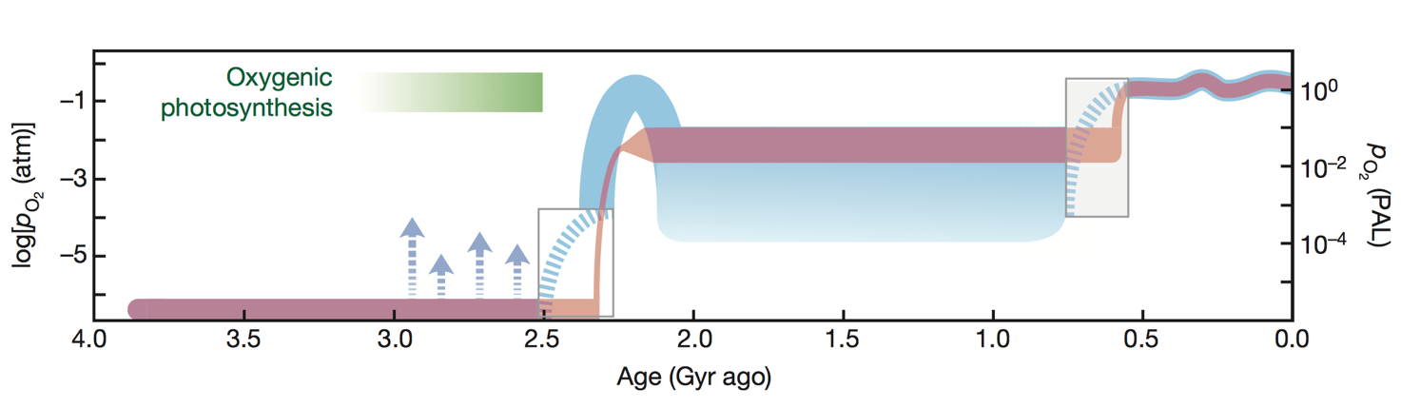
Photosynthesis and the rise of oxygen
https://en.wikipedia.org/wiki/Banded_iron_formation
Lyons et al. (2014). Nature, 506:307-315

Slide 38
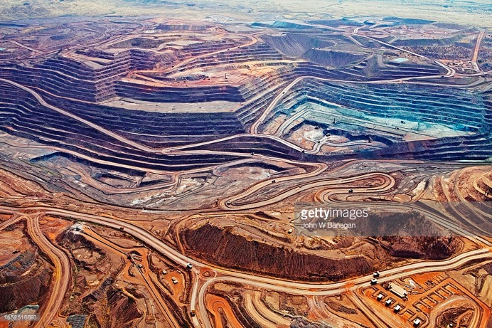

Photosynthesis and the rise of oxygen
Iron ores fuel our industry (even today)
Lyons et al. (2014). Nature, 506:307-315

Slide 39
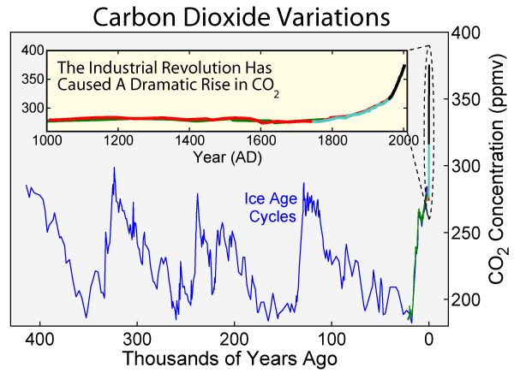
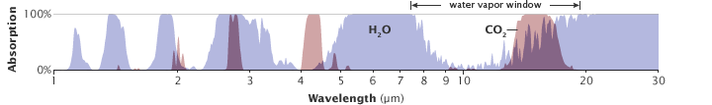
Photosynthesis and fossil fuels
Fossil fuels also drive our economy: we emit CO2 like never before
https://en.wikipedia.org/wiki/Radiative_forcing

Slide 40
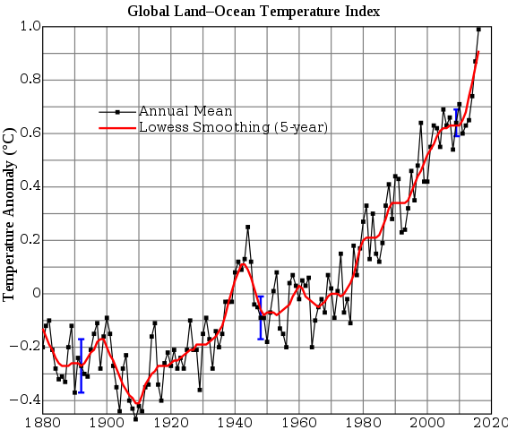
Photosynthesis and climate change
Anthropogenic CO2 emissions have a measureable impacts on Temperatures
https://en.wikipedia.org/wiki/Radiative_forcing

Slide 41
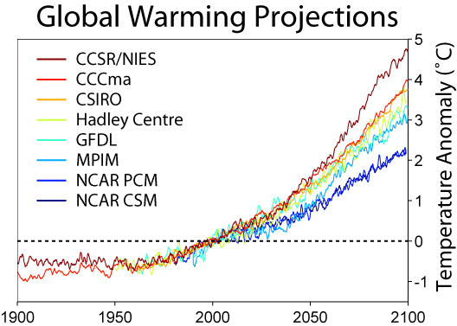

Photosynthesis and climate change
Why show houses and old cars?
https://cmi.princeton.edu/wedges/pdfs/teachers_guide.pdf
Anthropogenic CO2 emissions have a measureable impacts on Temperatures
https://en.wikipedia.org/wiki/Radiative_forcing
Notes:
Show houses because household energy expanses account for about 2/5 of emissions. Transport only 1/5
Electricity generation and residential, heating
Insulate houses, turn off lights and use energy efficient appliances do a lot!
Stabilization wedges (https://cmi.princeton.edu/wedges/pdfs/teachers_guide.pdf)

Slide 42
Take home message
All elements come from the Big Bang, supernova and through star recycling
Much can be learned by studying rocks and celestial bodies!
Physical and geological processes, which have acted over billions of year provide all our energy today
The sun is our most important energy source (good for another 5 billion years)
  Solar, wind, tidal are “free” to us
  Fossil and nuclear fuels are like battery that are depleting
    By using them, we are “undoing” geological processes
Notes:
From condensates of solar nebular gases about 4.5 billion years ago
We can estimate the composition of the nebular gas by measuring the composition of meteorites (planets are too fractionated)
Radiogenic heat production + primordial heat = 47 TW (10¹²W = 10 billion 100W light bulbs)
Vs 173000 TW from solar radiation

