Slide 1
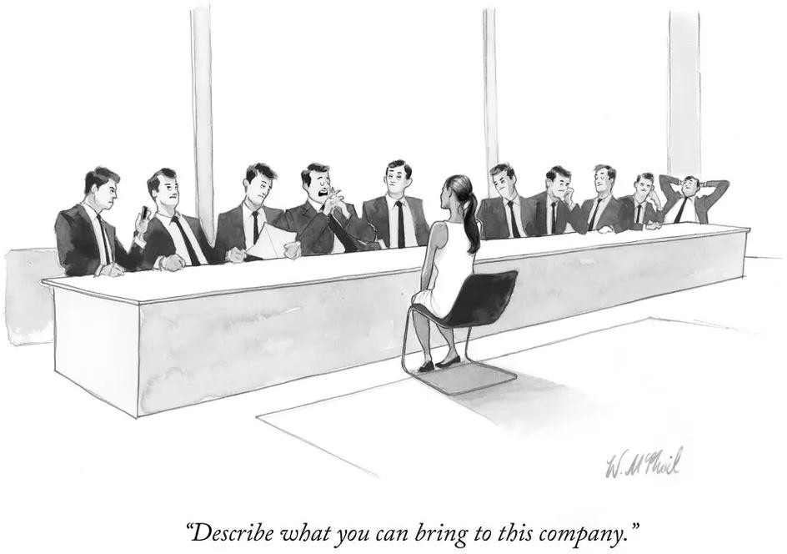
Recruitment workshop - positive action and Know Your Pool
© New Yorker
Prof. Stephen Curry
Assistant Provost (EDI), Imperial College London
08 November 2022

Slide 2
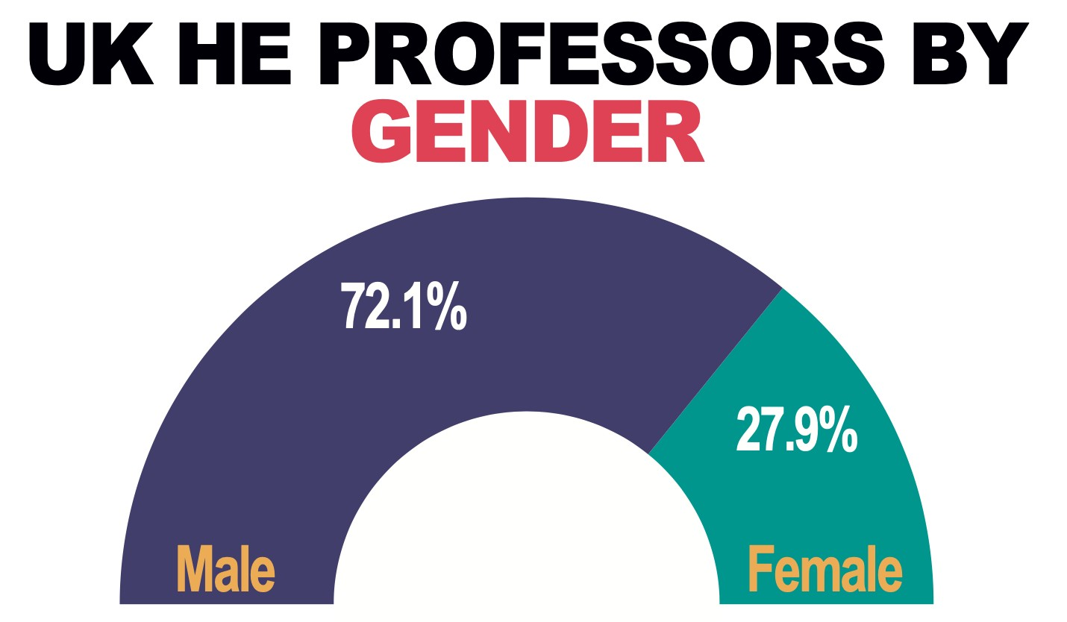
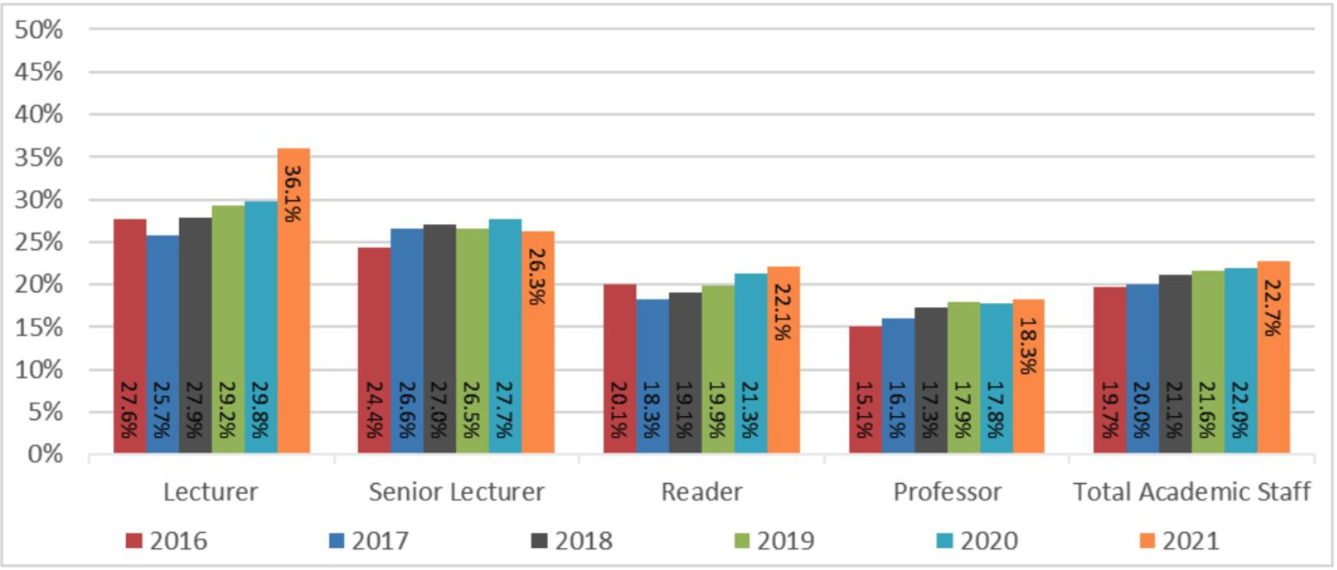
Academic staff - by grade (% women)
Overall, Imperial has been hiring women academics at a higher rate
Can we do better?
2

Slide 3
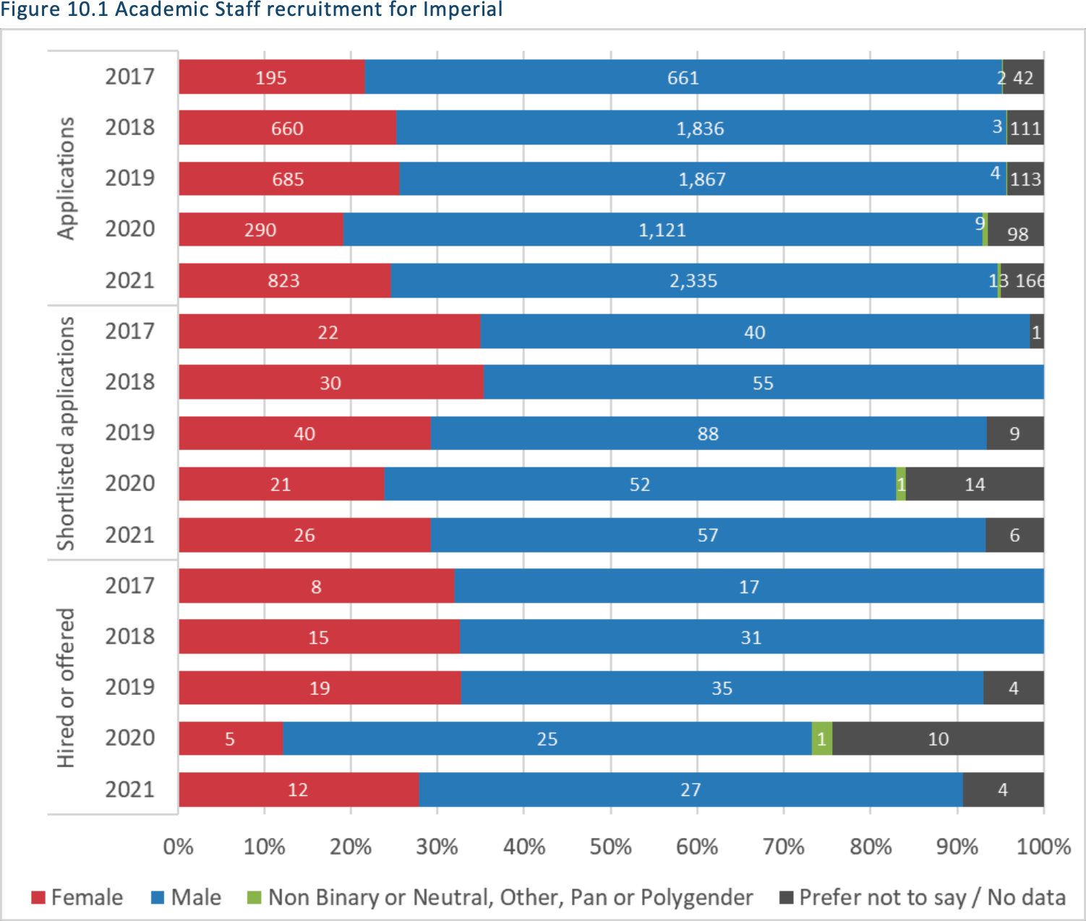
Academic Recruitment - by gender
A higher %F is shortlisted than applies – quality of applications?
A notable drop-off in
%F applicants in 2020 – Covid-19 effects?

Slide 4
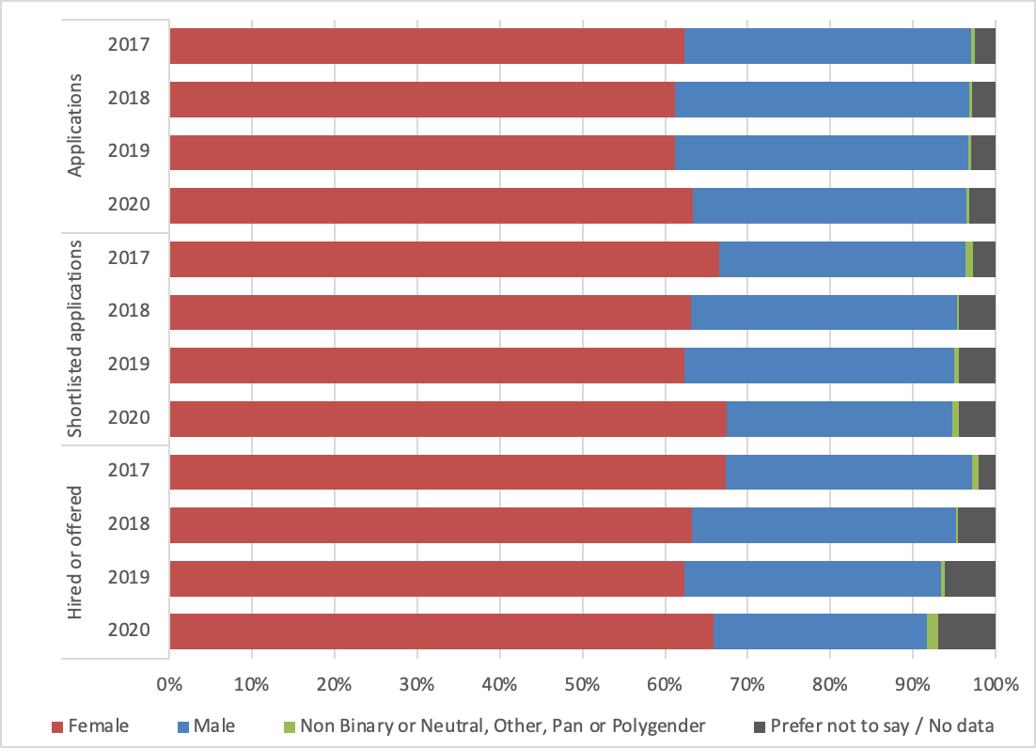
PTO Recruitment - by gender
No evidence of bias at shortlisting or interview stages?

Slide 5
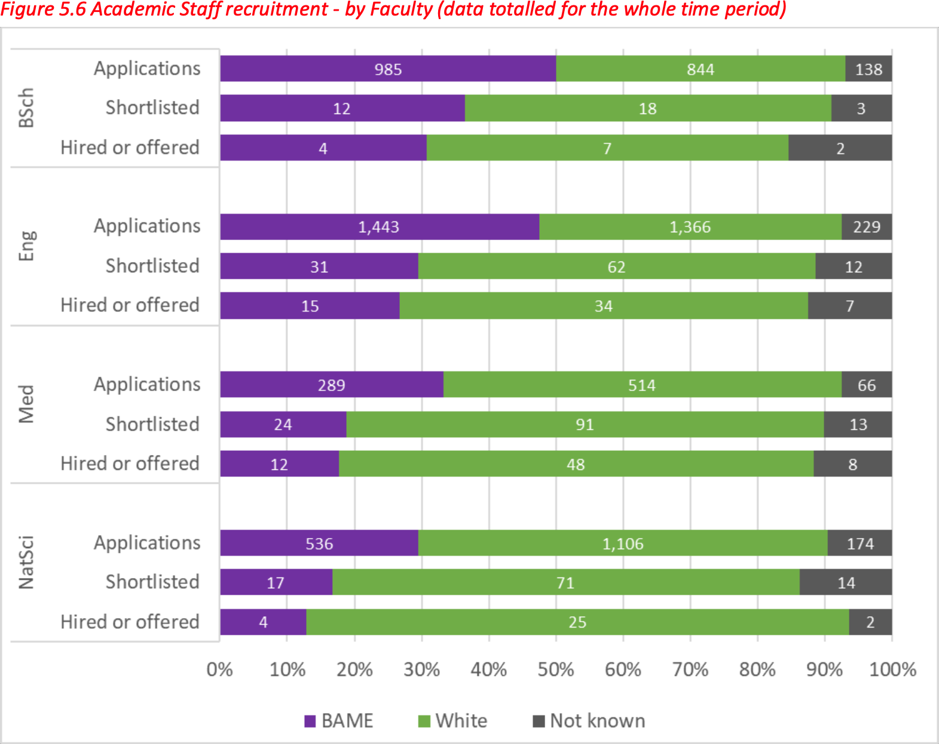
Academic Recruitment - by ethnicity
Evidence of bias at shortlisting?

