Slide 1
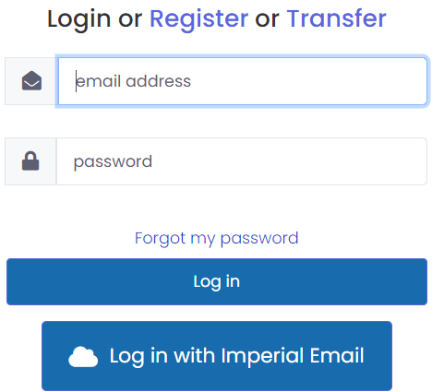
DC Reference Guide for Alumni Accessing your official documents
This document is aimed at students who have graduated after 2020.
It will guide you through the login process to access your official college documents, such as letters, transcripts, and certificates, or share a document with a third party.
Content links:
1. How to log in to the eDocuments website
2. How to register your account
3. How to transfer your account
4. How to view your documents
5. How to download or print your documents
6. How to report an issue with your document
7. How to share your documents
8. Troubleshooting and support
How to log in to the eDocuments website:
Click on ‘Access your eDocuments’ link.
1
Click ‘Register’ if you have never logged in to your ‘eDocuments’ using your Imperial account before.
2
Click ‘Transfer’ if you have recently graduated AND do not plan to continue your studies at Imperial.
Click ‘Log in’ if you have already registered or transferred your Imperial account to your personal email.
‘Log in with Imperial Email’ option is ONLY used by current students, NOT alumni.
Once you transfer your Imperial account, you will no longer be able to log in using your Imperial email. If you plan to continue your studies at Imperial after your graduation, you should keep using the ‘Log in with Imperial Email’ option.

Slide 2
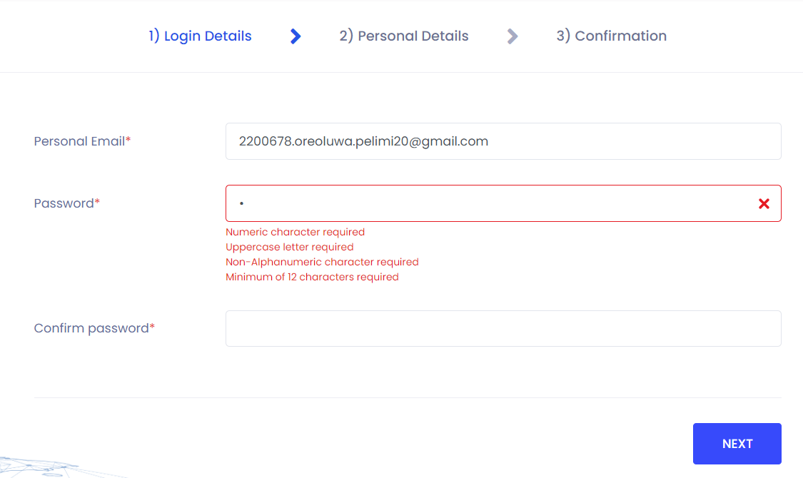
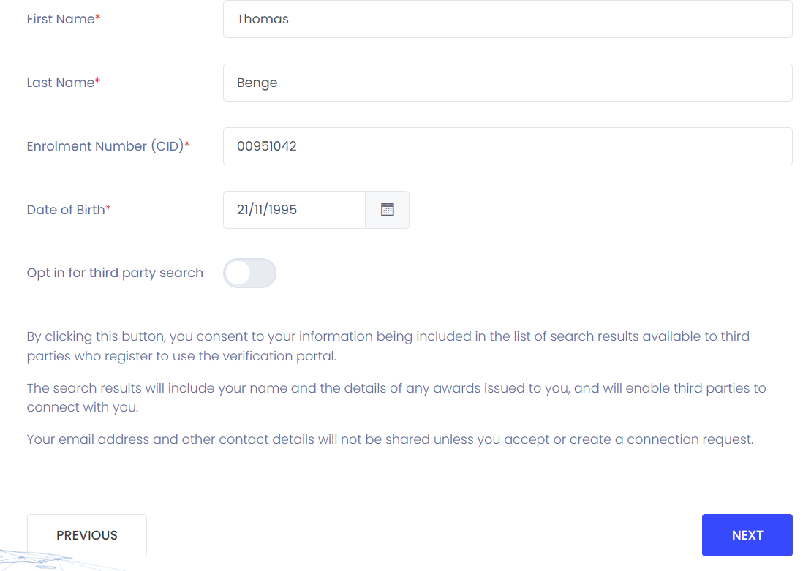
DC Reference Guide for Alumni Accessing your official documents
This document is aimed at students who have graduated after 2020.
It will guide you through the login process to access your official college documents, such as letters, transcripts, and certificates, or share a document with a third party.
How to register your account:
1
Enter your personal email, then create a secure password, following the criteria required, and click ‘Next’.
Security criteria will be displayed underneath the ‘Password’ box when setting your password.
2
Enter your ‘First Name’, ‘Last Name’, CID, ‘Date of Birth’ and click ‘Next’.
Use ‘Previous’ if you need to go back and/or make any changes.
3
Review your information, before clicking ‘Submit’.
A confirmation email outlining the next steps will go to your registered email address.
Use ‘Previous’ if you need to go back and/or make any changes.

Slide 3
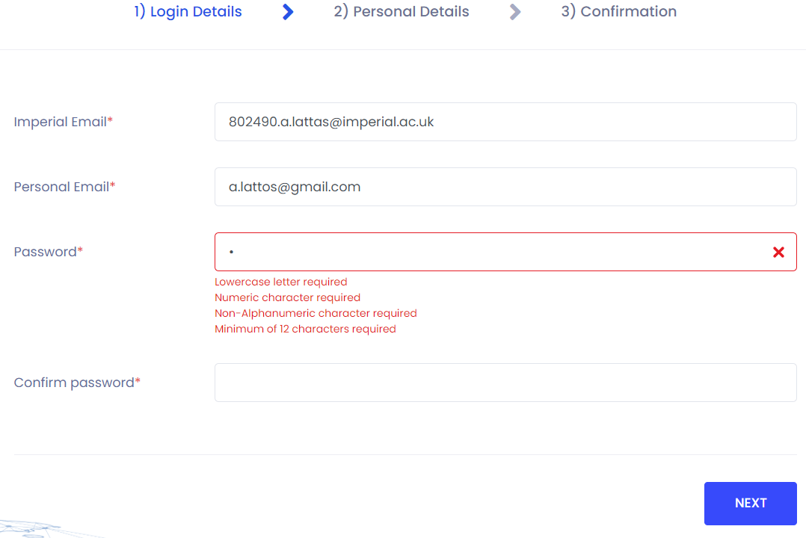
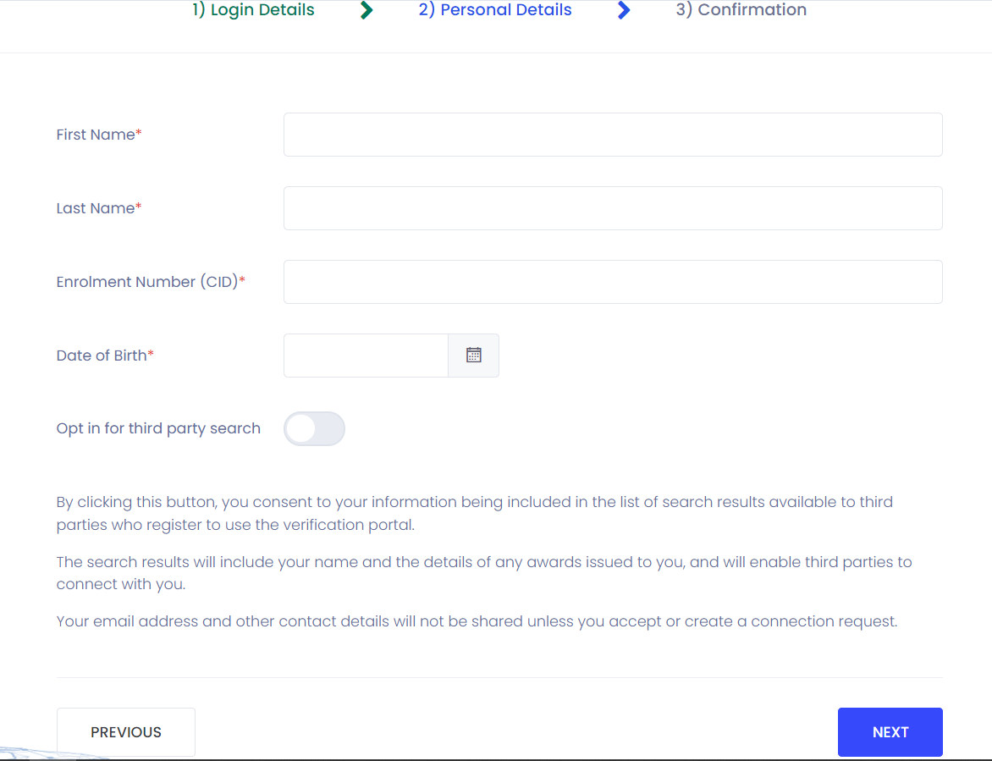
DC Reference Guide for Alumni Accessing your official documents
This document is aimed at students who have graduated after 2020.
It will guide you through the login process to access your official college documents, such as letters, transcripts, and certificates, or share a document with a third party.
How to transfer your account:
1
Enter your Imperial email, your personal email, create a secure password following the criteria required, and click ‘Next’.
Security criteria will be displayed underneath the ‘Password’ box when setting your password.
2
Enter your ‘First Name’, ‘Last Name’, CID number, ‘Date of Birth’ and click ‘Next’.
Use ‘Previous’ if you need to go back and/or make any changes.
3
Review your information, before clicking ‘Submit’.
A confirmation email outlining the next steps will go to your registered email address.
Use ‘Previous’ if you need to go back and/or make any changes.
Once you transfer your Imperial account, you will no longer be able to log in using your Imperial email.

Slide 4
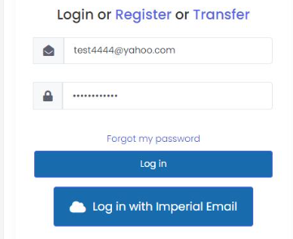
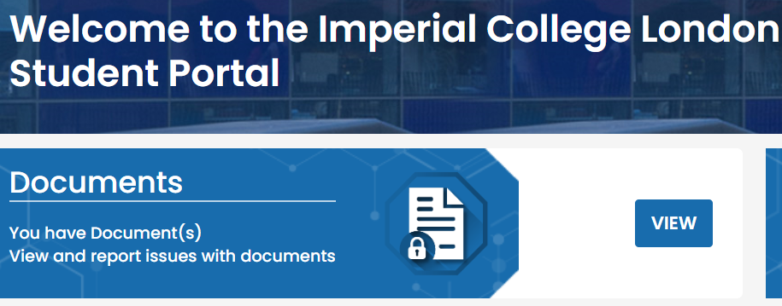
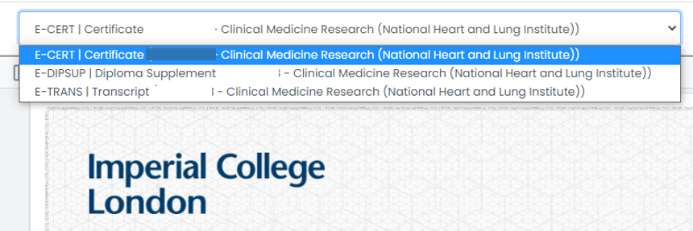
DC Reference Guide for Alumni Accessing your official documents
This document is aimed at students who have graduated after 2020.
It will guide you through the login process to access your official college documents, such as letters, transcripts, and certificates, or share a document with a third party.
How to view your documents:
1
Once you successfully transferred or registered your account, go to ‘Access my eDocuments’ link, enter your credentials and click ‘Log in’.
2
Click on the ‘View’ button next to ‘Documents’ tile.
3
Click ‘View’ on the document you want to view.
4
Use the dropdown option to switch in between award documents.
Award documents open by default on the Certificate. Use the dropdown to select the transcript or cover letter.

Slide 5
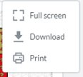
Quick Reference Guide for Students Accessing your official documents
DC Reference Guide for Alumni Accessing your official documents
This document is aimed at students who have graduated after 2020.
It will guide you through the login process to access your official college documents, such as letters, transcripts, and certificates, or share a document with a third party.
How to download or print your documents:
5
Click on the cog icon to 'Download' or 'Print'.
1
Some organisations will not accept this online version. In this situation you can share the documents with the third party. This is covered later in the guide.
6
If a downloaded file causes any issues e.g. it is too large to upload then you can instead print to PDF. Select ‘Print’ on the cog menu and then click ‘Print’ again.
How to report an issue with your documents:
Click on the yellow 'Report' button to report an issue.
7
Note that documents will be updated with any changes made via My Imperial by 2pm the following working day. If documents have still not updated after this, please send an email to: registry.systems@imperial.ac.uk.
8
Provide as much information as possible on the issue experienced.

Slide 6
Quick Reference Guide for Students Accessing your official documents
DC Reference Guide for Alumni Accessing your official documents
This document is aimed at students who have graduated after 2020.
It will guide you through the login process to access your official college documents, such as letters, transcripts, and certificates, or share a document with a third party.
How to share your documents:
1
Click on the ‘Manage’ button next to ‘Connections’ tile.
2
To add a new connection, click ‘Add Connection’.
3
Fill in the person’s name, email address and how long you wish them to have access to your documents and click ‘Send’.
On the next screen, tick the documents that you wish the person to view and then click ‘Share documents’.
4
Using the radio buttons under the ‘Actions’ section, you can edit the connection (documents shared, expiry date), delete it or resend an email.

Slide 7
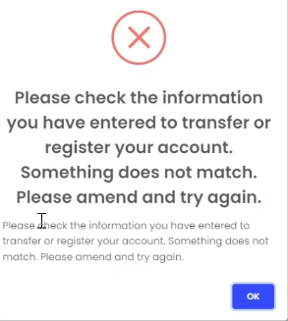
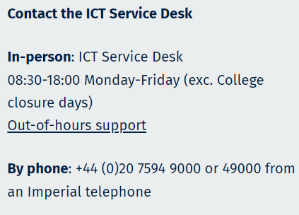
DC Reference Guide for Alumni Accessing your official documents
This document is aimed at students who have graduated after 2020.
It will guide you through the login process to access your official college documents, such as letters, transcripts, and certificates, or share a document with a third party.
Troubleshooting and support:
Q1: What happens if I get my Imperial email and/or name wrong when using the ‘Transfer’ login option?
A1: If you get your Imperial email or name wrong during the ‘Transfer’ process, you will get an error message. Double check the details entered are correct e.g., your name is in the correct format, as provided at the time of registration.
Q2: What happens if I get my CID and/or date of birth wrong when using the ‘Transfer’ login option?
A2: If this happens, you get an email confirmation message, and your user account goes into ‘Pending’, awaiting approval by an Admin user.
Q3: How do I know I have successfully transferred my Imperial account to my personal email address?
A3: When the information is correct, you should receive a confirmation email to your registered personal email address. You will still need to confirm your email address before you log in to the website.
Q4: Who do I reach out to if I need any technical support?
A4: For further support, please contact the ICT Service Desk. If you raise a ticket, a member of the ICT team will need to call you back to confirm your identity.
Q5: Where do I go for more information?
A5: Please access this link for more information, including some FAQs.

