Slide 1
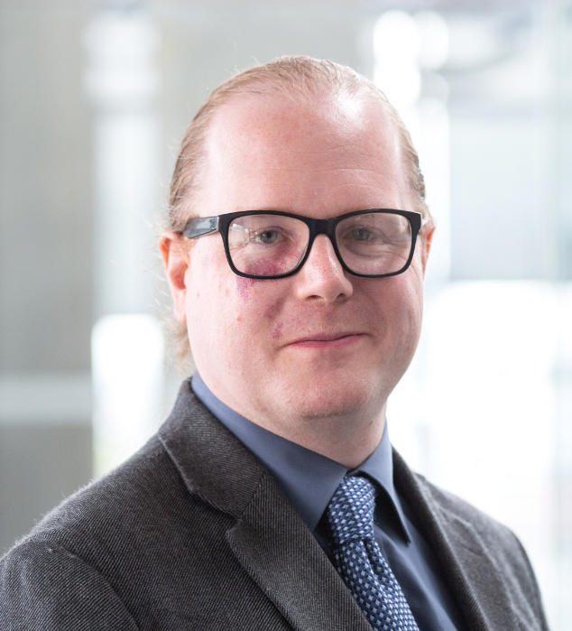
Senior Tutor Welcome
Department of Computing
October 2023
Dr Thomas Lancaster
PGT Senior Tutor
t.lancaster@imperial.ac.uk

Slide 2
Dr Thomas Lancaster
MSc Related Roles
PGT Senior Tutor
Department Disability Officer
Project Coordinator (MSc/ISO/Group Projects)
Academic Integrity Officer

Slide 3
Senior Tutor
I have overall responsibility for the academic and pastoral care of PGT students in the Department, with the support of many other people including our Wellbeing Advisor, Caroline Gilchrist
I have information about College processes, hardship funding and other services
You can always speak to Caroline and me in confidence

Slide 4
My Relationship With You
You are a student on postgraduate programme, so I intend to treat you as such

Slide 5
Your Personal Tutor
The first person you should speak to for advice about non-academic issues
Two small group meetings per term
Individual meetings as you need them

Slide 6
First Personal Tutor Meeting
Tuesday 3 October 2023 at 12 noon
You should have a printed message with the details of your Personal Tutor
Timings and rooms may change and some meetings may be held online
Please check your email for any updates

Slide 7
Support for Disabilities and Long-Term Health Conditions
Through the Disability Advisory Service (DAS)
DAS make recommendations to the Department for reasonable adjustments to help with your studies (we don’t make the decisions within the Department)
Please book an appointment with DAS if needed
My role as Department Disability Officer (DDO) is as a liaison with DAS

Slide 8
Our Expectations

Slide 9
Operate With Integrity
Work professionally
Tolerate and respect everyone’s views and beliefs
Use the computer systems for legal purposes
Produce assessed work independently (unless you have agreement to work in a group)
Respect your sources (avoid collusion, plagiarism and other ethical breaches)
Complete the mandatory Plagiarism Awareness course on Blackboard

Slide 10
Centre For Academic English
http://www.imperial.ac.uk/academic-english

Slide 11
Attendance And Absence
We do expect you to participate fully during the course
This includes during the summer Project period

Slide 12
Late Submission Policy
Time of Late Submission | Mark Awarded
Up to 24 hours after the deadline | Capped at pass mark
More than 24 hours after the deadline | Zero
If you think you are going to miss deadlines, please act first

Slide 13
Short-Term Extensions/Longer-Term Mitigating Circumstances
Procedures designed to help you to succeed
Please put requests in as early as possible and continue working on the assessments
https://www.imperial.ac.uk/computing/current-students/postgraduate-student-welfare/extensions-and-mitigating-circumstances/

Slide 14
Wellbeing Support Department of Computing
Department of Computing
October 2022
Caroline Gilchrist – Student Wellbeing Adviser

Slide 15
Student Wellbeing Advisor
E-mail: c.gilchrist@imperial.ac.uk
Huxley 304a
One-to-one appointments in person or online
Drop-in sessions
Workshops
Wellbeing initiatives

Slide 16
Support
Wellbeing Support
Department of Computing
Student Counselling and Mental Health Advice Service - www.imperial.ac.uk/counselling
Imperial College Health Centre – www.imperialcollegehealthcentre.co.uk All students should be registered with a London based GP throughout their studies
Chaplaincy - www.imperial.ac.uk/chaplaincy
International Student Support - www.imperial.ac.uk/study/international-students

Slide 17
Support (cont.)
Wellbeing Support
Department of Computing
Student Support Zone - http://www.imperial.ac.uk/student-support-zone
Student Hub - www.imperial.ac.uk/student-hub
Imperial Success Guide - https://www.imperial.ac.uk/students/success-guide/
DoC website – wellbeing resources

