Slide 1
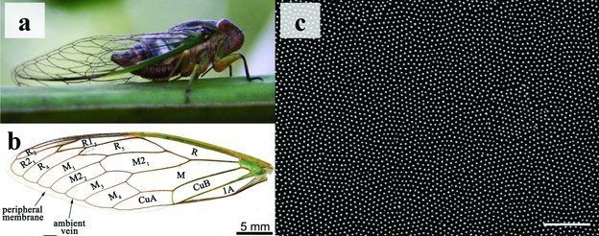
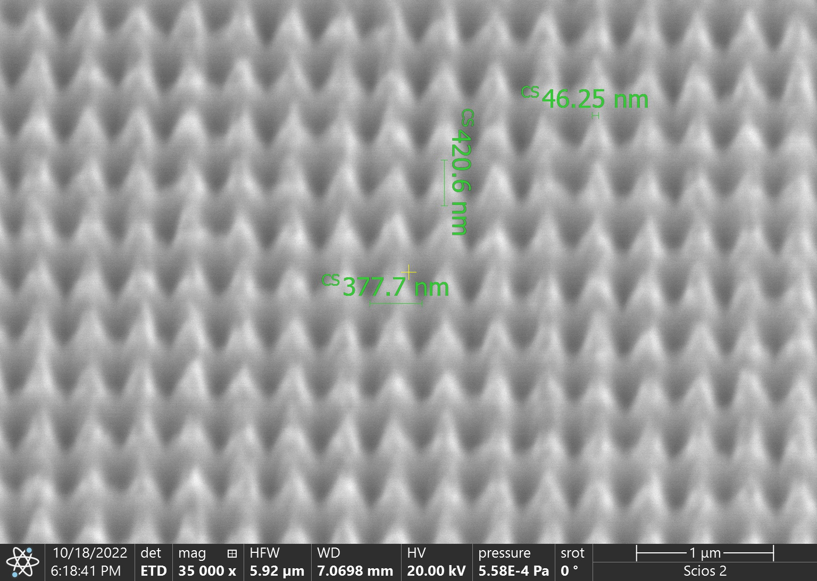
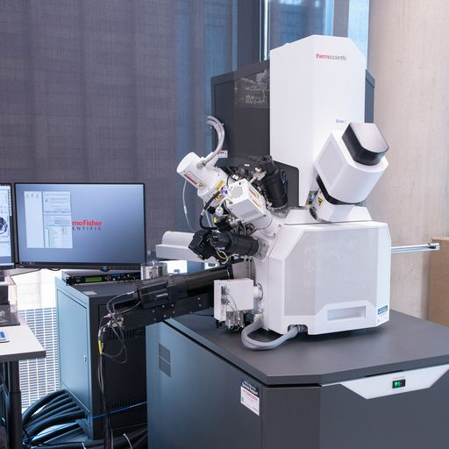
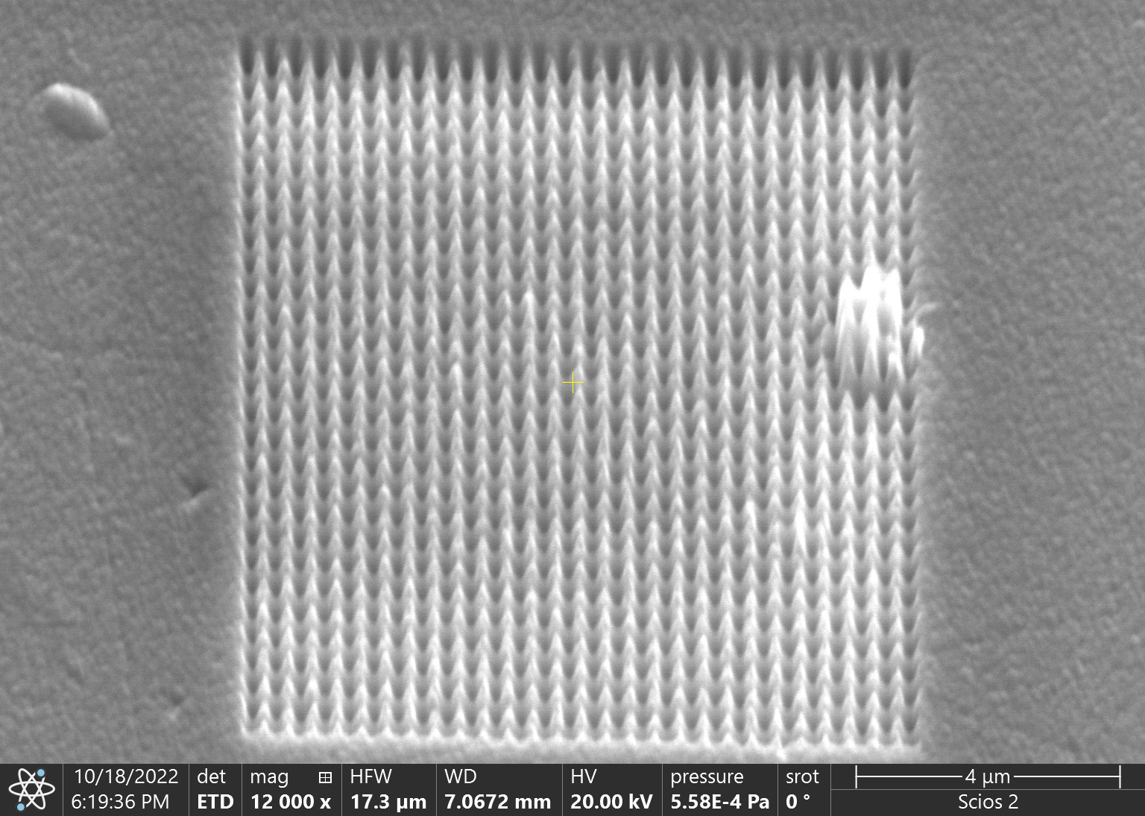
Robust Manufacturable Antimicrobial Surfaces
Dr Ryan Bower, Dr Daniel Price & Dr Peter Petrov
Introduction
Antimicrobial resistance is a growing issue in hospitals and public spaces, with high contact
surfaces identified as major transmission points for bacteria and other pathogens. Surface coatings that can kill drug-resistant bacteria will help to lower the number of infections and minimise the use of antibiotics.
The ROMANS team received £1.6M in EPSRC funding to develop unique materials and establish routes for commercial manufacturing of biomimetic surfaces capable of killing pathogens through a combination of photocatalytic and micromechanical means.
Ultrahard transition metal nitride thin films are deposited by High Power Impulse Magnetron Sputtering (HIPIMS) @ Sheffield Hallam University.
Small, Volume: 8, Issue: 16, Pages: 2489-2494, 04 June 2012
TiN HIPIMS discharge
Nanofabrication
Our researchers are using the nano-fabrication and characterisation equipment in the Royce Cleanroom to make these nano-patterned surfaces and optimising their design to maximise antimicrobial efficiency.
Focussed Ion Beam
Colloidal lithography and Reactive Ion Etching

