Slide 1
2024 Annual Meeting of the Imperial College Consortium on Pore-Scale Modelling and Imaging
16th January 2024
Martin Blunt and Branko Bijeljic
Department of Earth Science and Engineering
Imperial College London

Slide 2
Personnel and projects
Martin Blunt, Professor of Flow in Porous Media – multiphase flow in porous media
Branko Bijeljic, Principal Research Fellow – multiphase flow and reactive transport
Sajjad Foroughi, Post-doctoral researcher – pore-scale modelling
Sati Asli Gundogar, Post-doctoral researcher – pore-scale modelling and analysis
Rukuan Chai, Post-doctoral researcher – imaging and analysis of carbon dioxide storage
Anin Patmonoaji, Post-doctoral researcher – experimental measurements of displacement
Sepideh Goodarzi, 3rd year PhD student – analysis of hysteresis
Hussein Alzahrani, 3rd year PhD student – surfactant flooding
Abdulaziz Alsaleh, 2nd year PhD student – simulation of polymer flooding
Ademola Adebimpe, 2nd year PhD student – modelling of intermittency and Ostwald ripening
Jack Ma, 2nd year PhD student – application of machine learning to pore-scale modelling
Waleed Dokhon, 1st year PhD student – experimental studies of hydrogen storage
Ahmed Alzaabi, 1st year PhD student – nitrogen, carbon dioxide and hydrogen storage
Anfal Al Zarafi, 1st year PhD student – carbon dioxide storage in reservoir carbonates
Olatunbosun Adedipe, 1st year PhD student, reactive transport and cement dissolution
Ibrahim Alobaidan, 1st year PhD student, modelling and design of hydrogen storage
Qianqian Ma, 1st year PhD student, experimental studies of reactive transport
Yang Gao, Visiting PhD student, machine-learning based image segmentation
Gang Luo, Visiting PhD student, machine-learning applies to NMR measurements
Shanlin Ye, Visiting PhD student, AI-driven management of drilling
Mingliang Qu, 2nd year PhD student Zhejiang University, China – multiphysics modelling
Qingyang (Lewis) Lin, Professor, Zhejiang University, China – multiphase flow

Slide 3
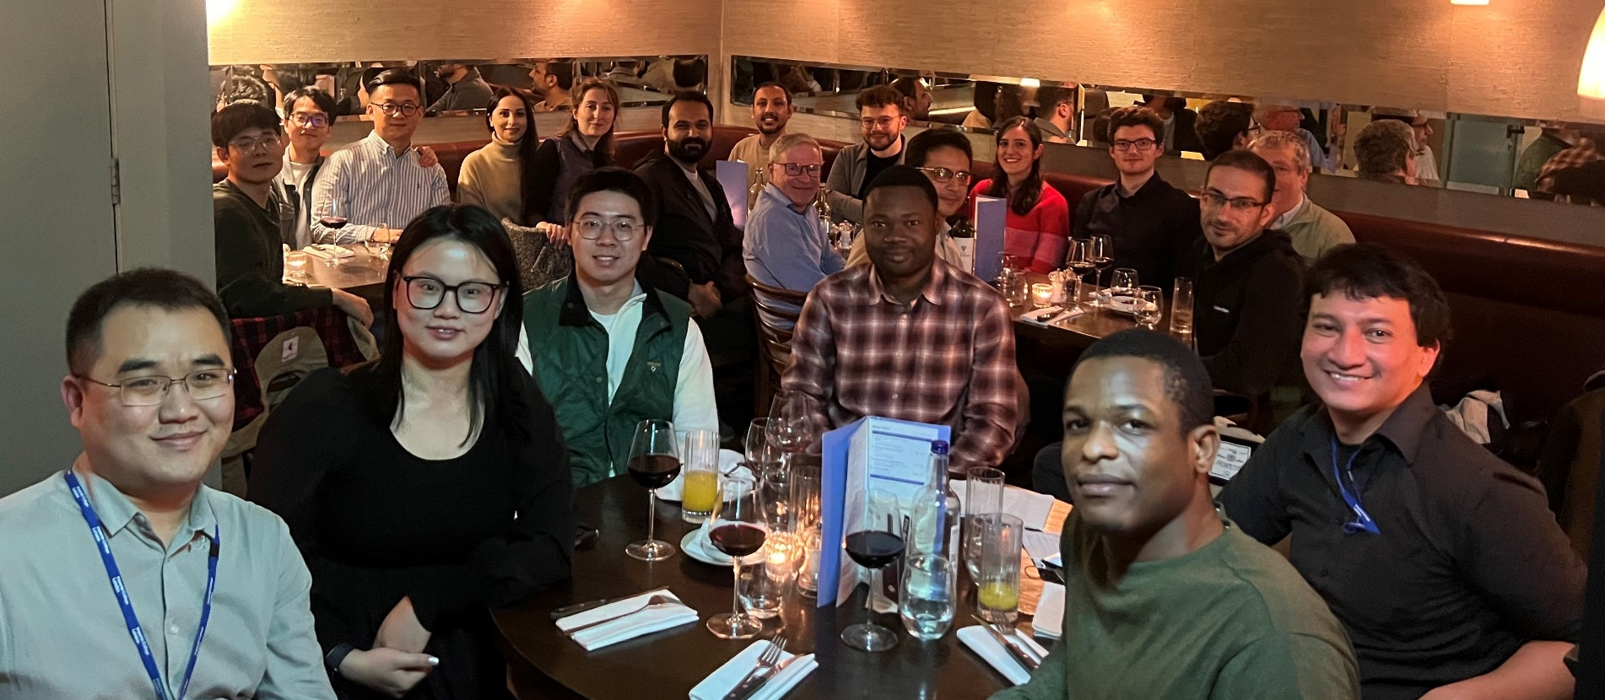
Personnel and projects

Slide 4
Agenda: 24th Pore-Scale Imaging and Modelling Meeting
9:00am Welcome coffee
9:15am Martin Blunt – Welcome and introduction
Session 1: Hydrogen storage
9:30am Sepi Goodarzi – Is there hysteresis in hydrogen storage and withdrawal: the impact of Ostwald ripening?
10:10am Waleed Dokhon: A pore-scale imaging study of the combined effects of displacement and pressure decline in hydrogen storage
10:40am Ahmed Alzaabi: Trapping in reservoir rocks: nitrogen, carbon dioxide and hydrogen
11:00: Coffee break
Session 2: Carbon dioxide and surfactants
11:20am Hussain Alzahrani: Pore-scale mechanisms of improved recovery in surfactant flooding
11:50am Olatunbosun Adedipe: Carbon-dioxide-cement interactions
12:20pm: Lunch
Session 3: Pore-scale modelling
1:20pm Sajjad Foroughi – Multi-scale network modelling applied to complex samples
1:50pm Ademola Adebimpe – A statistical approach for pore-scale modelling of intermittency
2:20pm Mingliang Qu – Pore-scale modelling of heat and mass transfer in packed bed reactors and for thermal energy storage
2:50pm: Coffee break
Session 4: Machine learning and porous media
3:20pm Jack Ma – Super-resolution imaging
3:50pm Yang Gao – AI-driven image segmentation for accurate characterization of wettability
4:10pm Shanlin Ye – A data-driven approach to drilling avoiding excessive bit wear
4:30pm Gang Luo – Machine learning and NMR interpretation
4:50pm: Close
6:30pm Dinner – Ognisko (Polish Club), Exhibition Road

Slide 5
Data, codes and AI
Open access papers, talks and data
https://www.imperial.ac.uk/earth-science/research/research-groups/pore-scale-modelling/
See also the Digital Rocks Portal, BGS etc.
Codes available on Github
https://github.com/ImperialCollegeLondon/porescale
Machine learning: we have the image data and a vision to create foundational AI models for 3D/4D image segmentation, analysis and modelling (Jack, Yang, Shanlin and Gang this afternoon).

Slide 6
Flow in Porous Media in the Energy Transition
As outlined last year, our research focus in now on flow in porous media related to the energy transition.
This falls in two main themes.
The first is the understanding of subsurface multiphase flow and heat transport in porous rocks with application to carbon dioxide sequestration, hydrogen storage, and thermal energy storage and recovery.
The second is to study processes in manufactured porous media, including gas diffusion layers (used in fuel cells and electrolysers) and packed bed reactors.

Slide 7
Displacement patterns

Slide 8
Which type of percolation process?
Primary drainage is invasion percolation without trapping – the wetting phase can escape through roughness and corners in the pore space (layer flow). Any drainage process is invasion-percolation like (this includes secondary water injection into an oil-wet rock).
Secondary imbibition is percolation with trapping. Layer flow allows the wetting phase to displace the non-wetting phase anywhere in the pore space. Strictly this is bond percolation caused by snap-off in throats combined with cooperative pore filling.
Trapping – obvious as the non-wetting phase cannot escape once surrounded by the wetting phase.
Drainage is always invasion percolation as the non-wetting phase has to be connected to the inlet.
Obvious, textbook stuff…. or is it?
P.S. Need a quick introduction to percolation and porous media?
https://youtu.be/raAeZqNYHac

Slide 9
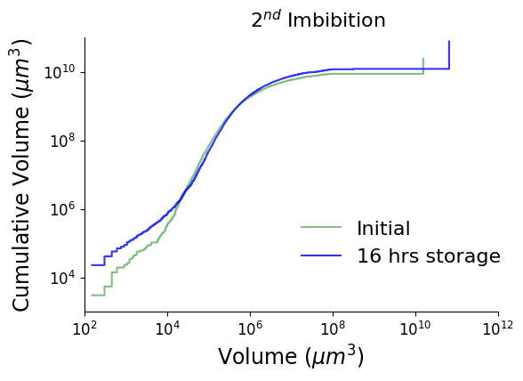
Ostwald ripening in hydrogen storage
H₂
Normalised Euler Characteristic (mm⁻³) | Normalised Euler Characteristic (mm⁻³)
 |  | Initial | 16hrs storage
Cycle 1 | Drainage | -57 | -
Cycle 1 | Imbibition | 21 | 20
Cycle 2 | Drainage | -18 | -21
 | Imbibition | 7 | 3
Cycle 3 | Drainage | -4 | -12
 | Imbibition | 14 | 11
Zhang et al. Geophysics Research Letters (2023)
Goodarzi et al. Int J Hydrogen Energy (2024)

Slide 10
Percolation without trapping!
Secondary imbibition is percolation without trapping for gases.
In equilibrium there is a constant capillary pressure everywhere, imposed through the connected non-wetting phase. There is no trapping constraint.
Hang on – with no trapping what’s going on in CO₂ storage? This is sounding rather dramatic!
In equilibrium with an infinite body of wetting phase, all the non-wetting phase dissolves (Gao et al., 2022) – this is just dissolution.
Locally though you can only impose a fixed capillary pressure with a connected non-wetting phase, so a finite residual saturation is defined – as usual – when the non-wetting phase disconnects.
Secondary drainage under pressure depletion is also percolation.
Working in acquiring experimental data (Sepi, Waleed and Ahmed).
Yes, our pore-scale modelling team are on it too! (Ademola, Sajjad, Asli)

Slide 11
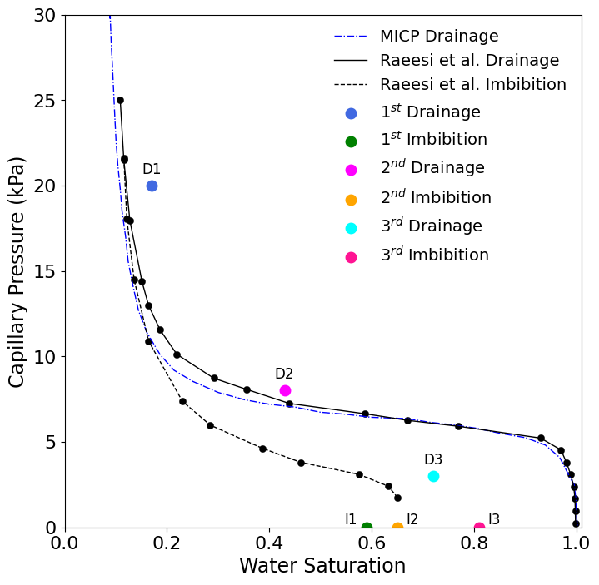
Working hypothesis
Reduced hysteresis. Good for hydrogen storage but may reduce the amount of capillary trapping for carbon dioxide.

Slide 12
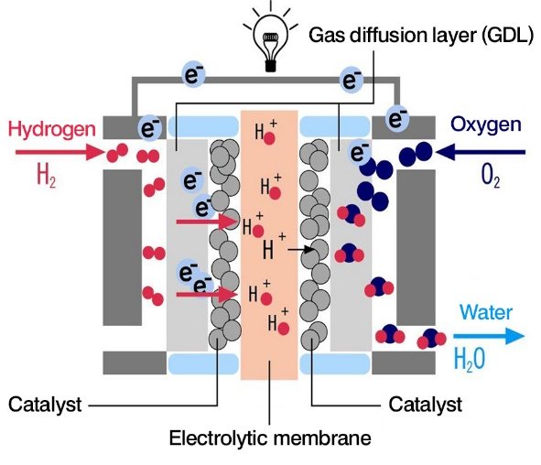

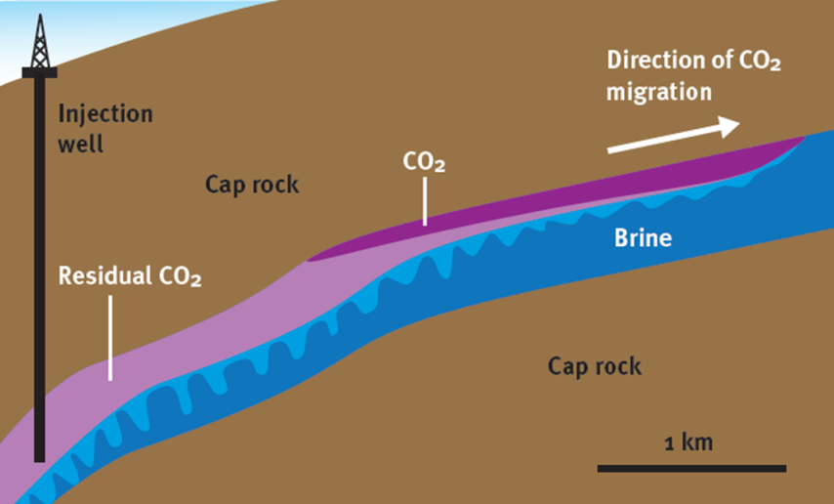
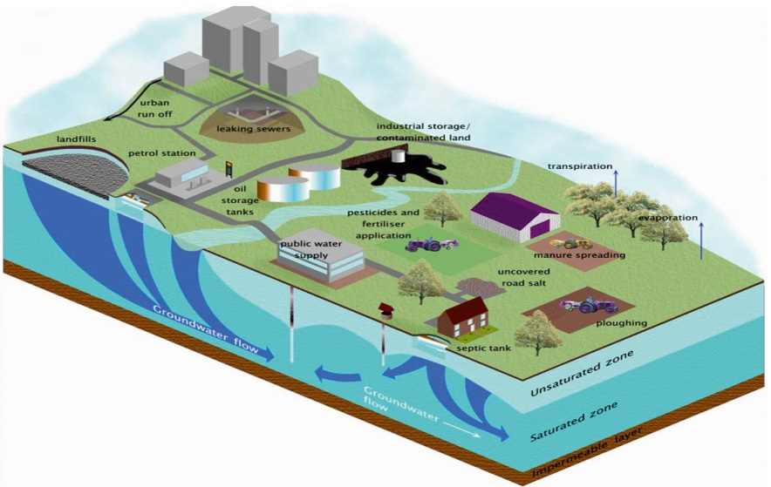
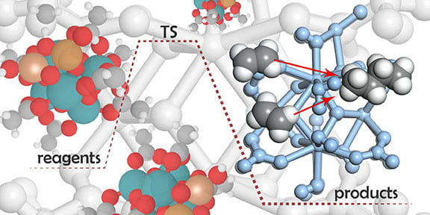
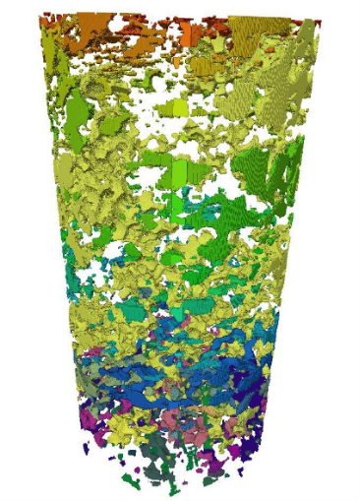
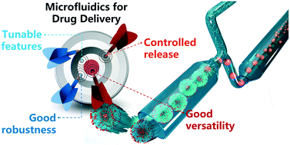
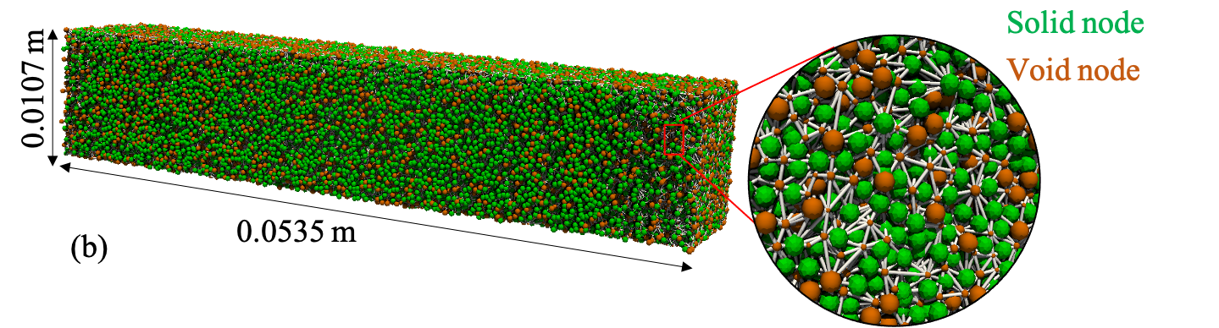
Does it matter?
Electrochemical devices
Carbon dioxide and Hydrogen Storage
http://www.euwfd.com/html/groundwater.html
Contaminant
Transport
http://energy.gov/
Heat and Mass Transport
Notes:
Industrial waste remedy
Biodegradation of landfills
Tracer studies
Miscible displacement
Capillary trapping – multi-phase flow
Development of miscibility - transport
Fluid-solid interaction - reaction

Slide 13















Many thanks

