Slide 1

24th Pore-Scale Imaging and Modelling Meeting
16/01/2024
Domain Adaptation Neural Network Based Prediction of Real-Time Drill Bit Wear
Shanlin Ye, Martin J. Blunt, Branko Bijeljic

Slide 2
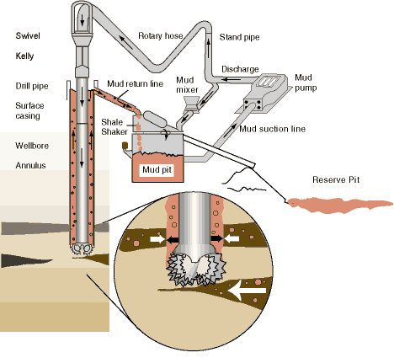
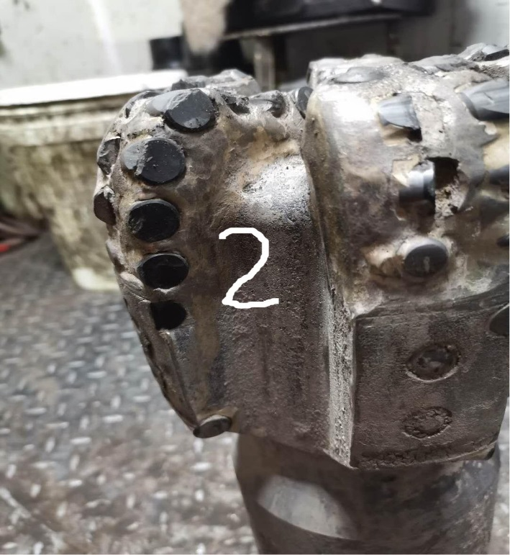

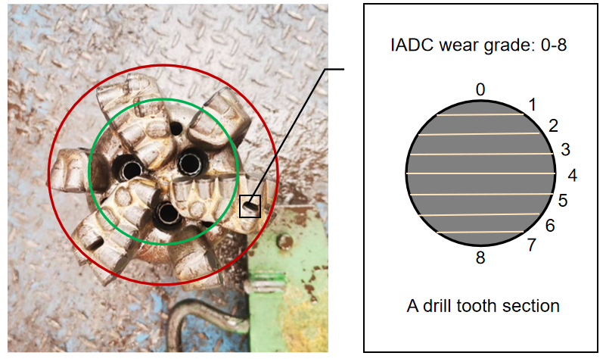
Introduction
What’s the bit wear ?
Important but difficult !
Reduced drilling efficiency
Decreased drill bit working life
Elevated accident risks
Invisible and uncertain working conditions
Data noisiness and variability
...
The drill bit obtains drilling wight and rotation speed to cut through the rock generating rock cuttings.

Slide 3
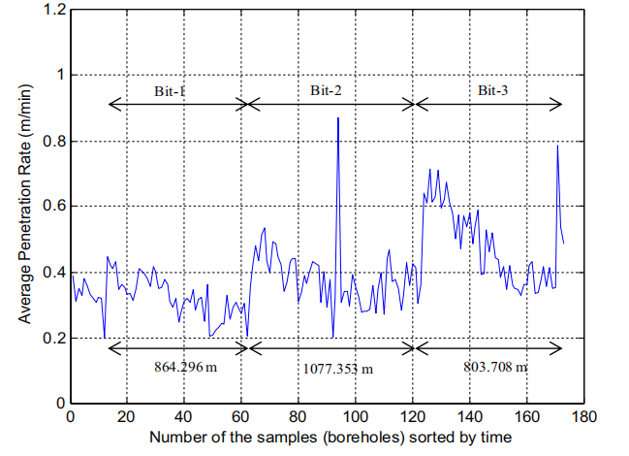
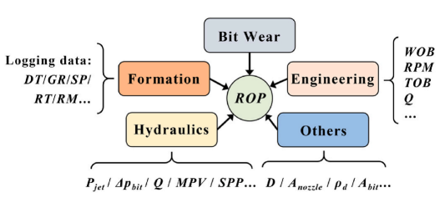
Introduction
How to effectively and simply monitor bit wear ?
We can get the real-time ROP easily
What should the penetration rate be if the bit is not worn out
The difference is important
The strong relationship between bit wear and drilling rate of penetration (ROP)prediction ：
the longer the drill bit is used, the lower the drilling speed will be

Slide 4
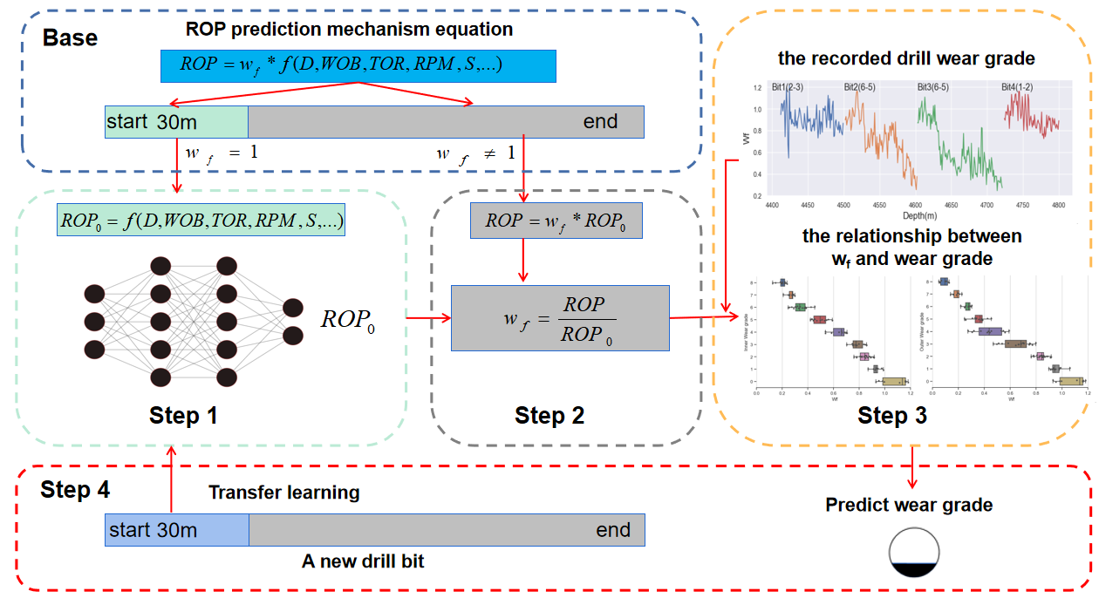
How to do
Step 1: predict the ideal ROP₀ using a neural network.
Step 2: calculate w_{f} （wear coefficient） using the ratio of ROP to ROP₀
Step 3: get the relationship between w_{f} and wear grade.
Step 4: monitor a new bit wear grade by the relationship.

Slide 5
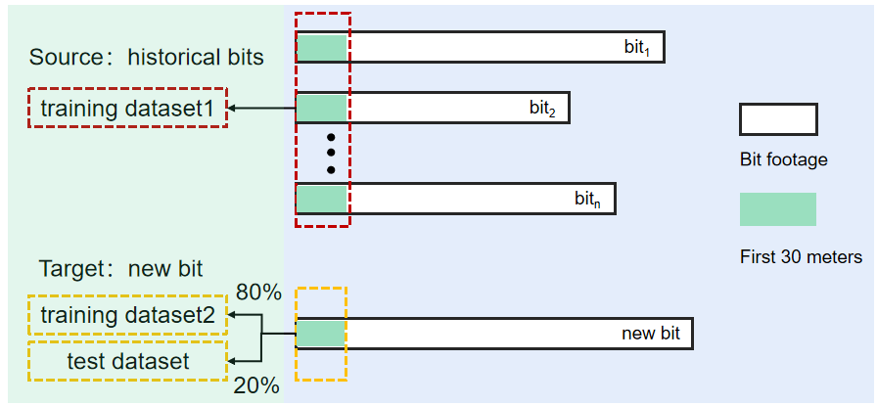
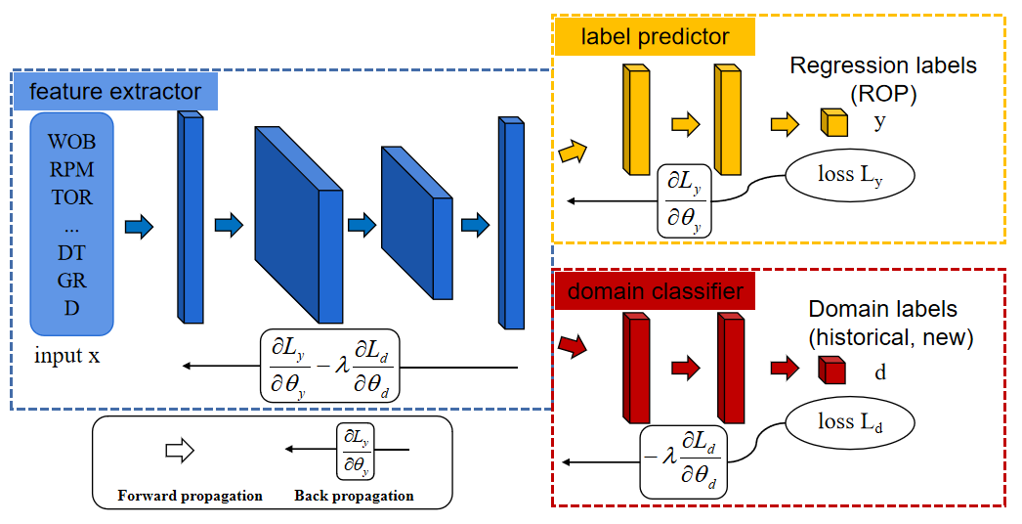
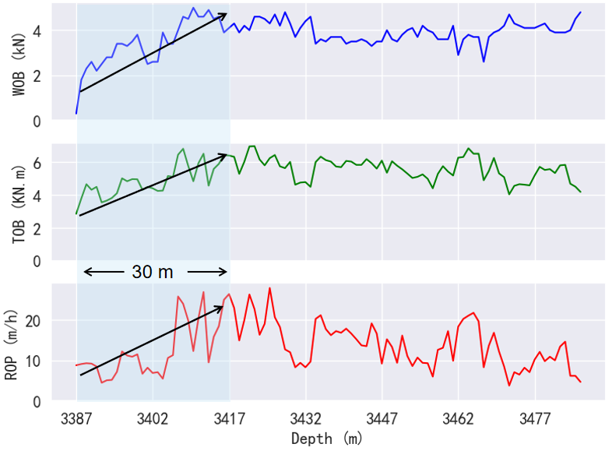
How to do
Choosing a Neural Network and data
Training Set 1 is from the first 30 m of historical drill bits, Training Set 2 is 80% of the first 30 m of new drill bits, and the Test Set is the remaining 20% of the first 30 m of new drill bits.
The structure of the DANN ideal ROP prediction model. The feature extractor extracts common features from high-dimensional input data. The label predictor predicts the ideal ROP, and the domain classifier distinguishes whether the data comes from a new or old drill bit.

Slide 6
How to do
Input features
Table1. Features in mechanistic ROP prediction models. A-H represent the Maurer, Warren, Bourgoyne-Young, Hareland, Detournay, Motahhari, and the modified Bourgoyne-Young models respectively.
Features | A | B | C | D | E | F | G | H
Weight on bit, WOB(kN) | √ | √ | √ | √ | √ | √ | √ | √
Rotary speed, RPM(rev/min) | √ | √ | √ | √ | √ | √ | √ | √
Torque on bit, TOB(kN*m) |  |  |  |  |  | √
Flow rate, Q(L/s) |  |  |  | √ |  | √
Density of drilling fluids, (g/cm3) |  |  | √ | √
Formation properties,DT; GR |  |  |  | √ | √ | √ | √
Bit diameter, D(inch) | √ | √ | √ | √ | √ | √ | √
Depth,d(m) |  |  |  | √ |  |  |  | √

Slide 7
How to do
Analysis of the Ideal ROP Prediction Model.
It can be observed that the DANN model outperforms the MLP model in terms of prediction accuracy, exhibiting higher R² and lower MAPE, across drill bits of different size.
This improvement is attributed to the DANN model's ability to adapt to the working environment of new drill bits with minimal new data
(a), (b), (c), and (d) show the prediction results of the MLP model for different sizes of drill bit. (e), (f), (g), and (h) show the prediction performance of the DANN model for different sizes of drill bit.

Slide 8
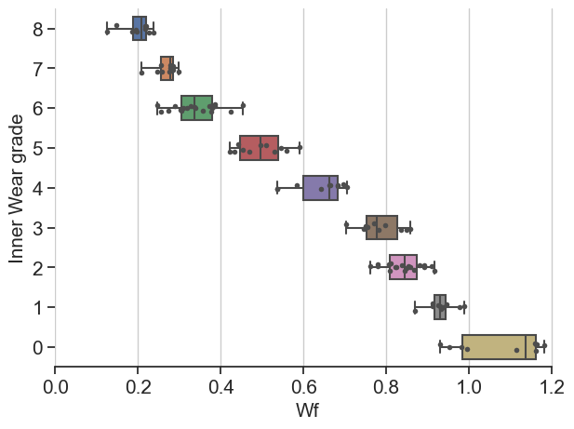
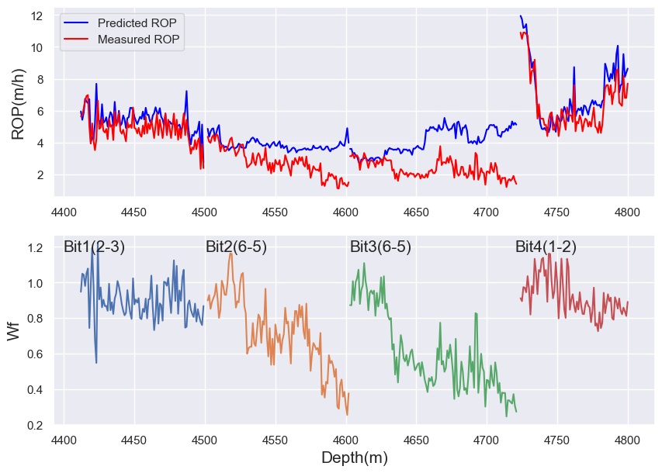

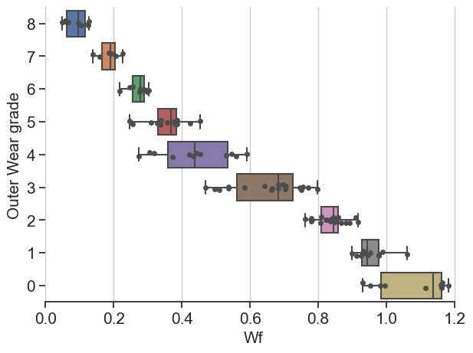
How to do
Relationship between w_{f} （wear coefficient）and wear grade.

Slide 9
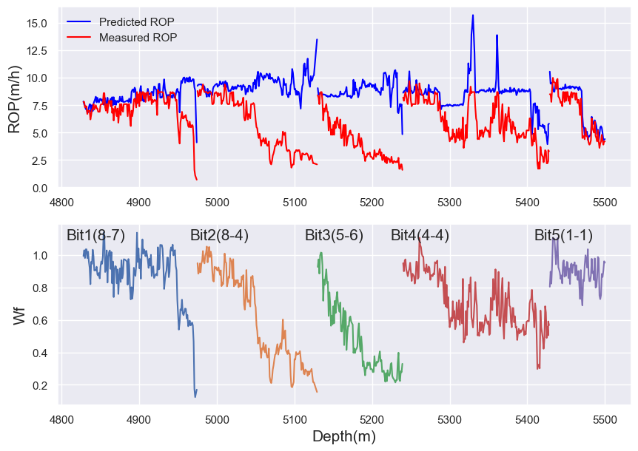
Case study
Model Validation
Case | Working interval | Final w_{f} | Predicted grade | Recorded grade
Bit1 | 4828m-4974m | 0.17 | 8-7 | 8-7
Bit2 | 4975m-5129m | 0.18 | 8-7 | 8-4
Bit3 | 5130m-5239m | 0.35 | 6-5 | 5-6
Bit4 | 5240m-5428m | 0.58 | 5-3 | 4-4
Bit5 | 5429m-5500m | 0.93 | 1-0 | 1-1
The results indicate that the average error in inner wear grade is 0.4 and the average error in outer wear grade is 1.2 on an 8 scale.

Slide 10
Conclusions
Utilizing a transfer learning neural network, we establish an ideal ROP prediction model to calculate the ROP under bit wear-free conditions. The predicted ideal ROP is then compared with the measured drilling rate to derive the wear coefficient.
Compared to traditional neural networks, the DANN-based model exhibits more accurate predictions of the ideal ROP.
The results indicate that the average error in inner wear grade is 0.4 and the average error in outer wear grade is 1.2 which demonstrates the model's effectiveness in monitoring drill bit wear and can provide assistance for safe and efficient drilling decisions.

Slide 11
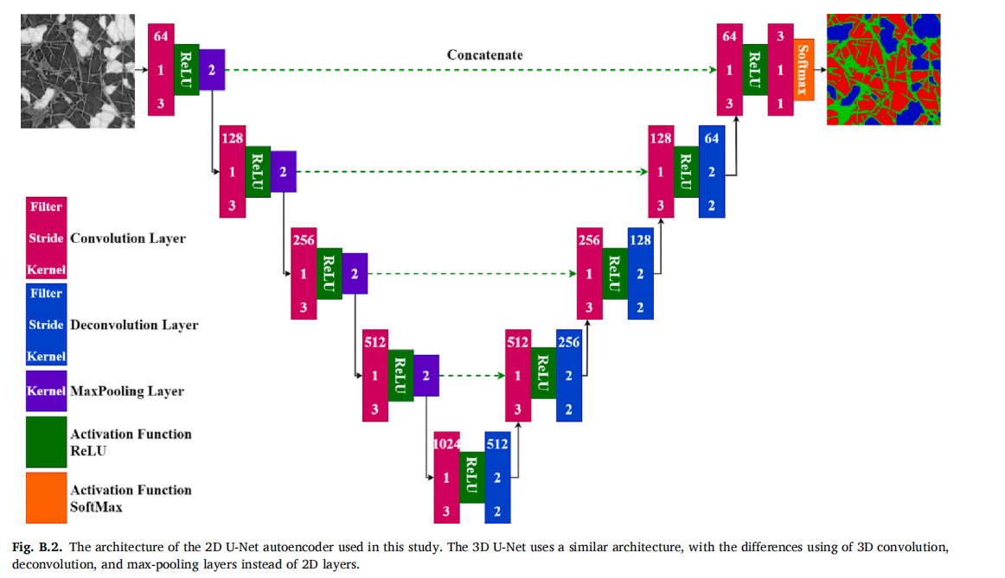
Future work
Deep learning for multiphase segmentation of X-ray images
In the segmented images, the aqueous phase, air, and fibres are shown in blue, red, and green, respectively
Disadvantages
1. High-quality labels are needed.
2. Takes a lot of time to train the model.

Slide 12
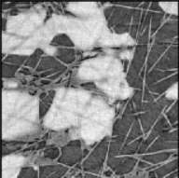
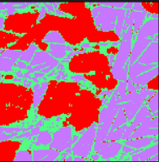
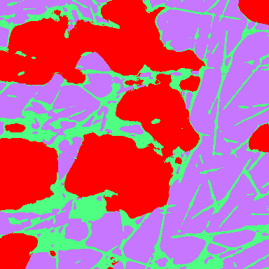
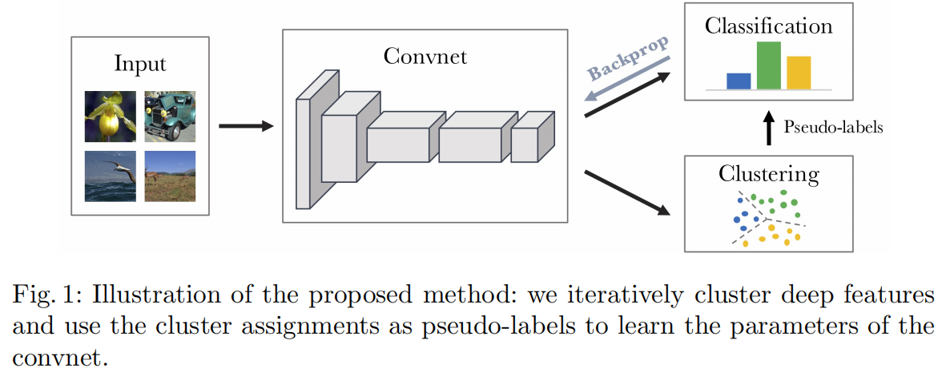
Future work
Unsupervised algorithm for multiphase segmentation of X-ray images
The clustering algorithms do not need training labels, and the image is segmented according to the Euclidean distance of the gray value of the pixels.
Disadvantages
Convolutional neural networks(CNN) can extract features such as object shape and texture in pictures
Convolutional neural network is combined to make up for the shortcomings of unsupervised clustering algorithm
Original
Kmeans（Clustering algorithms）
Label
Deep Clustering

Slide 13
24th Pore-Scale Imaging and Modelling Meeting
16/01/2024
Thanks a lot

