Slide 1






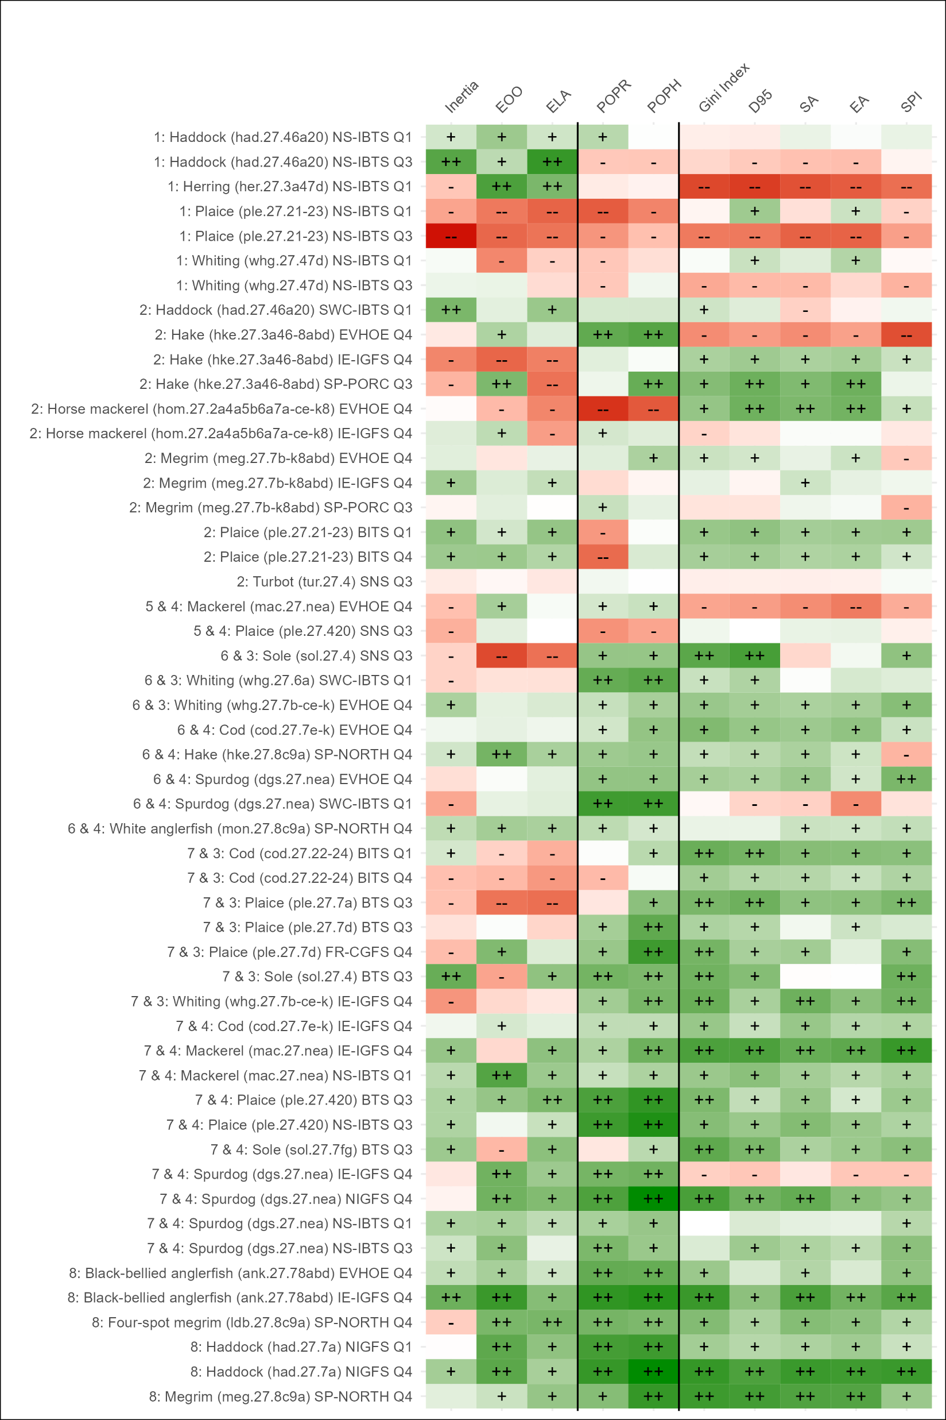
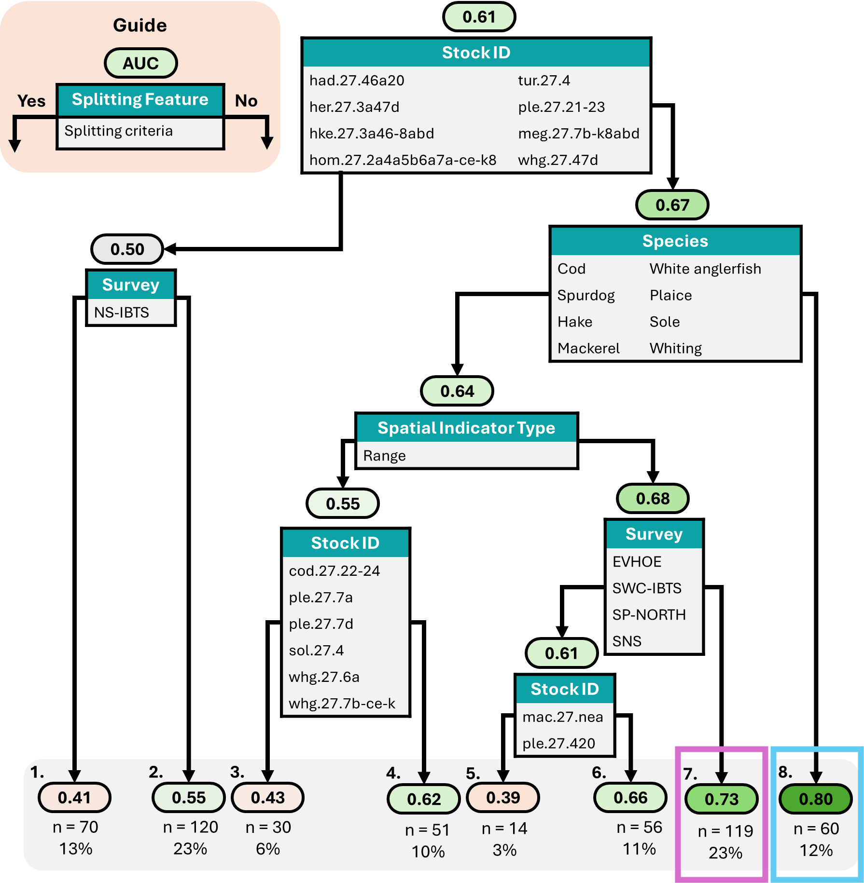
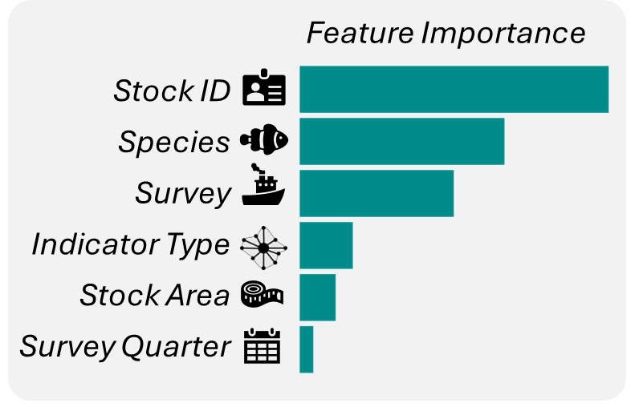





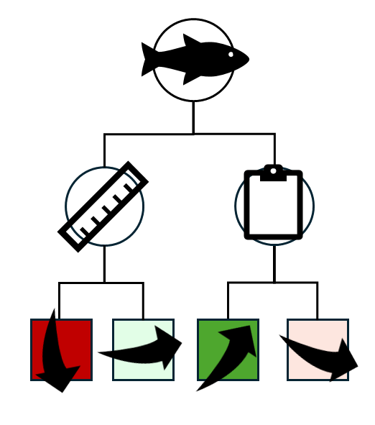
Assessing the ability of spatial indicators to classify the health of fish stocks
Peter Kidd^{1, 2*}, José De Oliveira², Laurence Kell¹ & Alexandra Collins¹
¹ Centre for Environmental Policy, Imperial College London, UK
² Centre for Environment, Fisheries and Aquaculture Science (Cefas), Lowestoft
* peter.kidd@cefas.gov.uk
Background
Fish exhibit dynamic non-random patterns of spatial distribution. Changes in fish abundance are often accompanied by changes in their spatial distribution¹. Understanding and accounting for how fish move across space over time is important for providing effective catch advice. Maintaining a healthy species spatial distribution is a key criteria for achieving good environmental status². However, spatial-temporal dynamics are often ignored in models used for fisheries management due to complexity, assumptions, and data requirements associated with spatially explicit models. Alternatively, simple empirical spatial indicators can describe population spatial characteristics such as range, occupancy, and aggregation³. Spatial indicators have the potential to provide insights into the status of a broader range of stocks that have data-limitations and are currently not formally assessed.
Analysis
Spatial Indicator
Results
The classification performance of spatial indicators differed across stocks, species, and surveys (Figure 1). POPH scored the highest average AUC score (0.68), followed by Gini index (0.65) and D95 (0.64). POPH had the largest proportion of analyses with AUCs ≥ 0.8 (36%). Healthy stock status was associated with a lower level of aggregation and an increased occupancy of territories for many stocks.
Regression tree group: Species (Stock) Survey Data
Range
Occupancy
Aggregation
++
0.8
+
0.6
Indicator Performance (AUC)
0.4
-
0.2
This work aims to identify indicators of spatial distribution, if any, that can correctly classify a fish stock as either healthy or unhealthy
- -
Range: how dispersed are the fish across space?
Figure 2. Importance of features used within the regression tree model to group AUC outcomes.
Feature selection revealed six variables that were useful for grouping AUC outputs (Figure 2). A regression tree revealed eight groupings of AUCs based on these features (Figure 3). Occupancy and aggregation indicators performed well for several stocks and species, but performance depended on the survey data used to calculate the indicators (Figure 3, node 7). All indicator types performed well for some black-bellied anglerfish, four-spot-megrim, haddock, and megrim stocks (Figure 3, node 8).
Methodology
1. Annual timeseries of 10 spatial indicators were calculated using fishery-independent survey data for 25 data-rich fish stocks (N=520). Spatial indicators measured range (N=3), occupancy (N=2) and aggregation (N=5) population characteristics.
2. Indicator timeseries were validated against biomass estimates from stock assessments using Receiver Operating Characteristic (ROC) curves. ROC curves are a graphical method used to assess the accuracy of predictions by plotting the true positive rate (TPR) against the false positive rate (FPR).
Occupancy: how much of an area do the fish occupy?
Aggregation: how concentrated are the fish in space?
TPR: the proportion of years where stock status was correctly classified as healthy
FPR: the proportion of years where stock status was incorrectly classified as healthy
Figure 3. Regression tree describing eight distinct groupings of AUC scores. Highest AUC values were associated with nodes 8 and 7 (blue and pink bounding boxes). A guide to interpret the tree is displayed on the top left of the plot in orange.
Conclusion
This work tested the ability of ten spatial indicators to classify stock status.
Occupancy and aggregation indicators correctly signalled the health status of many stocks, but performance was influenced by the survey data
Suggests that as the health of certain stocks improved, the stock occupied more regions and were more evenly spread across space.
These results provide initial support for the incorporation of spatial indicators within fisheries management and identifies the most useful candidates.
Future work aims to integrate spatial indicators within the rules that govern catch advice and test how well they can maintain the health of a stock.
3. The area under the curve (AUC) is a key performance metric that measures the classification skill of an indicator. AUC ranges from 0 to 1 with higher values indicating better ability to classify stock status correctly. AUCs from each indicator timeseries were compared. Feature selection and a regression tree were used to identify key features that influenced indicator performance.
Figure 1. Heatmap of AUC values produced for each spatial indicator across 52 analyses. Higher AUC values (darker green) indicate better ability to classify stock status correctly. Analyses are ordered by the groupings identified in the regression tree. The pink and blue bounding boxes highlight groupings where AUC values were highest.
References.
[1] Zwanenburg, K., Mohn, R., & Black, J. 2002. “Indices of Fish Distribution as Indicators of Population Status.” Fisheries & Oceans Canada, Science, Canadian Science Advisory Secretariat.
[2] European Commission. 2008. “Directive 2008/56/EC of the European Parliament and the Council establishing a framework for community action in the field of marine environmental policy (Marine Strategy Framework Directive).” L 164/19-40.
[3] Woillez, M., Rivoirard, J., & Petitgas, P. 2009. “Notes on Survey-Based Spatial Indicators for Monitoring Fish Populations.” Aquatic Living Resources 22 (2): 155–64. https://doi.org/10.1051/alr/2009017.
Notes:
Fish are distributed dynamically across space in non-random patterns that vary over time according to physiological and environmental pressures and preferences.
Spatial indicators also use alternative information that is not typically used in stock assessment. If spatial indicators can be shown to be a good proxy of abundance and stock status then they can be used to provide information on the state of a stock for stocks that are not formally assessed.
calculate indicators of population range, occupancy, and aggregation and validate their ability to classify a fish stock as either healthy or unhealthy.
The International Council for the Exploration of the Seas (ICES) gives advice on the amount of catch that can be taken for many fish stocks. The method used to calculate catch advice depends upon the availability and quality of data for each fish stock. Fish stocks with the most severe data-limitations are not formally assessed and catch advice is set to the same as the previous year, plus a precautionary buffer that reduces catch advice. This method slowly reduces catch advice to zero over time, without an understanding of the health status of the stock. New methods or data sources are required to assess stock status and provide more adaptive catch advice to ensure that data-limited stocks are sustainably fished.
Fish display non-random patterns of spatial distribution that reflect abundance, since changes in abundance are often accompanied by changes in distribution. Spatial dynamics are often ignored in fisheries management due to complexity, assumptions, and data requirements associated with spatial models. As an alternative, the spatial dynamics of a population can be characterised using simple empirical spatial indicators. Spatial indicators could therefore be used as a proxy of abundance and stock status to help provide catch advice for data-limited stocks.
The work presented here tested the ability of 10 spatial indicators to classify stock status of 25 data-rich stocks, using Receiver Operating Characteristic (ROC) curves.
A ROC curve is a graphical method that evaluates the performance of an indicator by comparing predictions against known observations .
of stock status to the known observations of stock status and the number of instances that are correctly and incorrectly classified are counted. A good classifier will correctly classify all instance.
years when the stock was in an unhealthy or healthy state. To be able to validate an indicator, we must know the true status of the stock so that we can compare
ROC curves are a graphical method that assess the accuracy of binary predictions by comparing them to observations. The aim is to validate predictions made by spatial indictaors to what is estimated yy our most comprepehnsive fisheries models. The area underneath the ROC curve (AUC) is a performance metric that tells you how good or bad your predictions are. An AUC of 1 tells you that all instances were correctly classified; an AUC of 0 tells you that all instances were incorrectly classified, and an AUC of 0.5 is what would be expected from a random predictor.
evaluate how well an indicator correctly classifies stock status as healthy or impaired by comparing the indicator predictions to values of the known true state of the stock.
A suite of spatial indicators that measure range, occupancy, and aggregation population characteristics were calculated using the ICES Database on Trawl Surveys (DATRAS) data and compared to stock assessment outputs of 36 data-rich fish stocks. Receiver Operating Characteristic (ROC) curves were used to assess the ability of each spatial indicator to classify stock status.
Each indicator time series was then compared to the annual estimated status of the respective stocks from stock assessment models.
Validation is the process of ensuring that a model accurately represents the system it intends to represent, through comparing predictions with real observations.
Observations
ICES data-rich stock assessments provide estimates of annual biomass as well as a biomass threshold. If estimated biomass is above or equal to this threshold, stock status is healthy. If estimated biomass is below the threshold stock status is unhealthy. This gives us the binary observations that we can validate our spatial indicators against. (Note: the assumption here is that these data-rich stock assessments are correct).
Predictions
Spatial indicators were calculated using fishery-independent survey data
This study provides an initial investigation into the potential of such spatial indicators of species distribution to inform on stock status using data rich stocks for which stock assessments are available. The aim is to develop methods to validate, verify, and calibrate potential indicators.
Information on the spatial distribution of a fish population may serve as an alternative data source that enables the classification of stock status for DLS. Fish populations and the individuals within the populations itself are located across space in a non-random way. Changes in abundance of a population is often accompanied by changes in spatial distribution. Density-dependent habitat selection predicts that the density of fish will increase in marginal habitats as abundance increases.
Changes in the spatial patterns of a population can be detected by calculating simple empirical spatial indicators. These spatial indicators can track population characteristics such as range, occupancy, and aggregation
The work presented here assesses the relationship of 10 spatial indicators with fish biomass
ICES methods have not been updated since 2012.
The observed binary status of a stock (healthy vs unhealthy) in each year of a timeseries was taken from official stock assessment outputs of each stock. Receiever Operating Characteristic (ROC) curves were used to validate indicator predictions of stock status against observations. ROC curves are a graphical method that plots the true positive rate (TPR) against the false positive rate (FPR).

