Slide 1
Modelling regional attitude-driven just energy transitions
Judy Jingwei Xie, Iain Staffell, Joeri Rogelj
Centre for Environmental Policy
Imperial College London
CEP PhD Symposium
30th June 2022
Contact: j.xie20@imperial.ac.uk

Slide 2
1. Research motivations and questions

Slide 3



Just Transition in climate negotiations
Motivation | Questions | Distribution | Recognition | Path Forward
“… Just Transition of the workforce and safeguarding and creating sustainable employment and decent work are crucial to ensure public support for long-term emission reductions, as well as to enable countries to reach the long-term goals of the Paris Agreement” – Silesia Declaration 2018
COP26 “Supporting the Conditions for a Just Transition Internationally”
Support for workers in the transition to new jobs
Support and promote social dialogue and stakeholder engagement
Economic Strategies
Local, inclusive, and decent work
Supply chains
Paris Agreement reporting and Just Transition
Notes:
Preamble of the Paris Agreement
Developed through the Silesia Declaration in Poland
Declaration “Supporting the Conditions for a Just Transition Internationally”
Support for workers in the transition to new jobs
Support and promote social dialogue and stakeholder engagement
Economic Strategies
Local, inclusive, and decent work
Supply chains
Paris Agreement reporting and Just Transition

Slide 4

Just Transition: what, who, how
Motivation | Questions | Distribution | Recognition | Path Forward
“both physical allocation of benefits and ills, and … distribution of associated responsibilities” (Walker 2009)
Distribution
“access to decision-making processes that govern the distributions” (Jenkins et al. 2016)
Recognition
Procedure
“calls to acknowledge the divergent perspectives rooted in social, cultural, ethnic, racial and gender differences” (Jenkins et al. 2016)

Slide 5
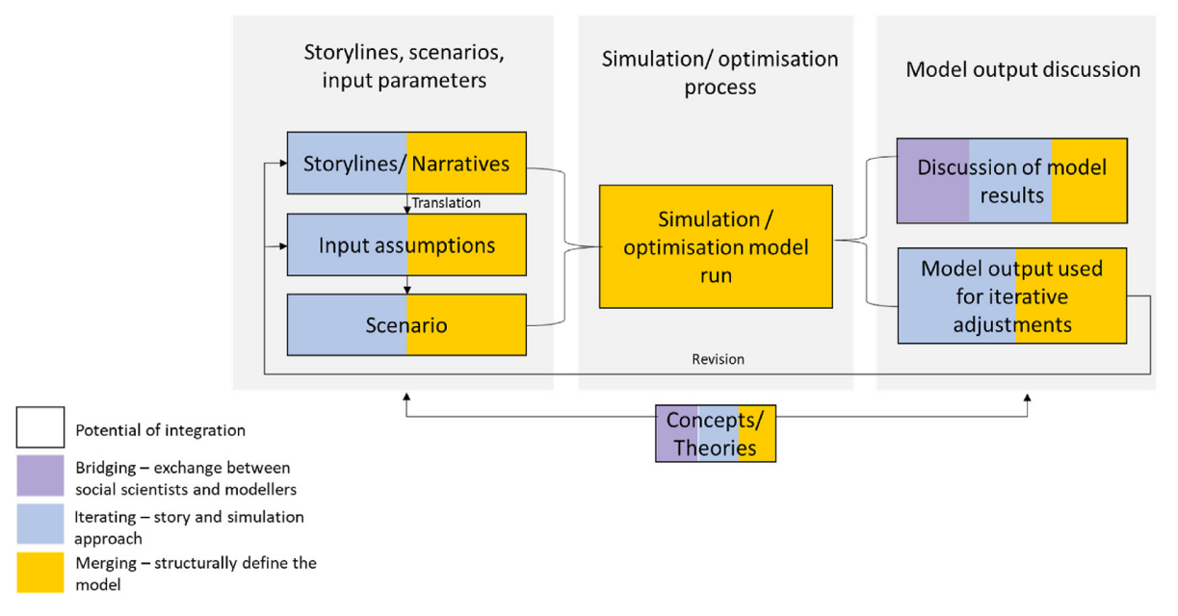
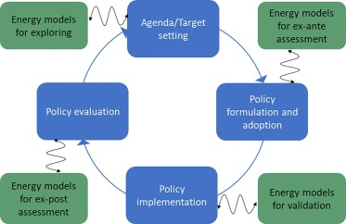
The role of quantitative energy modelling
Motivation | Questions | Distribution | Recognition | Path Forward
The policy cycle and potential use of models in the different stages.
(Figure source: Süsser et al. 2021)
Potential of integrating social science in energy modelling.
(Figure source: Krumm et al. 2022)

Slide 6



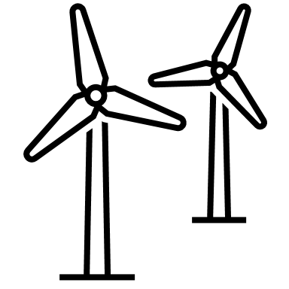



Different scales of the transition
Motivation | Questions | Distribution | Recognition | Path Forward
Energy access
Representation and governance
Burden sharing
Global
Tax burdens
Labour impacts
Public preferences
National
Stakeholder engagement
Local
Modelling
Distribution | Recognition | Procedure
Social science

Slide 7
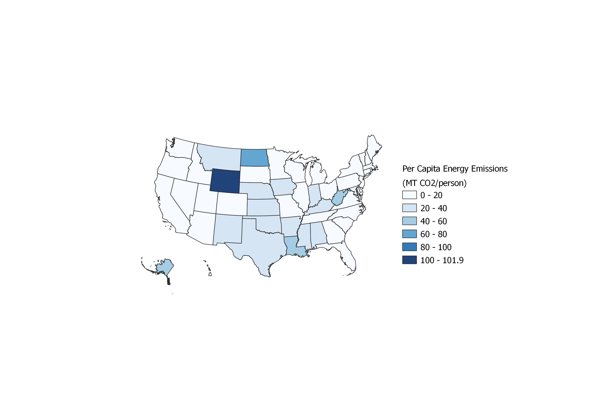
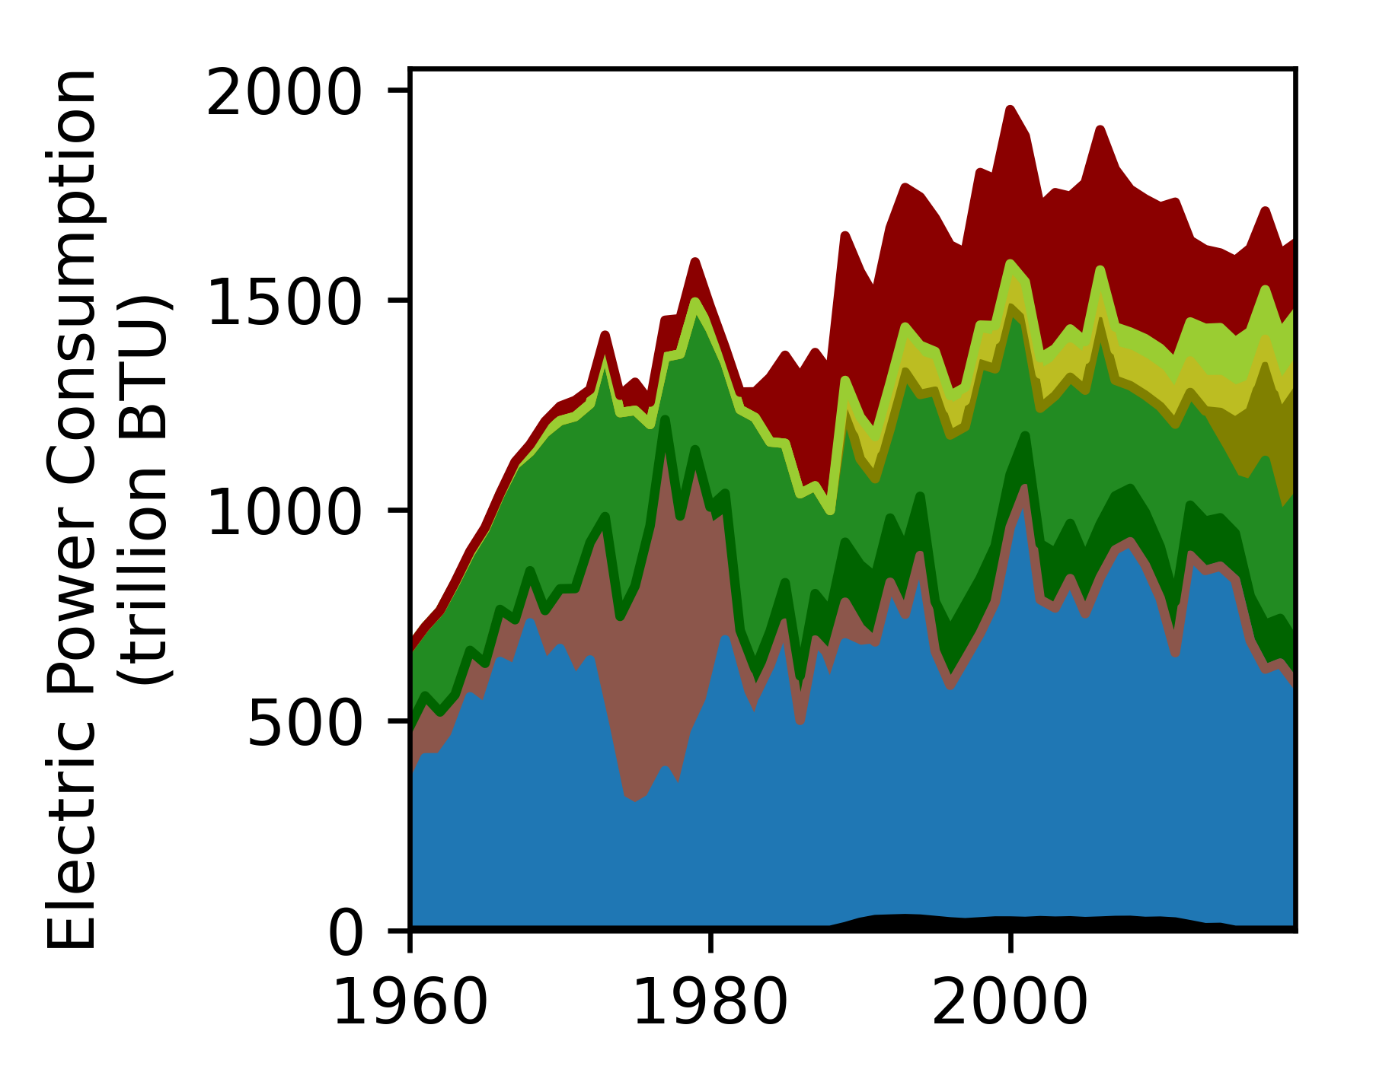
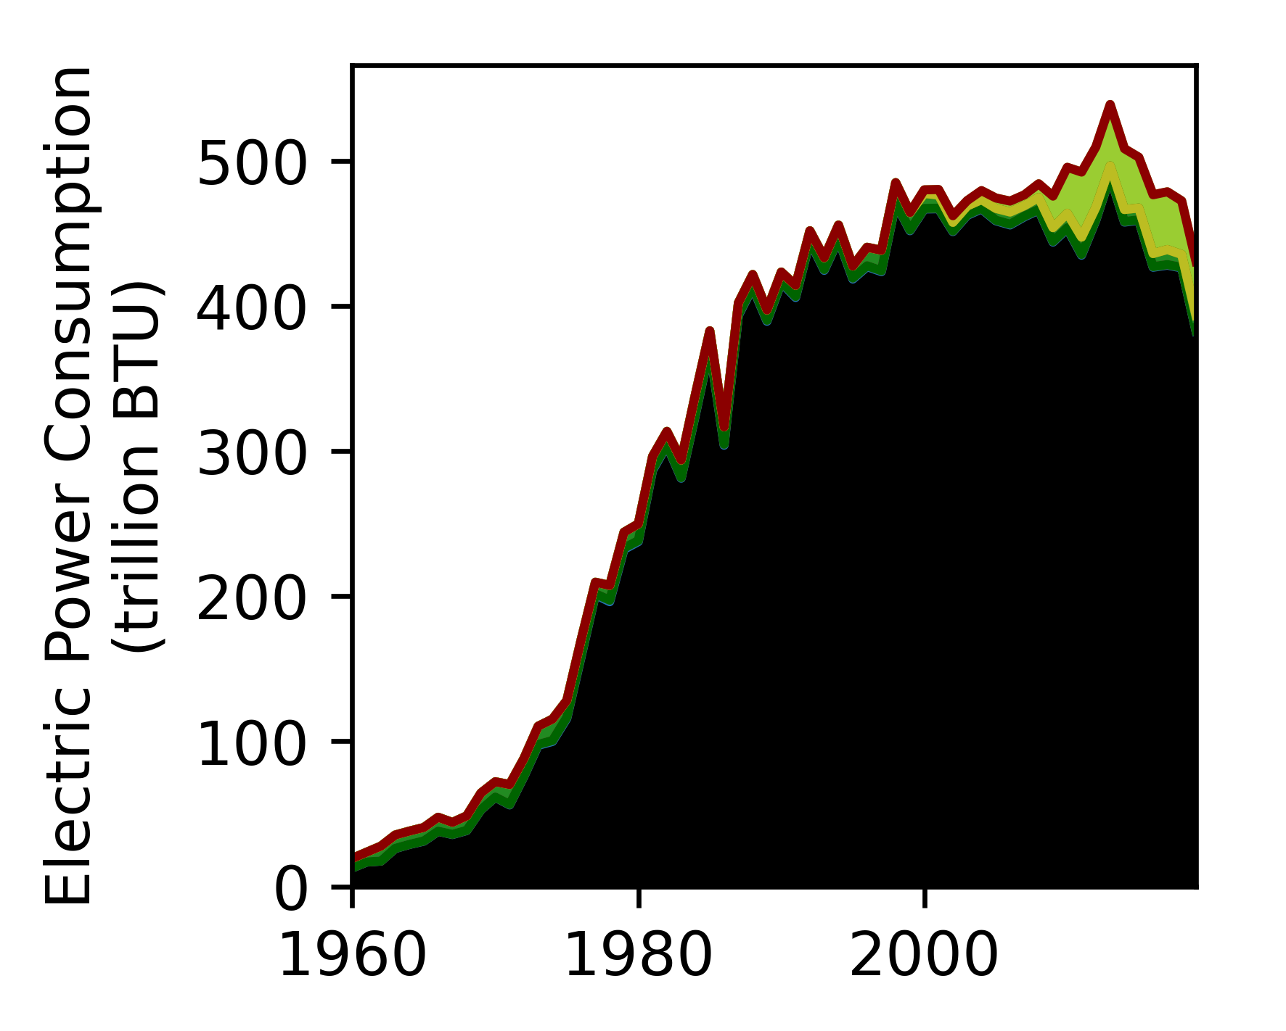
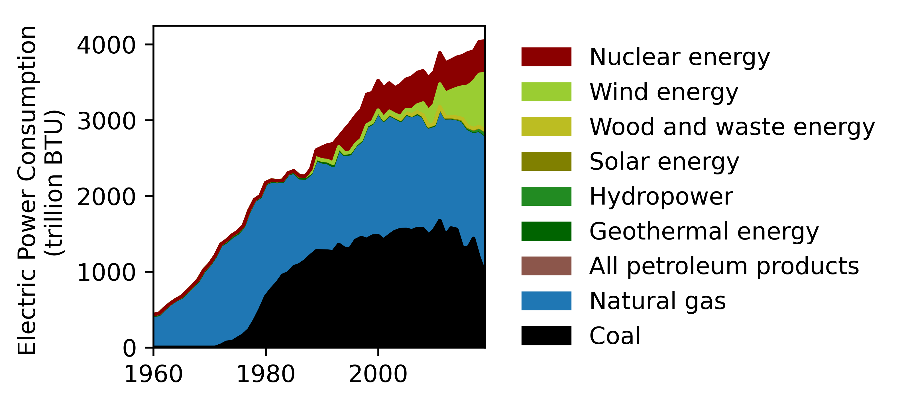
US states case study: heterogenous landscape
Motivation | Questions | Distribution | Recognition | Path Forward
CA
WY
WY
CA
TX
TX
(Data source: US Energy Information Administration)

Slide 8



Research questions
Motivation | Questions | Distribution | Recognition | Path Forward
What are the distributional labour impacts of decarbonising the power sector? Where and who may be more affected?
How can modellers recognise regional specific public attitudes in transition scenarios? What are the alternative societal outcomes?
What policy mechanisms and procedures are more conducive for just outcomes?

Slide 9
2. Regional distributional labour impacts of transitioning the power sector in the US

Slide 10
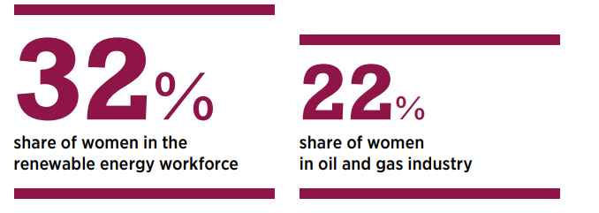
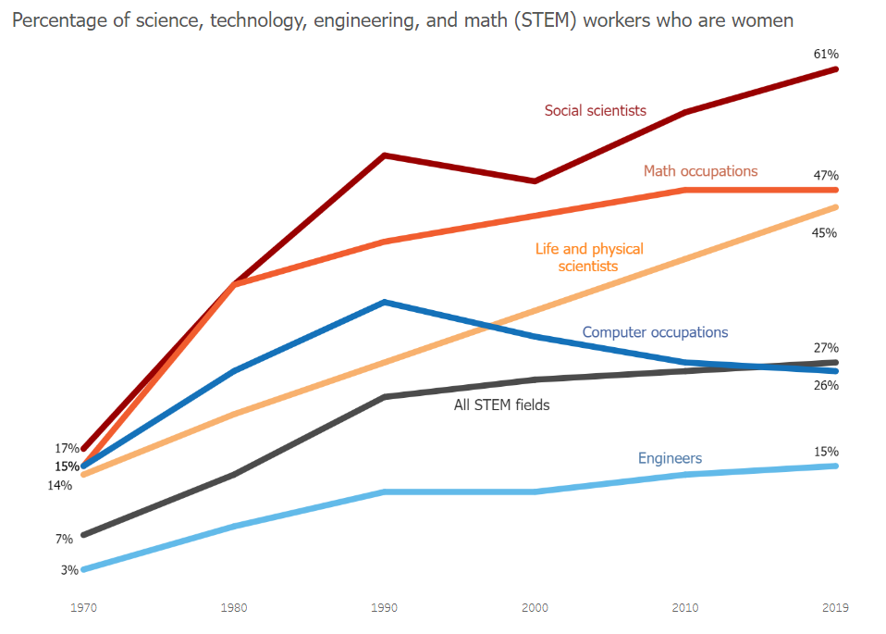
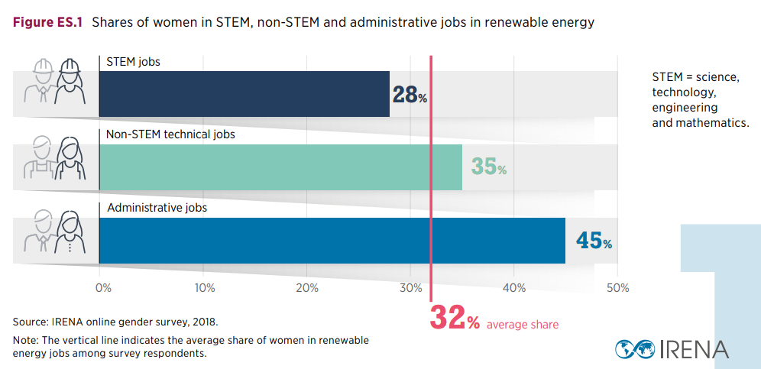
Women in energy and STEM
Motivation | Questions | Distribution | Recognition | Path Forward
Percentage of women workers in science, technology, engineering, and math (STEM)
(Figure source: IRENA 2019)
(Figure source: US DoL 2019)
Notes:
https://www.dol.gov/agencies/wb/data/occupations-stem?_ga=2.25754357.979025751.1655142867-1412523775.1655142867
https://data.bls.gov/pdq/SurveyOutputServlet

Slide 11



Uncertainties in distributional impacts
Motivation | Questions | Distribution | Recognition | Path Forward
BAU
(Framework adapted from Rogelj 2013)
NZ50
Emission reduction
scenarios
NZ35
Technology portfolio
Power Sector
Model
Labour Impact
Model
Distributional Impact
Analysis
Labour impact
Distributional impact

Slide 12
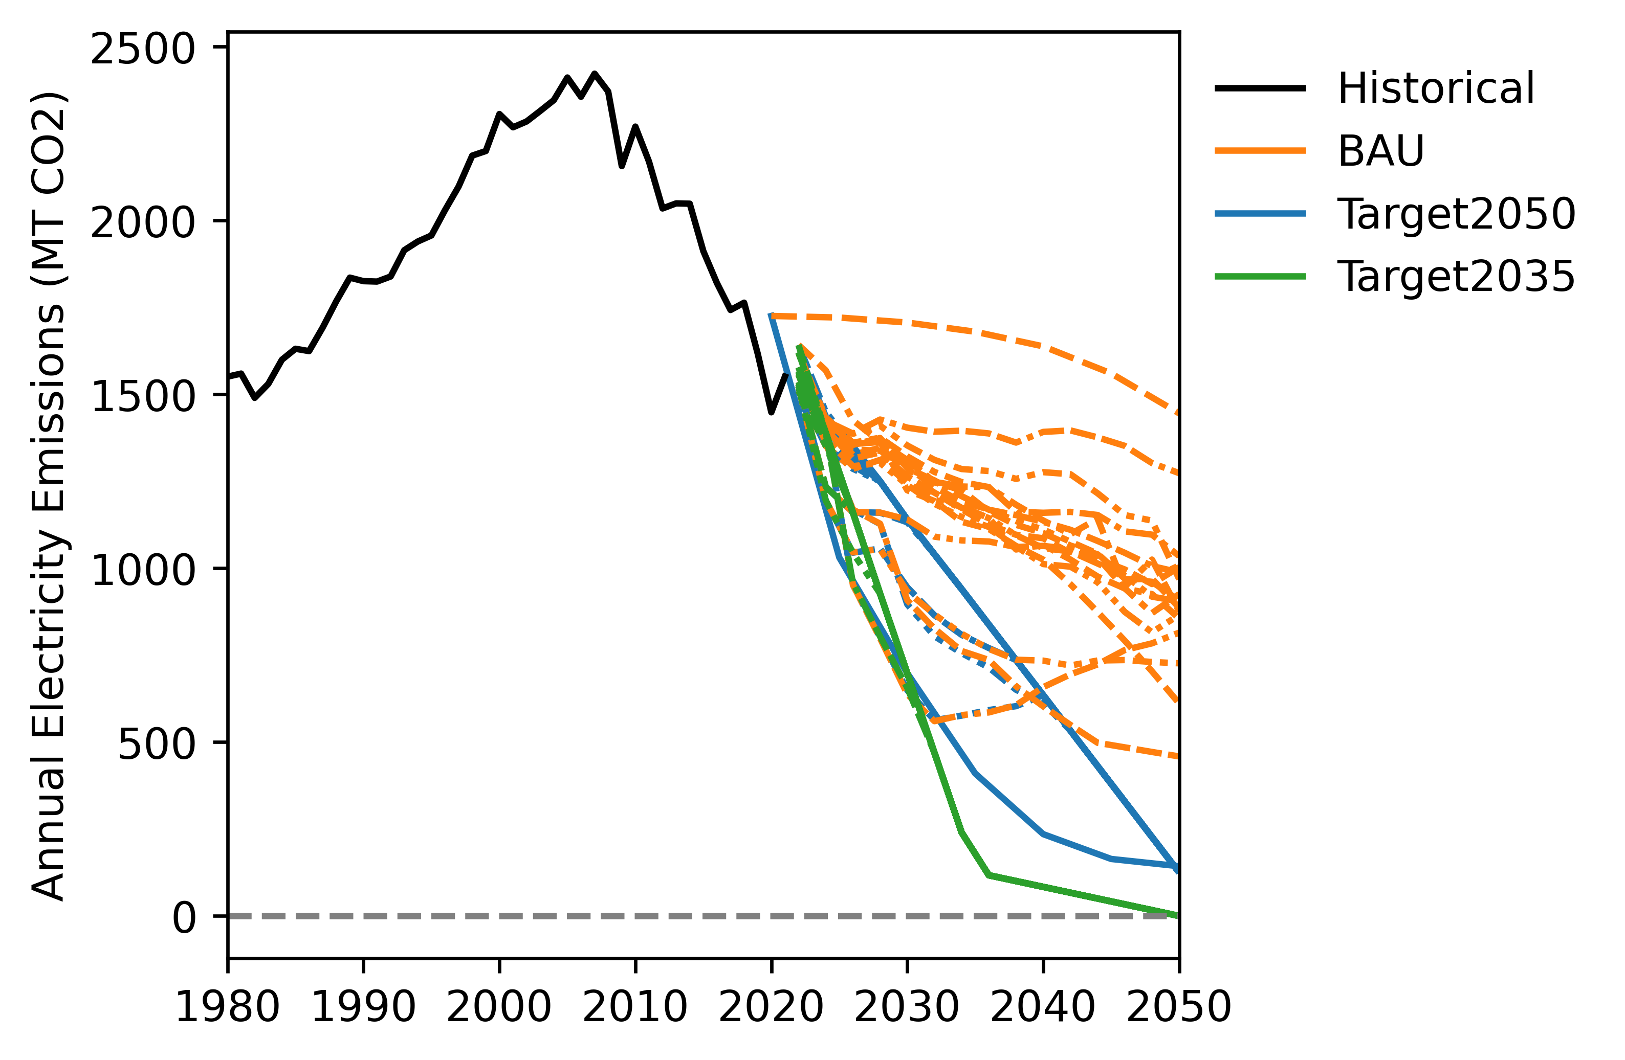

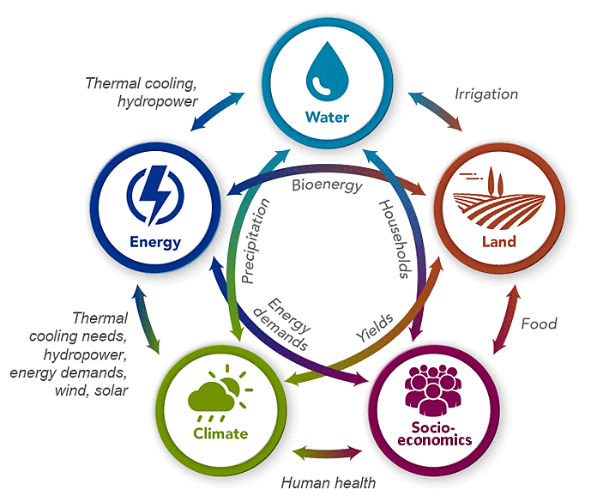
Uncertainties in the power sector
Motivation | Questions | Distribution | Recognition | Path Forward
Regional Energy Deployment System (ReEDS) model
National Renewable Energy Lab
Supply (min cost) and demand (max utilities) equilibrium
143 Balancing Areas in the US
Global Change Analysis Model (GCAM)
Pacific Northwest National Lab
Global integrated assessment model
US state-level details
GCAM
High RE Cost
Low RE Cost
GCAM

Slide 13
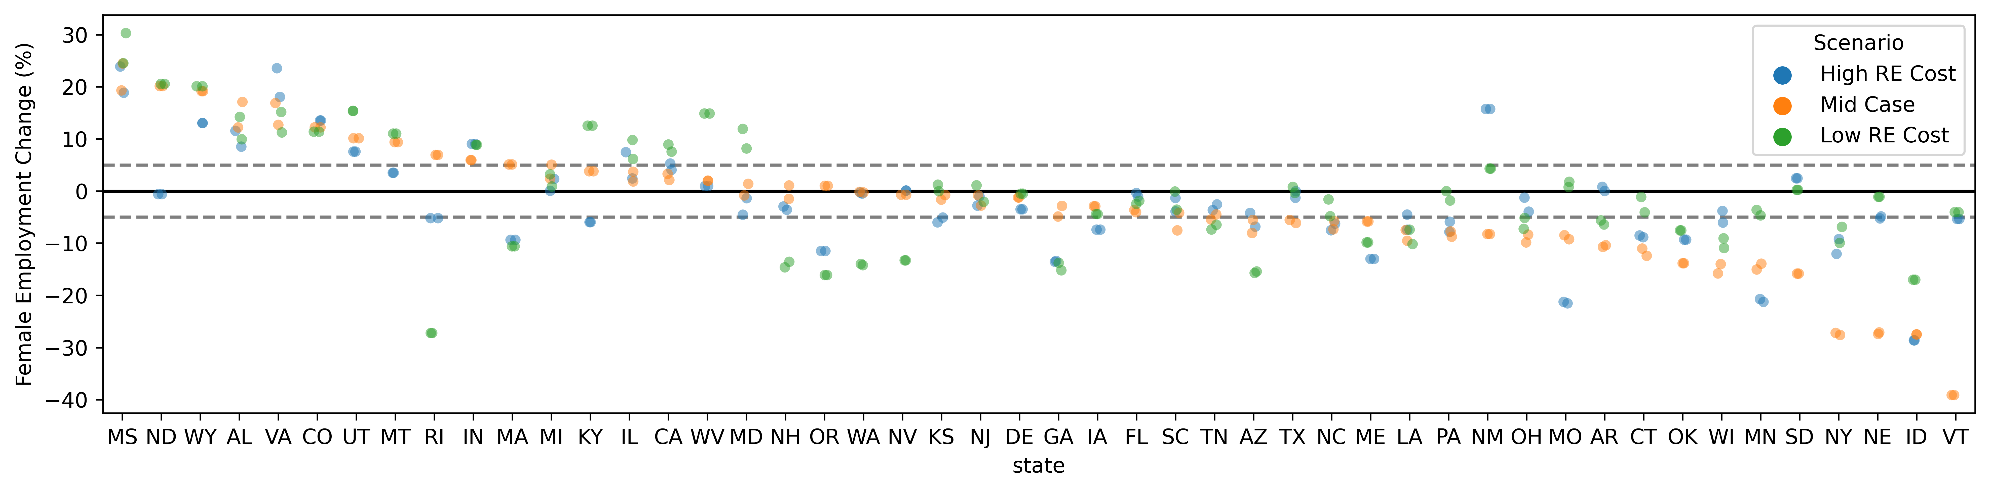
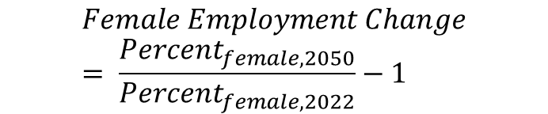
Motivation | Questions | Distribution | Recognition | Path Forward
Business as usual, unusual for women
Large variations across states
The reduced use of coal and increased use of RE encourages employment in sectors with more women
Construction related fields employ less women
$$Female Employment Change= \frac{{Percent}_{female,2050}}{{Percent}_{female,2022}}−1$$

Slide 14
3. Modelling local attitude-driven energy transitions

Slide 15
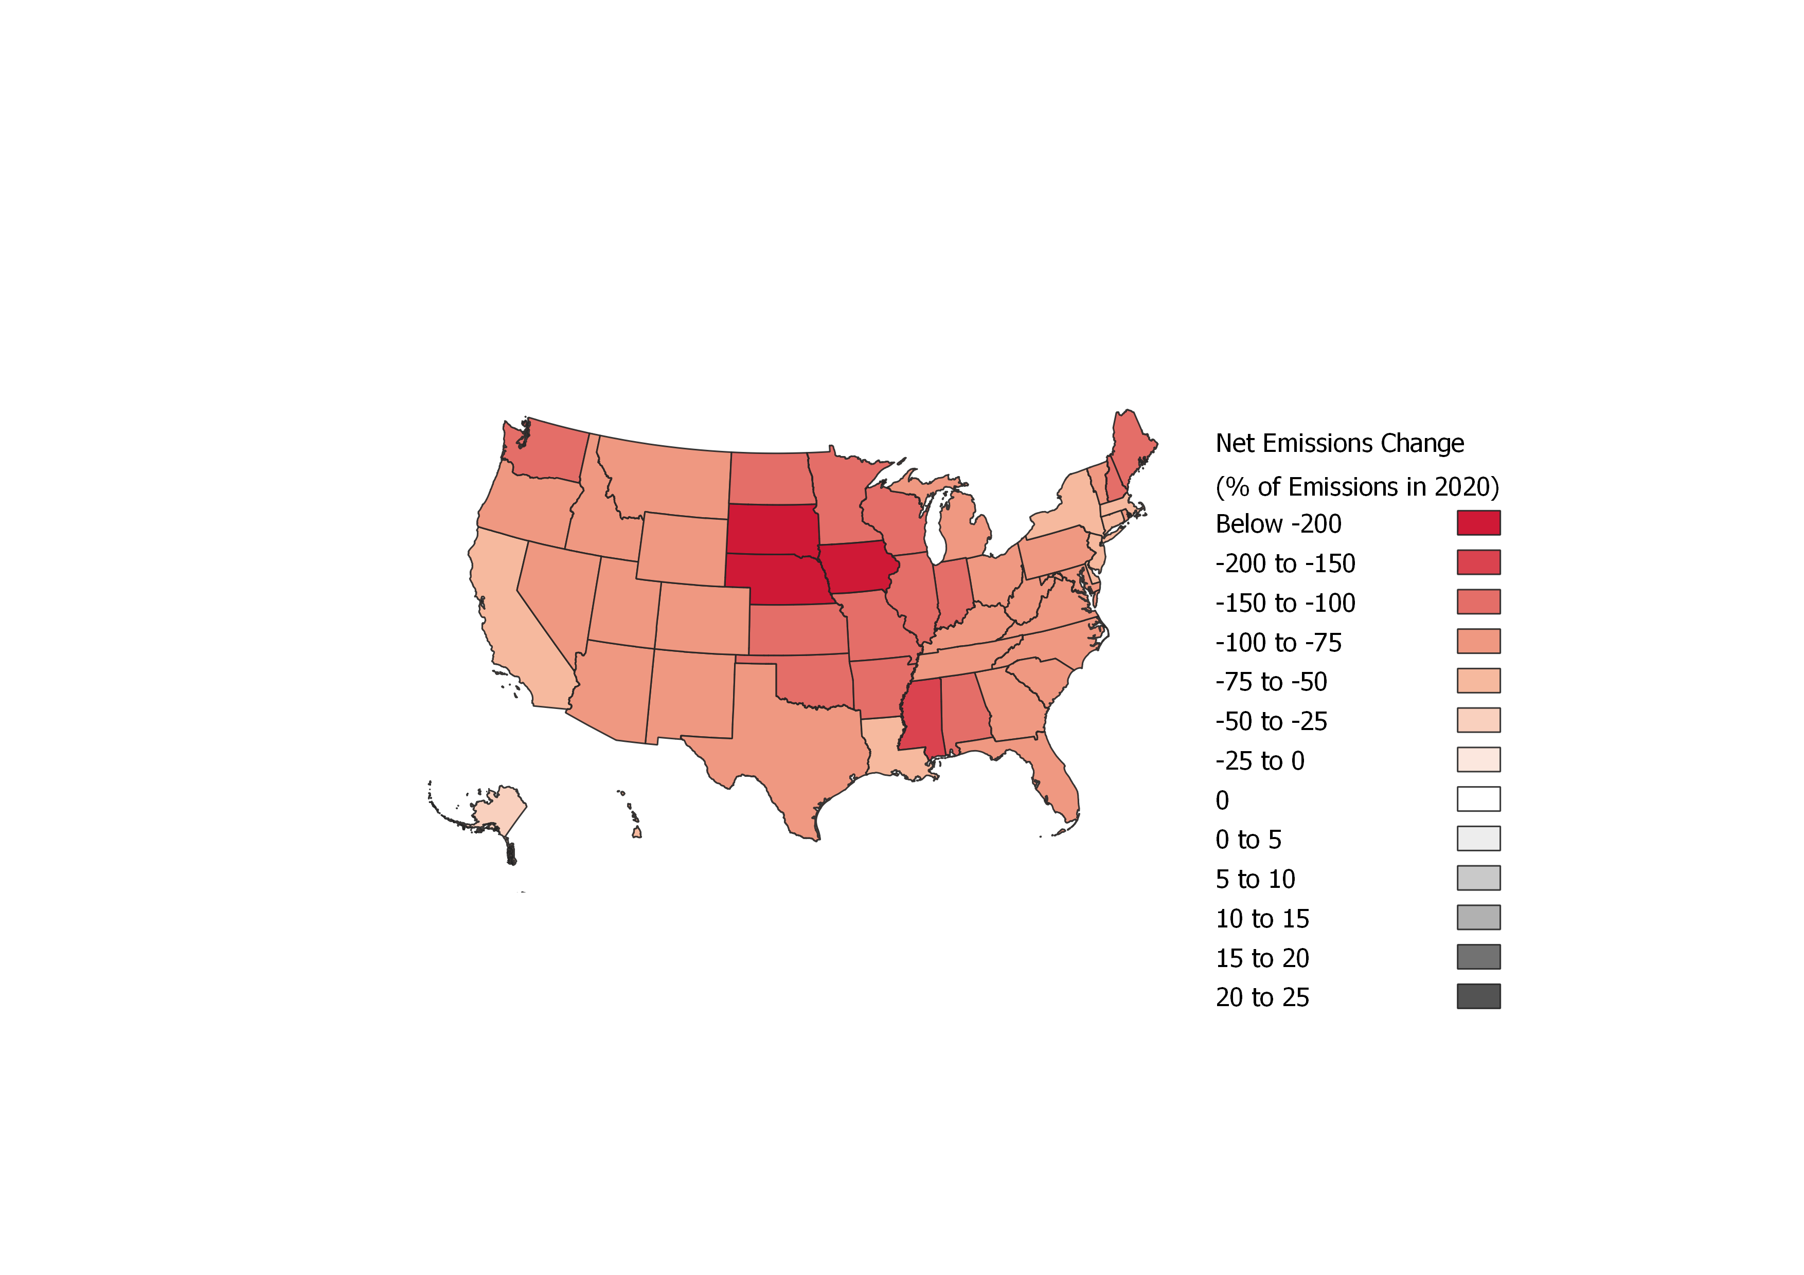
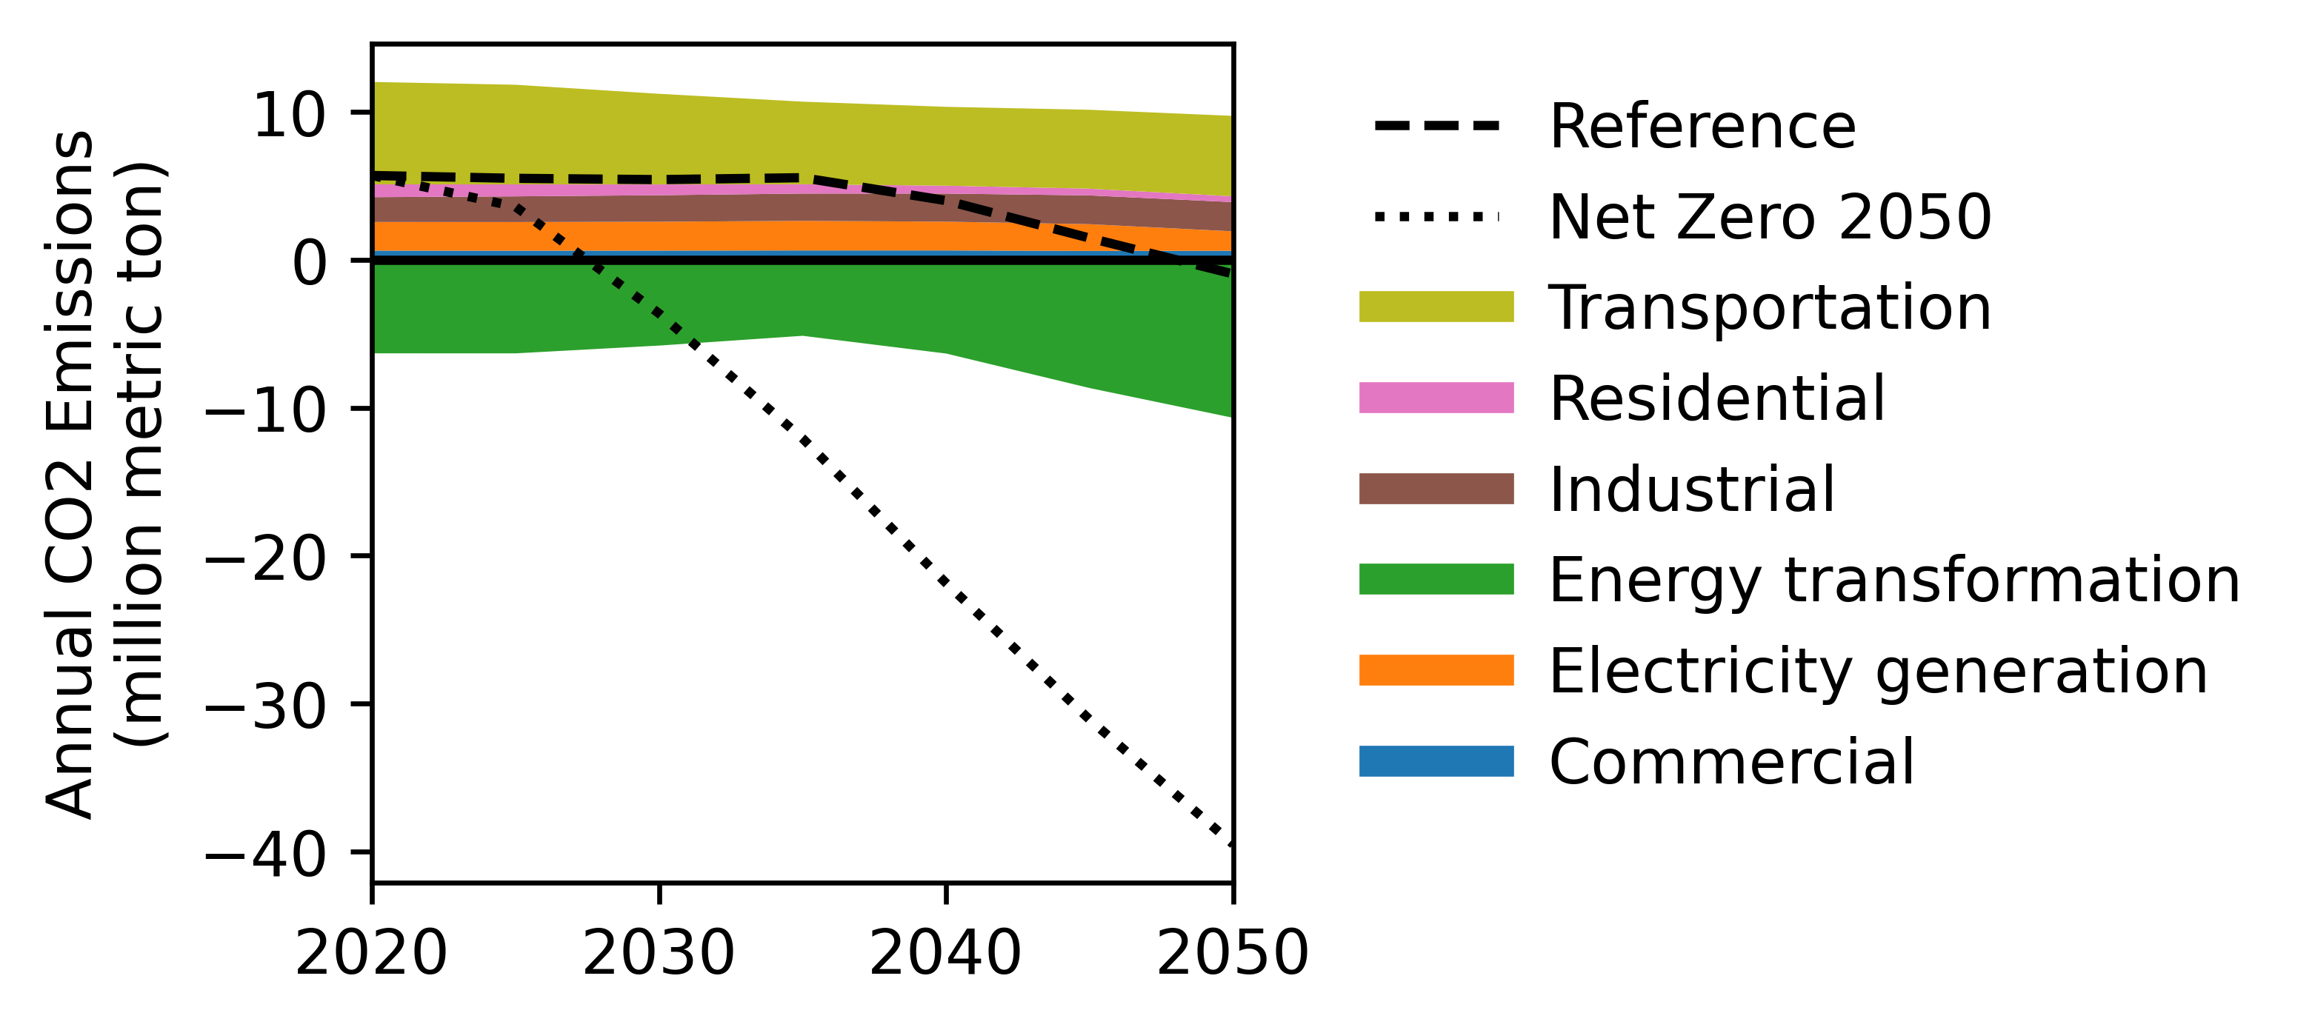
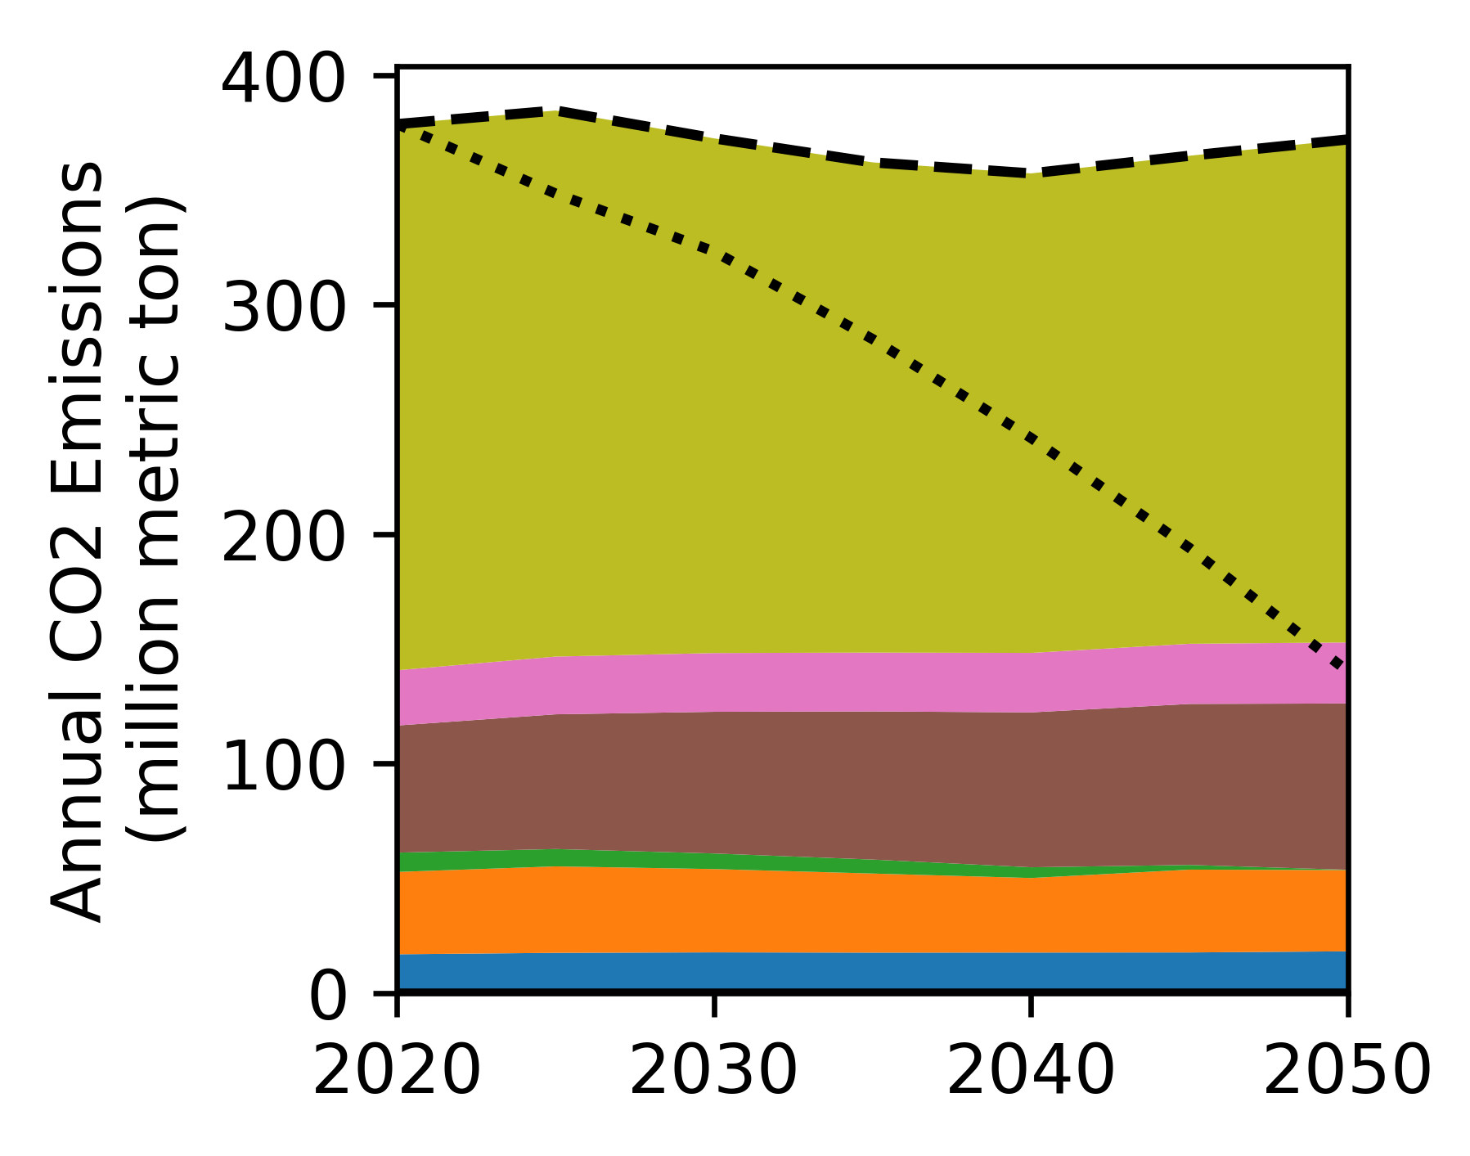
If there is a national carbon price…
Motivation | Questions | Distribution | Recognition | Path Forward
SD
SD
?
CA
CA
(Data source: GCAM model results)
?

Slide 16
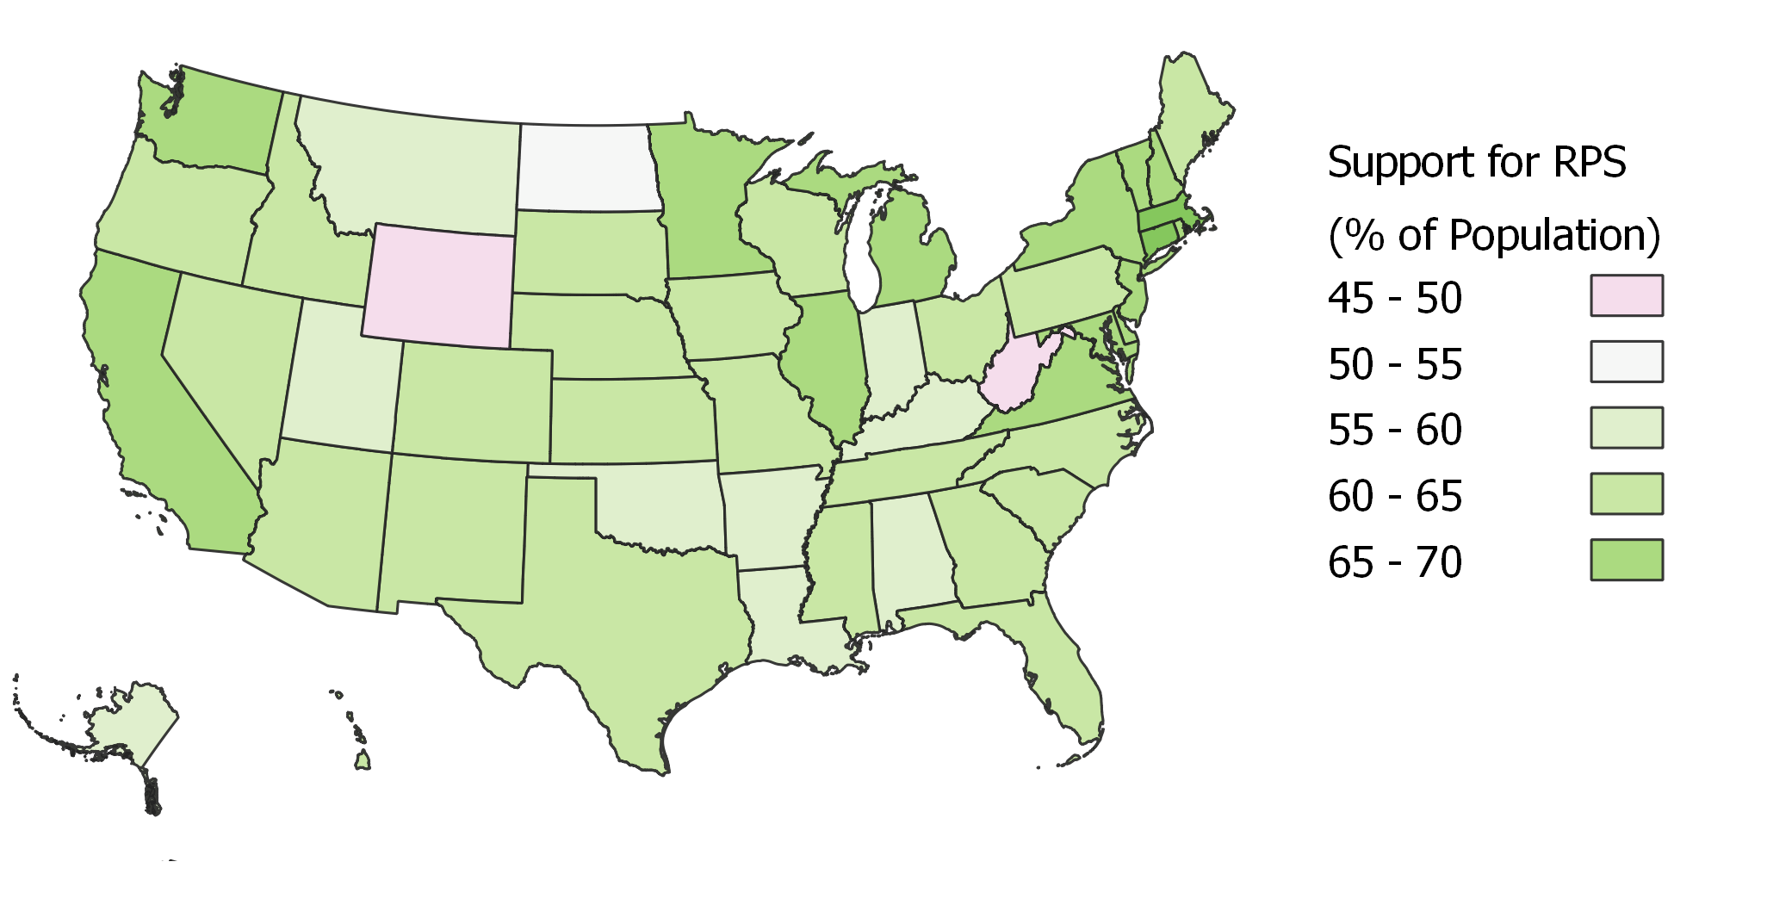
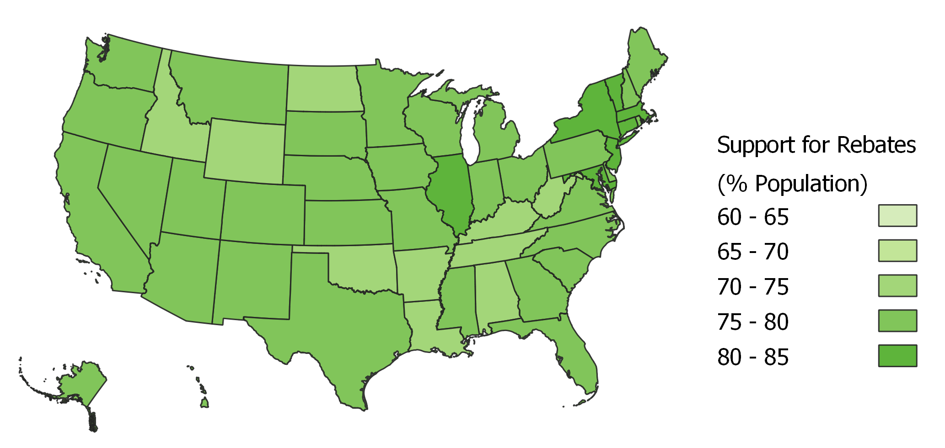
Reality: varying policy support
Motivation | Questions | Distribution | Recognition | Path Forward
% of adults who support requiring utilities to produce 20% electricity from renewable sources. The national average is 64%. (Data source: Yale Climate Opinion Maps 2021, Howe et al. 2015)
% of adults who support providing tax rebates for people who purchase energy-efficient vehicles or solar panels. The national average is 77%. (Same data source)

Slide 17
4. Path forward

Slide 18
Next Steps
Motivation | Questions | Distribution | Recognition | Path Forward
Complete the distributional impact analyses on all available model scenarios
Review USA state-level surveys on behavioural change
Discuss intended modelling methods with psychologists and social scientists

Slide 19

Merging “two worlds”?
Motivation | Questions | Distribution | Recognition | Path Forward
Distribution
Recognition
Procedure

Slide 20
Thank you!
j.xie20@imperial.ac.uk
Twitter @judyjwxie

Slide 21
Acknowledgements
Joeri Rogelj and the Climate Science and Policy Group
Iain Staffell and the Staffell Research Group
Melissa Martin, E4Tech
Gokul Iyer, Pacific Northwest National Laboratory
Wei Peng, Penn State
Anjali Sharma, Penn State
Leon Clarke, University of Maryland
Shivika Mittal, Grantham Institute

Slide 22
Reference
Walker, G. (2009) “Beyond Distribution and Proximity: Exploring the Multiple Spatialities of Environmental Justice,” Antipode. DOI: 10.1111/j.1467-8330.2009.00691.x
Jenkins, K. et al. (2016) “Energy justice: A conceptual review,” Energy Research & Social Science. DOI: 10.1016/j.erss.2015.10.004
Süsser, D. et al. (2021) “Model-based policymaking or policy-based modelling? How energy models and energy policy interact,” Energy Research & Social Science. DOI: 10.1016/j.erss.2021.101984
Krumm, A. et al. (2022) “Modelling social aspects of the energy transition: What is the current representation of social factors in energy models?” Energy. DOI: 10.1016/j.energy.2021.121706
Rogelj, J. (2013) “Uncertainties of low greenhouse gas emission scenarios,” Doctoral Thesis, ETH Zurich, Switzerland.
IRENA (2019) “Renewable Energy: A Gender Perspective” IRENA, Abu Dhabi.
US Department of Labor (2019) “Percentage of women workers in science, technology, engineering, and math (STEM)” Link:https://www.dol.gov/agencies/wb/data/occupations-stem?_ga=2.25754357.979025751.1655142867-1412523775.1655142867
Marlon, J. et al. (2021). Yale Climate Opinion Maps. https://climatecommunication.yale.edu/visualizations-data/ycom-us/
Howe, P., Mildenberger, M., Marlon, J., & Leiserowitz, A. (2015) “Geographic variation in opinions on climate change at state and local scales in the USA,” Nature Climate Change. DOI: 10.1038/nclimate2583

Slide 23
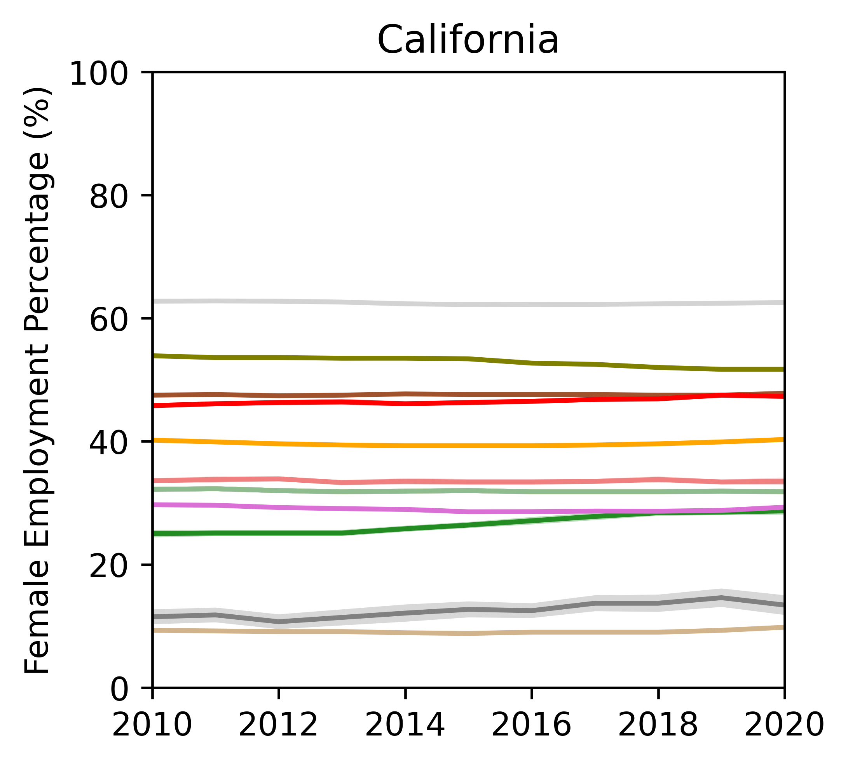
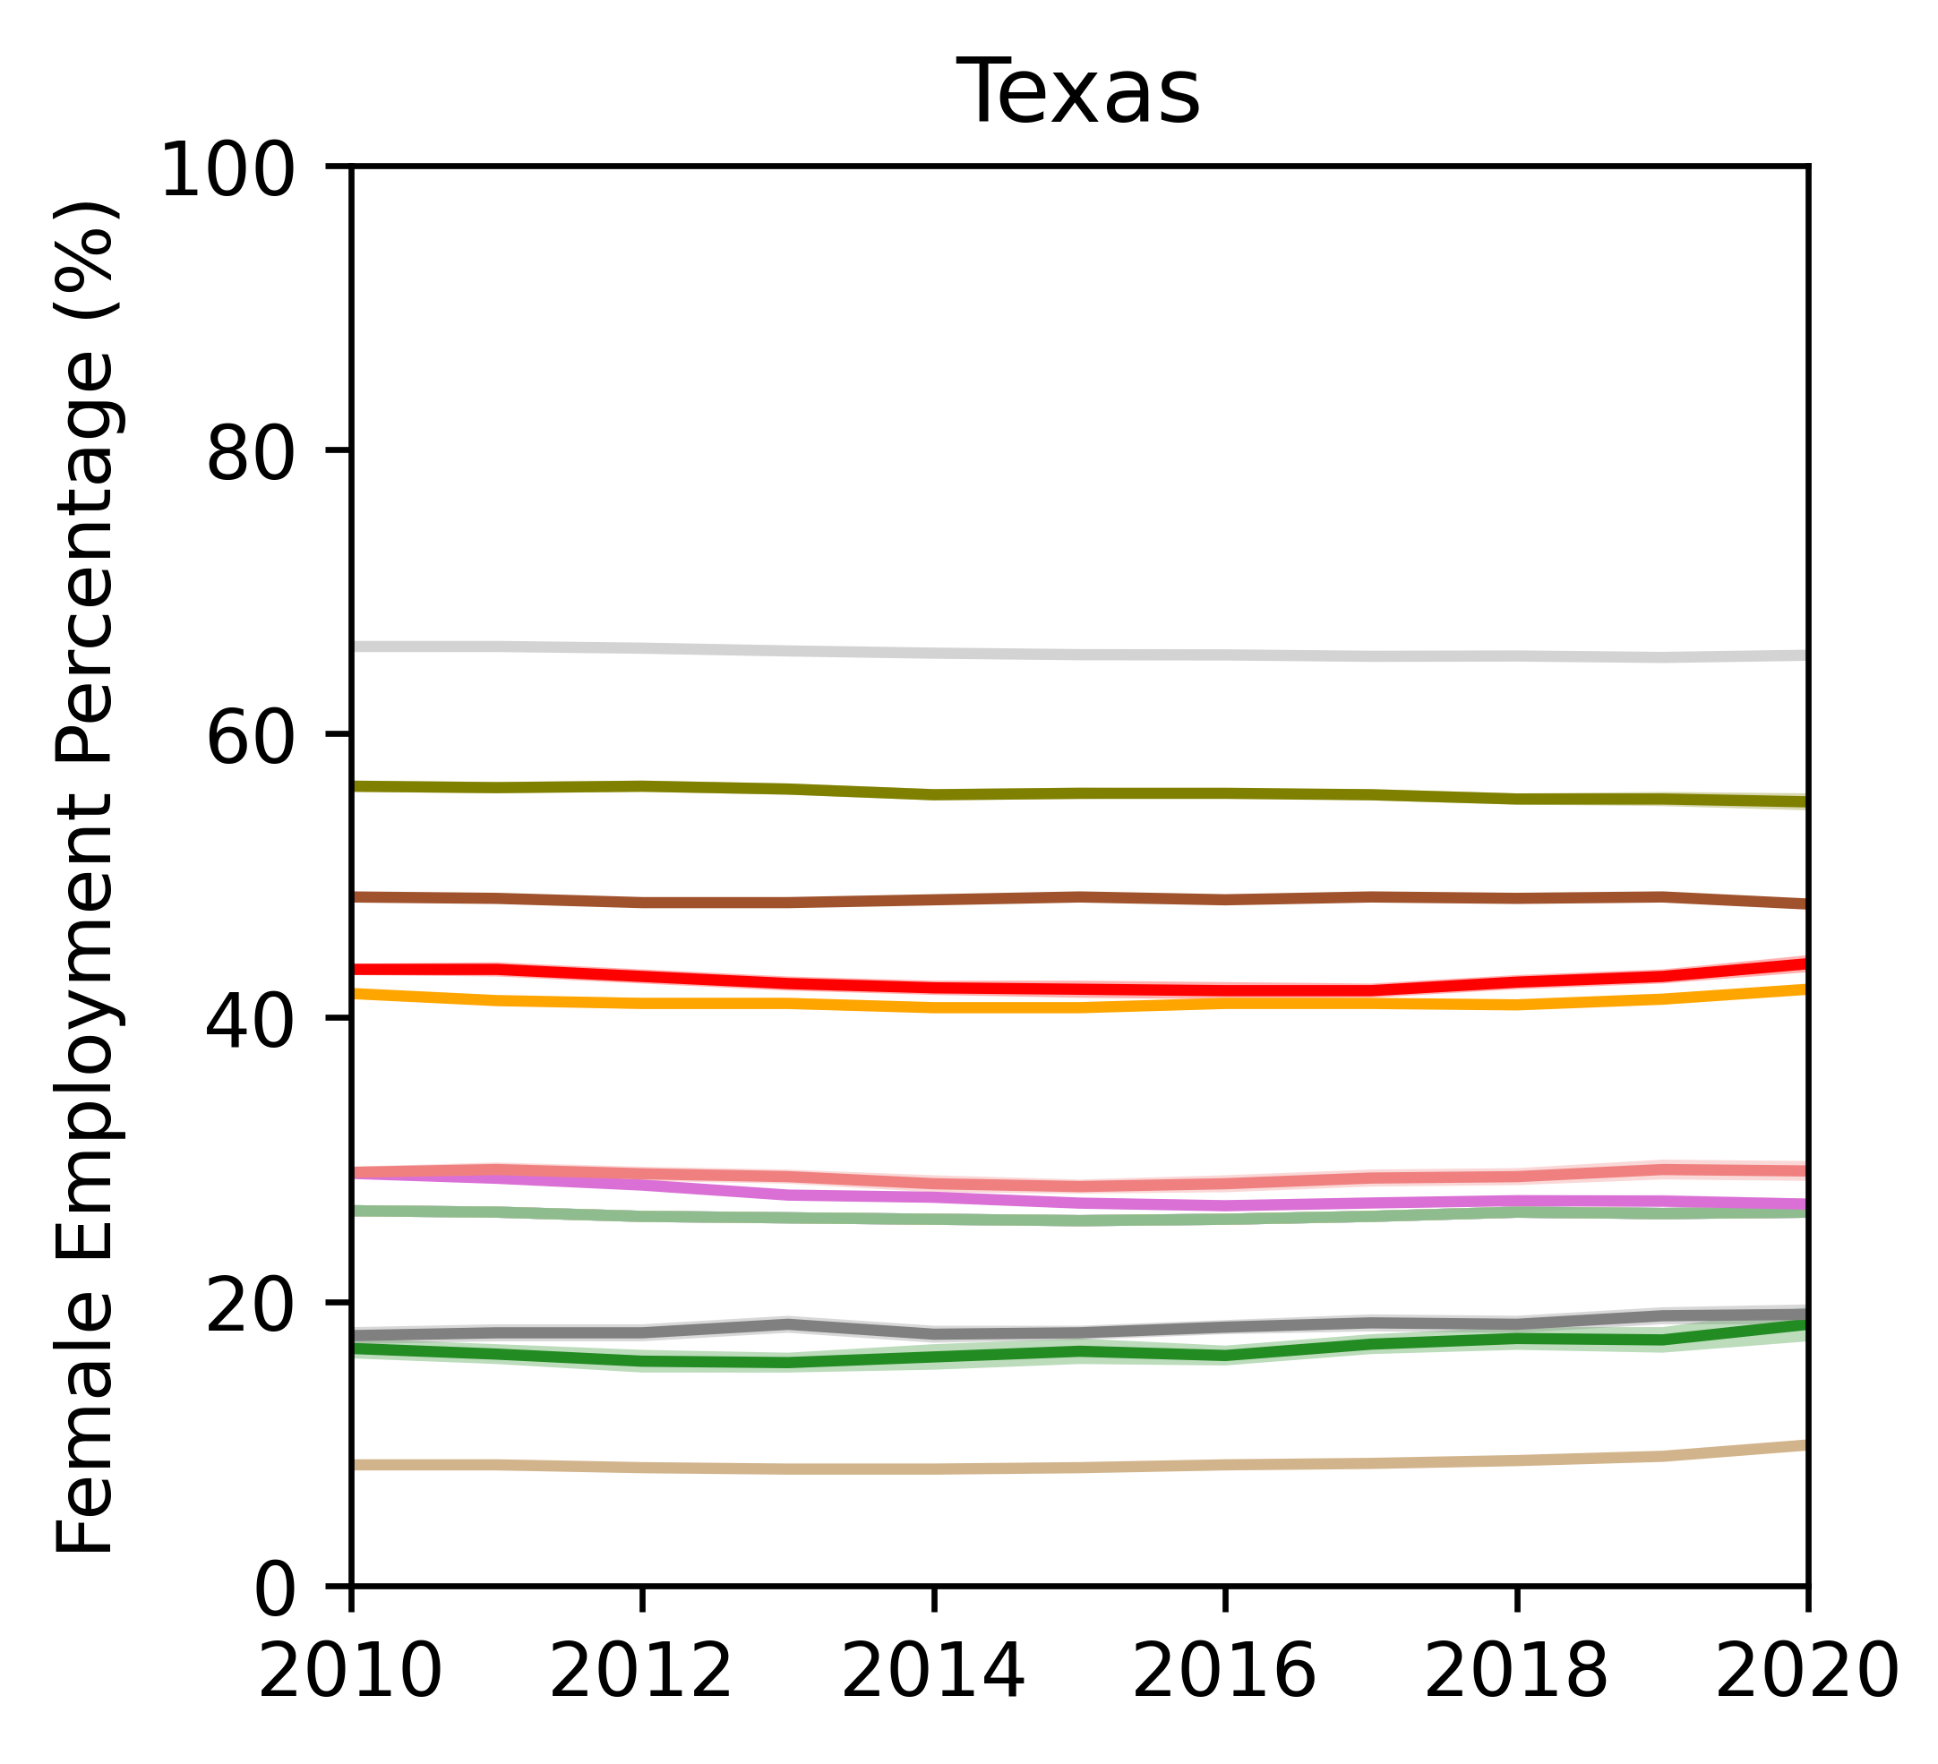
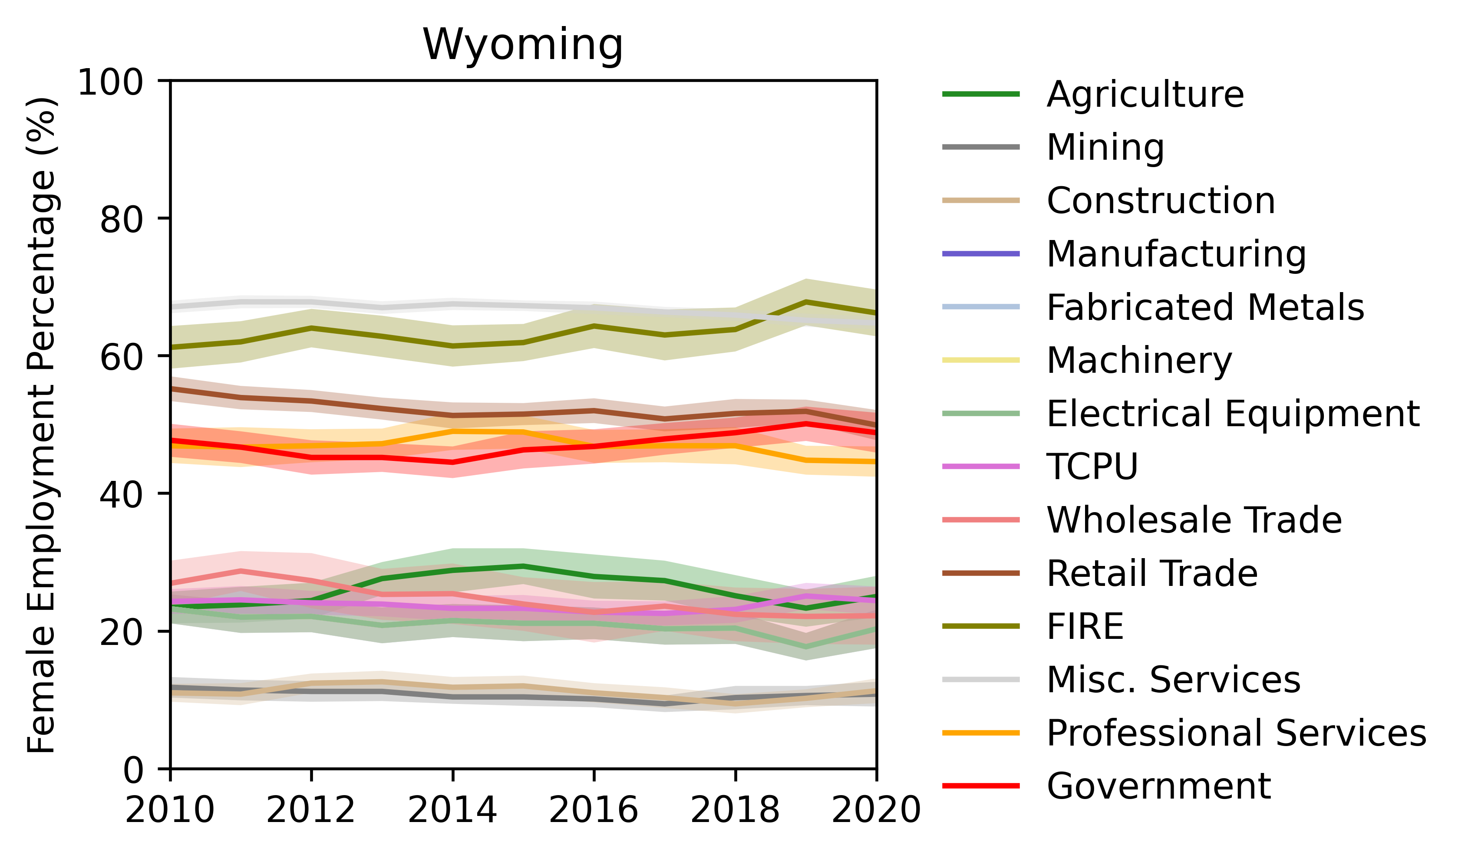
Regional variations
Misc. Services = Education, health care, and social assistance + arts and entertainment + other services
TCPU = Transportation, communications, public utilities
FIRE = Finance, insurance, real estate
Mining, construction, and agriculture employ the lowest amount of women
Population variations: California 39.35 million, Texas 28.64 million, Wyoming 0.58 million

