Slide 1
Assessing socio-ecological drivers of fire regimes in the Brazilian Amazon in a context of varying governance of natural resources
PhD candidate: Michel Valette
Supervision: Morena Mills, Jeremy Woods and Yiannis Kountouris
Other members of the project: Anna Freni Sterrantino, Minerva Singh

Slide 2
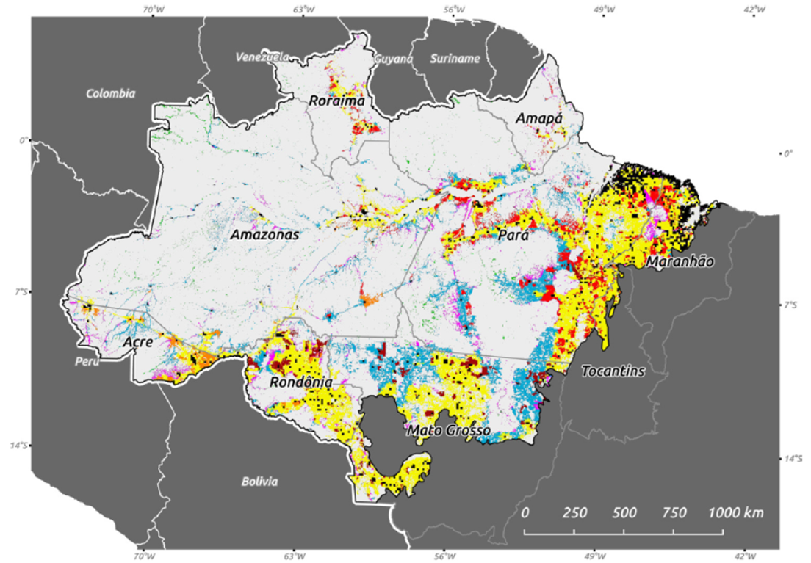
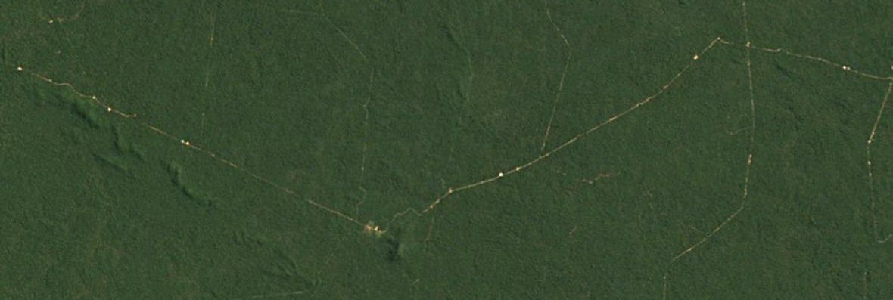
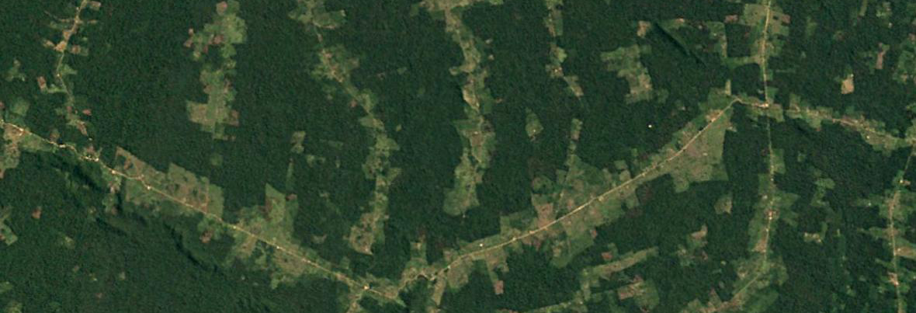
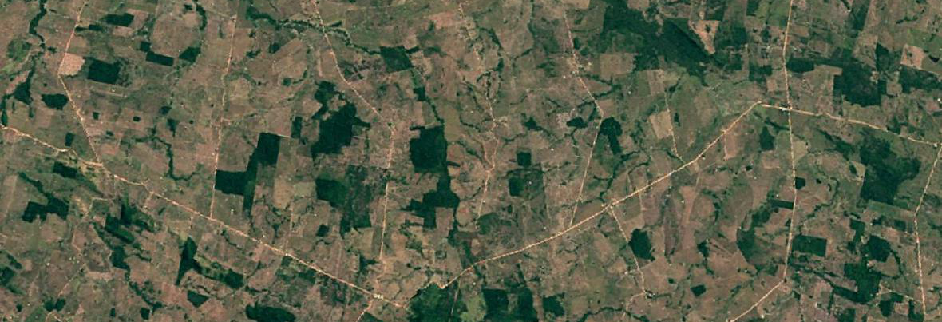
Land use change in the Brazilian Amazon
Road opening
Pasture expansions (new frontiers)
Frontier consolidation
Map of the old deforestation frontiers (yellow), new deforestation frontieres (blue) and settlement areas (red) in the Brazilian Amazon, From Schielein et Böner (2018)

Slide 3
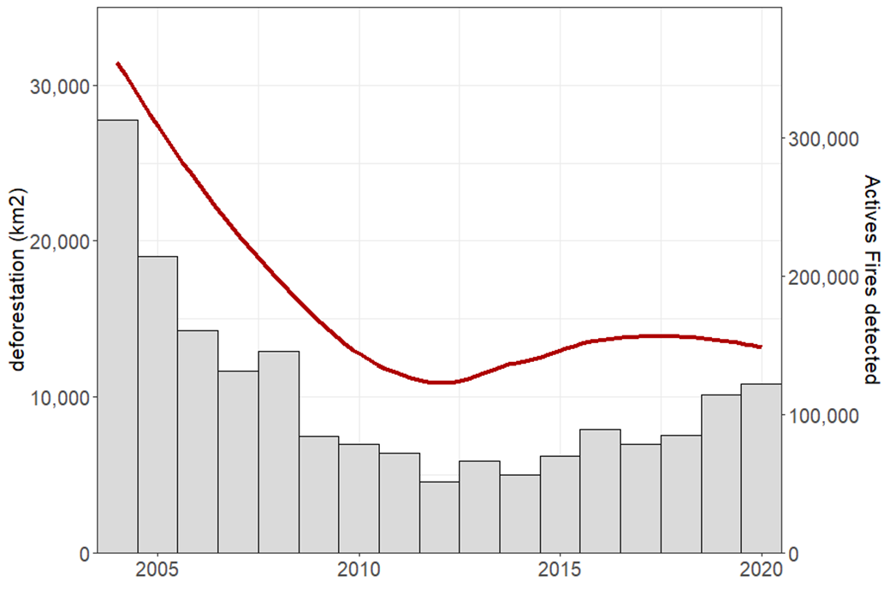

Conservation framework
Conservation reform adopted in 2004 drastically decreased deforestation rates in the next decade
Since 2016, the federal government has been dismantling the conservation framework by :
  Pro-deforestation rhetoric
  Legislative changes
  Disempowerment of institutions controlling deforestation
  Land titles granted to illegal squatters
Deforestation in the Brazilian Legal Amazon (grey) and smoothed average of the number of active fires detected by MODIS satellites for the 2004-2020 period

Slide 4
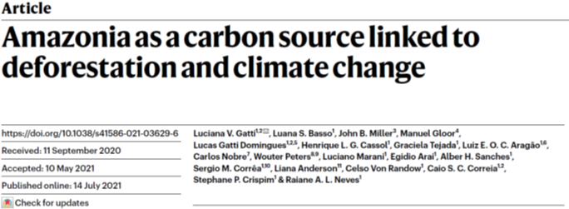
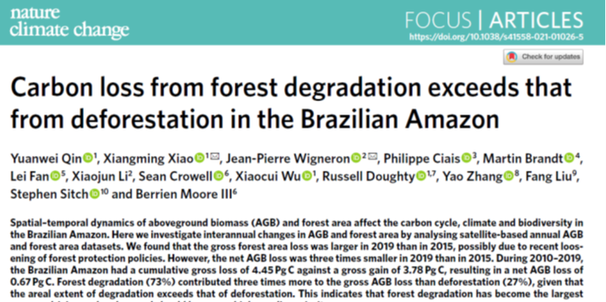
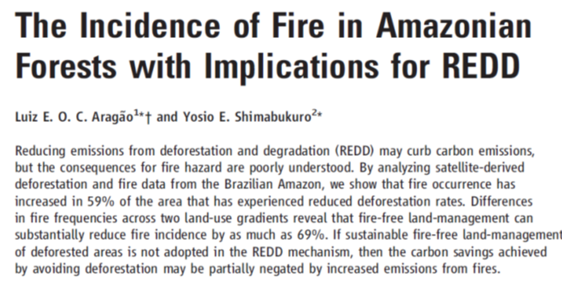
Decoupling of deforestation and forest degradation
Forest degradation represents more than 70% of above-ground biomass loss of the Brazilian Amazon for the last decade (Qin et al. 2021)
Feedbacks between deforestation, forest degradation and precipitations bringing the Amazon forest close to a massive dieback
Fires could catalyse the forest dieback by increasing turnover of vegetation communities and favour fire-resistant species associated with seasonal forest and savannas (Malhi et al. 2009)

Slide 5
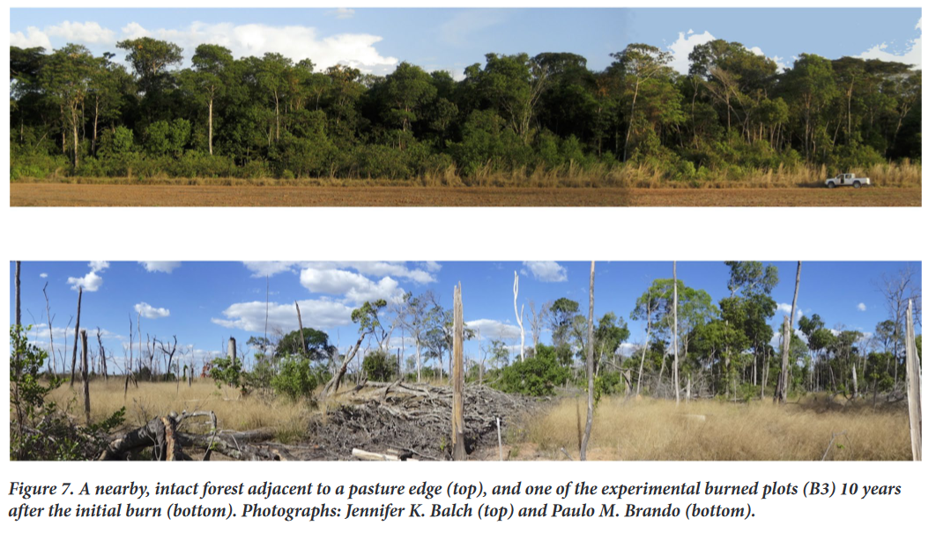
Decoupling of deforestation and forest degradation
Intact forest (top) and experimental plot after 3 burn cycle (bottom). Balch et al. 2015

Slide 6
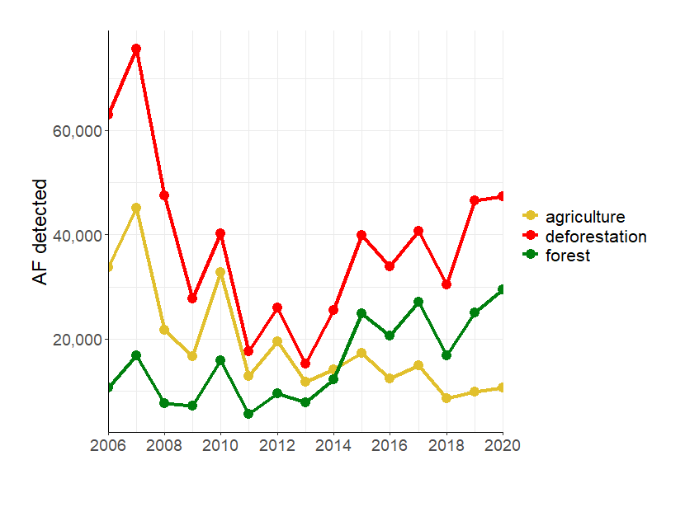
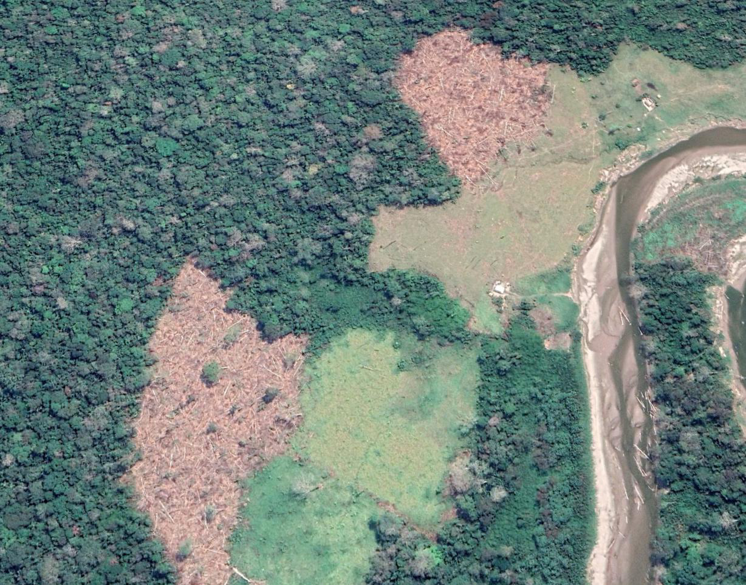



Typology of fires
Actives fires detected by satellite classified thanks to land use and deforestation datasets (>6.5ha)
Number of active fires classified in the different categories for 2006 - 2020

Slide 7
Research questions and methods
What are the drivers of deforestation fires, agricultural fires and forest fires in the Brazilian Amazon?
How did their influence evolve over different phases of governance of forest resources?
What were the influences of anti-deforestation policies on the fire regimes?
Approach: Use of Bayesian Generalized Additive model with a spatio-temporal component, capturing the variance in responses variable which is poorly explained by explanatory variables and avoid wrong estimation of model parameters
Based on INLA-SPDE framework, efficient for computing large-scale spatial models

Slide 8
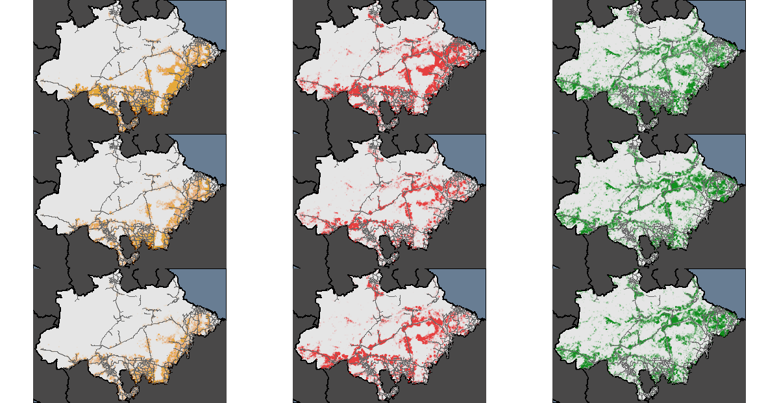
Methods
Three periods:
  2006-2010: deployment of
  anti-deforestation policies
  2011-2015: consolidation of
  anti-deforestation policies
  2016-2020: dismantlement of
  anti-deforestation policies
Category of drivers:
  Climatic conditions
  Agricultural land use
  Ecosystem integrity
  Infrastructure
  Environmental policies
  2006-2010
  2011-2015
  2016-2020
Agricultural fires
Deforestation fires
Forest fires

Slide 9
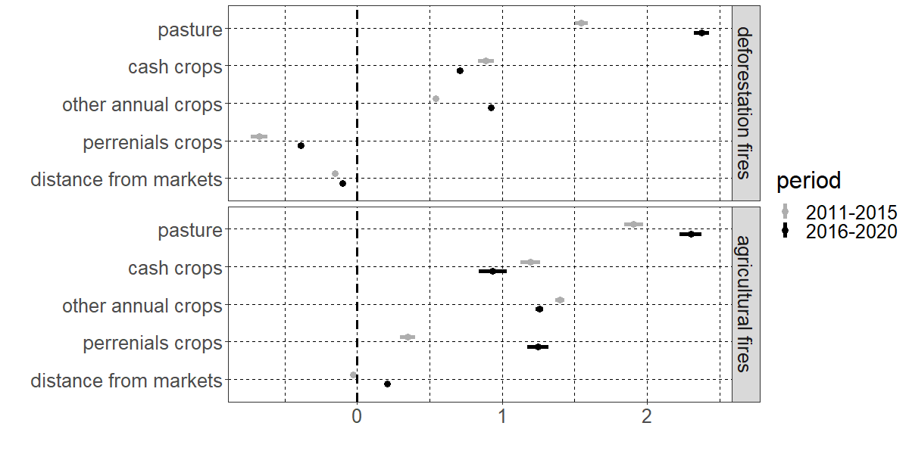
Results – fires regimes and agricultural systems
Confidence intervals of the explanatory variables of the model for deforestation and agricultural fires. Intervals higher than zero indicate an increase in fires occurrence, and inferior to zero a decrease in fires occurrences

Slide 10
Results
Less fires
More fires
Confidence interval of the explanatory variables of the model for deforestation and agricultural fires. Intervals higher than zero indicate an increase in fires occurrence, and inferior to zero a decrease in fires occurrences

Slide 11
Results – fires regimes and agricultural systems
Confidence intervals of the explanatory variables of the model for deforestation and agricultural fires. Intervals higher than zero indicate an increase in fires occurrence, and inferior to zero a decrease in fires occurrences

Slide 12
Results – fires regimes and agricultural systems
Confidence intervals of the explanatory variables of the model for deforestation and agricultural fires. Intervals higher than zero indicate an increase in fires occurrence, and inferior to zero a decrease in fires occurrences

Slide 13
Results – fires regimes and agricultural systems
Confidence intervals of the explanatory variables of the model for deforestation and agricultural fires. Intervals higher than zero indicate an increase in fires occurrence, and inferior to zero a decrease in fires occurrences

Slide 14
Results – fires regimes and agricultural systems
Confidence intervals of the explanatory variables of the model for deforestation and agricultural fires. Intervals higher than zero indicate an increase in fires occurrence, and inferior to zero a decrease in fires occurrences

Slide 15
Results – fires regimes and agricultural systems
Confidence intervals of the explanatory variables of the model for deforestation and agricultural fires. Intervals higher than zero indicate an increase in fires occurrence, and inferior to zero a decrease in fires occurrences

Slide 16
Results – fires regimes and agricultural systems
Confidence intervals of the explanatory variables of the model for deforestation and agricultural fires. Intervals higher than zero indicate an increase in fires occurrence, and inferior to zero a decrease in fires occurrences

Slide 17
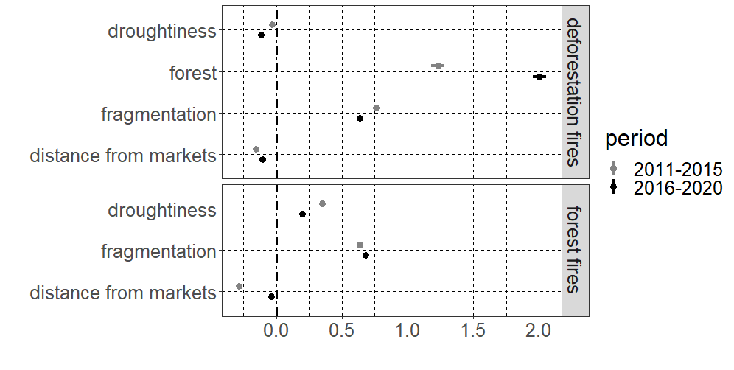
Results – ecosystems integrity
Confidence intervals of the explanatory variables of the model for deforestation and forest fires. Intervals higher than zero indicate an increase in fires occurrence, and inferior to zero a decrease in fires occurrences

Slide 18
Results – ecosystems integrity
Confidence intervals of the explanatory variables of the model for deforestation and forest fires. Intervals higher than zero indicate an increase in fires occurrence, and inferior to zero a decrease in fires occurrences

Slide 19
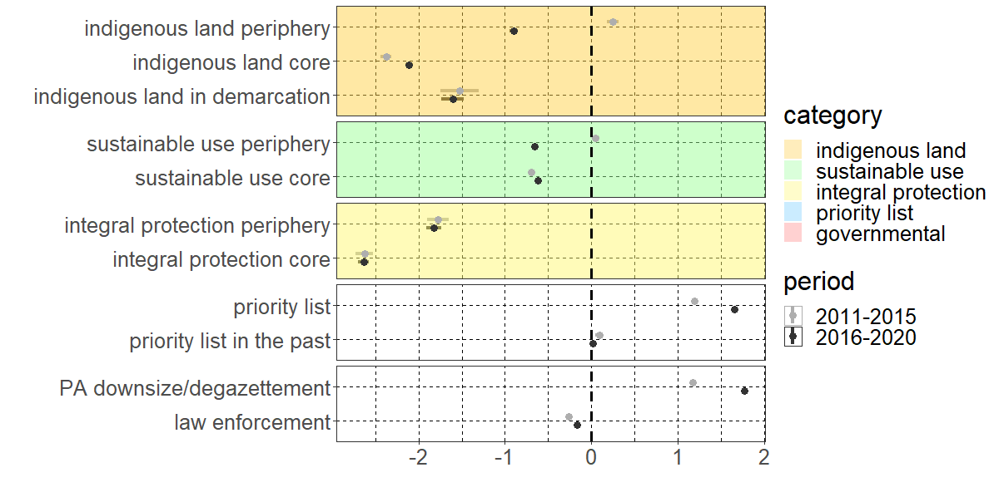
Results – environmental policies
Confidence intervals of the explanatory variables of the model for deforestation fires. Intervals higher than zero indicate an increase in fires occurrence, and inferior to zero a decrease in fires occurrences

Slide 20
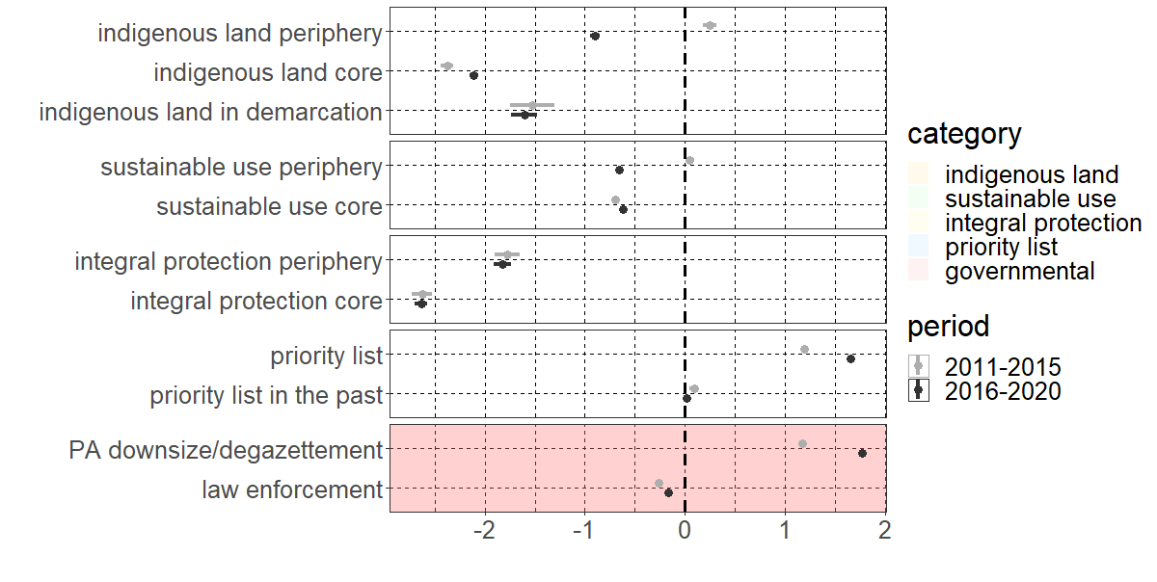
Results - environmental policies
Confidence intervals of the explanatory variables of the model for deforestation fires. Intervals higher than zero indicate an increase in fires occurrence, and inferior to zero a decrease in fires occurrences

Slide 21
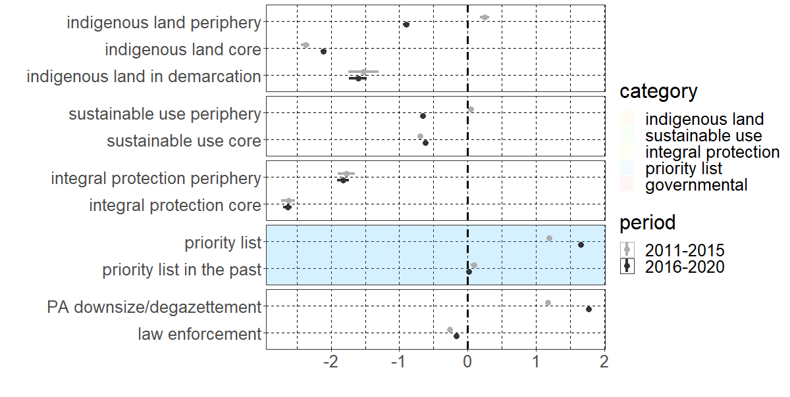
Results - environmental policies
Confidence intervals of the explanatory variables of the model for deforestation fires. Intervals higher than zero indicate an increase in fires occurrence, and inferior to zero a decrease in fires occurrences

Slide 22
Key points
Contrasting fire regimes between new deforestation frontiers and consolidated deforestation frontiers
Recent increase in deforestation fires associated to expansions of pastoralism in remote parts of the landscape
Fragmentation of remaining forests is an important driver of forest fires
Indigenous land and integral protected areas are the most efficient protection regimes, but with constant pressure from the outside
Support and law enforcement efforts for municipalities with high deforestation rates can affect fire management practices

Slide 23
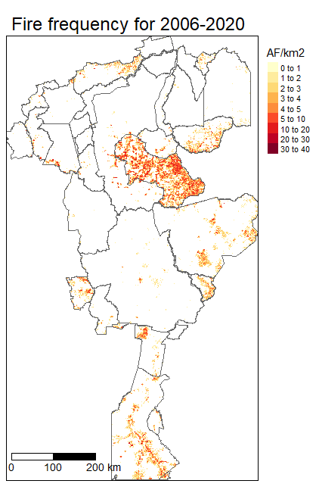
Next chapters: drivers of fire regimes in a network of protected areas
Protected area network of the Xingu basin: 21 indigenous lands , 5 integral protected areas, 9 sustainable use areas
Varying degrees of environmental degradation and fire frequency
Recent pavement of a section of a highway next to the PA network
Research questions:
  What are the drivers of fire regimes in the protected areas?
  How did fire regimes and fire management practices change over the last 20 years?
  Why do certain protected areas experience higher rates of fires than others?
Use of mixed methods approach with interviews and focus groups discussion in a few communities and then spatial modelling exercise to scale-up findings

Slide 24
Thank you for your attention!
Bibliography
Balch, J. K., Brando, P. M., Nepstad, D. C., Coe, M. T., Silvério, D., Massad, T. J., Davidson, E. A., Lefebvre, P., Oliveira-Santos, C., Rocha, W., Cury, R. T. S., Parsons, A., & Carvalho, K. S. (2015). The Susceptibility of Southeastern Amazon Forests to Fire : Insights from a Large-Scale Burn Experiment. BioScience, 65(9), 893‑905. https://doi.org/10.1093/biosci/biv106
Malhi, Y., Aragao, L. E. O. C., Galbraith, D., Huntingford, C., Fisher, R., Zelazowski, P., Sitch, S., McSweeney, C., & Meir, P. (2009). Exploring the likelihood and mechanism of a climate-change-induced dieback of the Amazon rainforest. Proceedings of the National Academy of Sciences, 106(49), 20610‑20615. https://doi.org/10.1073/pnas.0804619106
Qin, Y., Xiao, X., Wigneron, J.-P., Ciais, P., Brandt, M., Fan, L., Li, X., Crowell, S., Wu, X., Doughty, R., Zhang, Y., Liu, F., Sitch, S., & Moore, B. (2021). Carbon loss from forest degradation exceeds that from deforestation in the Brazilian Amazon. Nature Climate Change, 11(5), 442‑448. https://doi.org/10.1038/s41558-021-01026-5
Schielein, J., & Börner, J. (2018). Recent transformations of land-use and land-cover dynamics across different deforestation frontiers in the Brazilian Amazon. Land Use Policy, 76, 81‑94. https://doi.org/10.1016/j.landusepol.2018.04.052

