Slide 1


SUSTAINABILITY TRANSFORMATION OF URBAN WATER SYSTEMS THROUGH THE WHOLE SYSTEMS APPROACH
Wan Izar Haizan Wan Rosely
Supervisor: Prof. Dr. Nikolaos Voulvoulis
CEP PhD Seminar 2022
30 JUN 2022

Slide 2
Introduction
What are the problems?
Sustainability Transformation
A Whole Systems Approach
Research Overview
Aim/Approach
Initial findings
Future Works
Future works
Conclusion

Slide 3
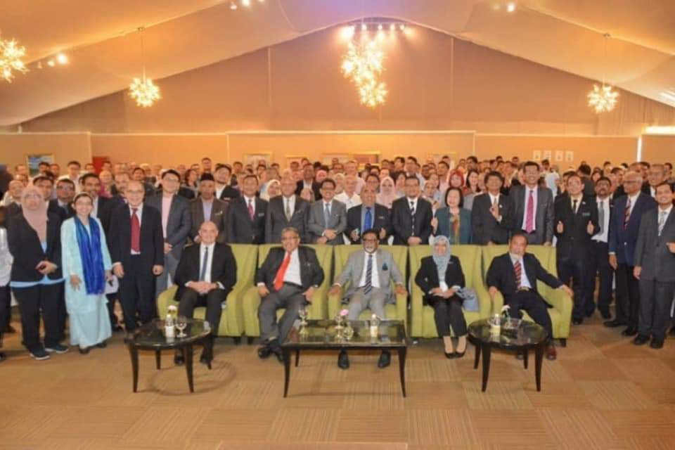
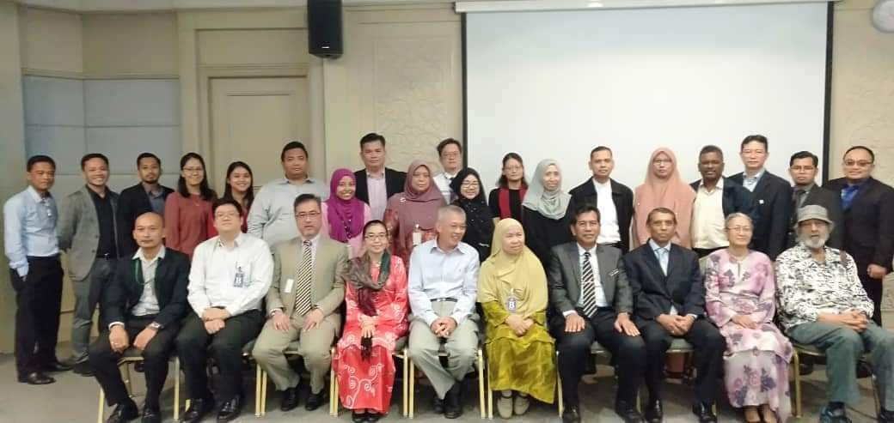
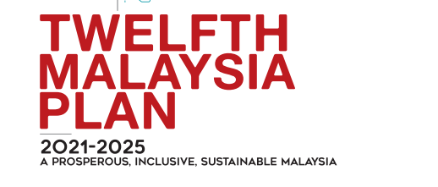
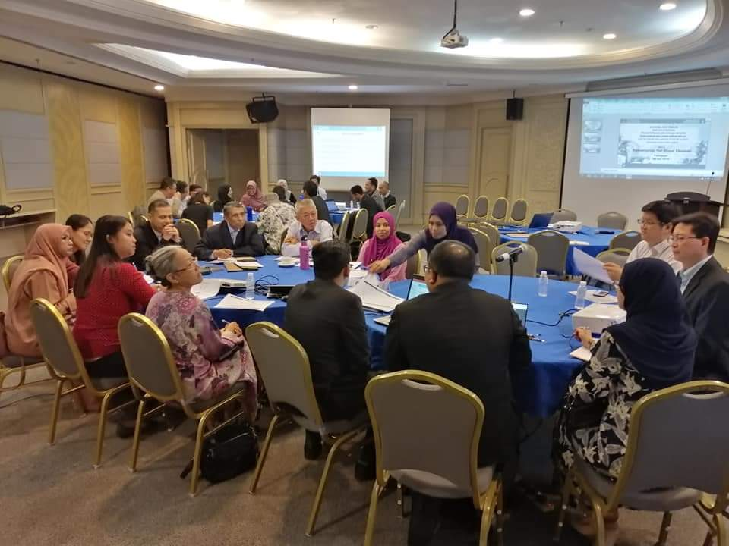
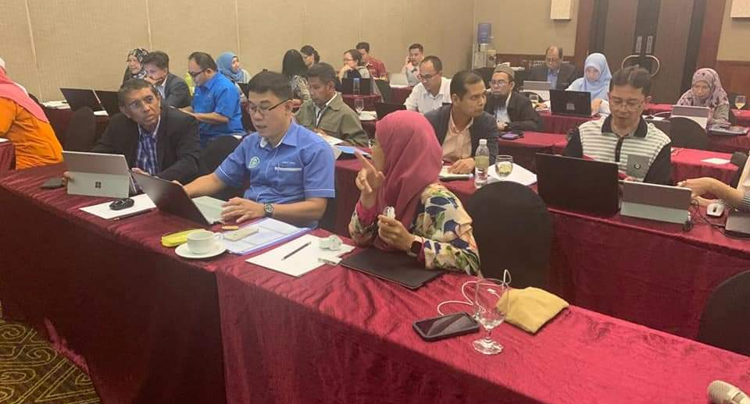
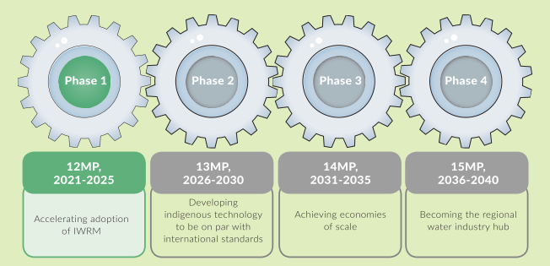
Malaysia’s Water Sector Transformation 2040 (WST 2040)
WST 2040
Water security for all
Water sector as the next dynamic growth engine
NRE
30 sessions (FGD, workshops, public dialogues, meetings) with agencies, NGOs, academicians, businesses (2019-2020)
EPU
Source: EPU, 2019, 2020 and 2020

Slide 4
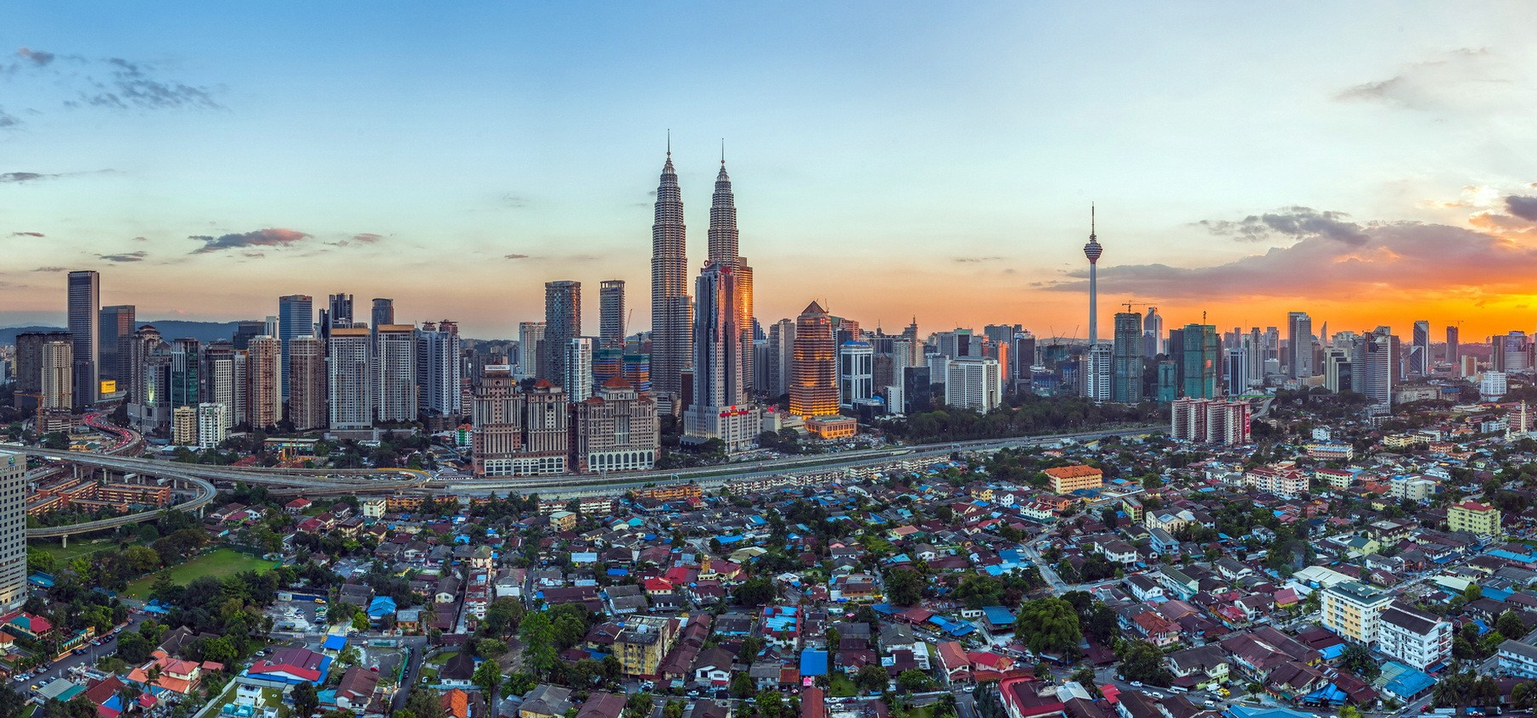
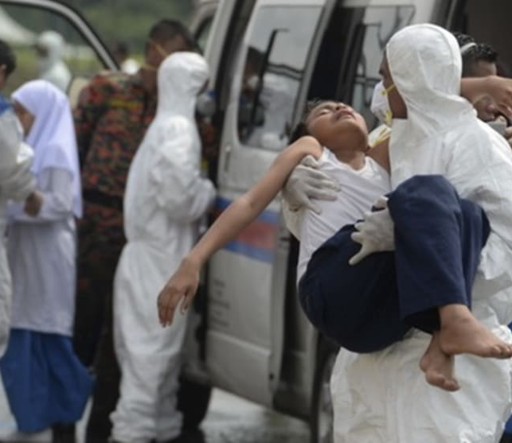
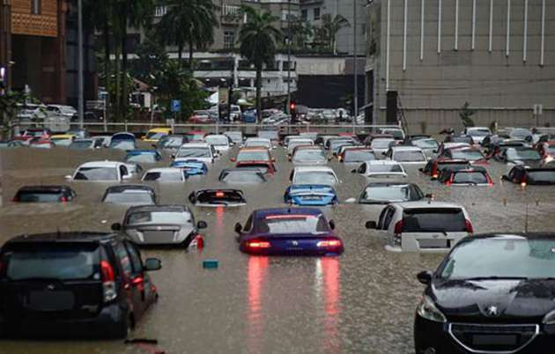
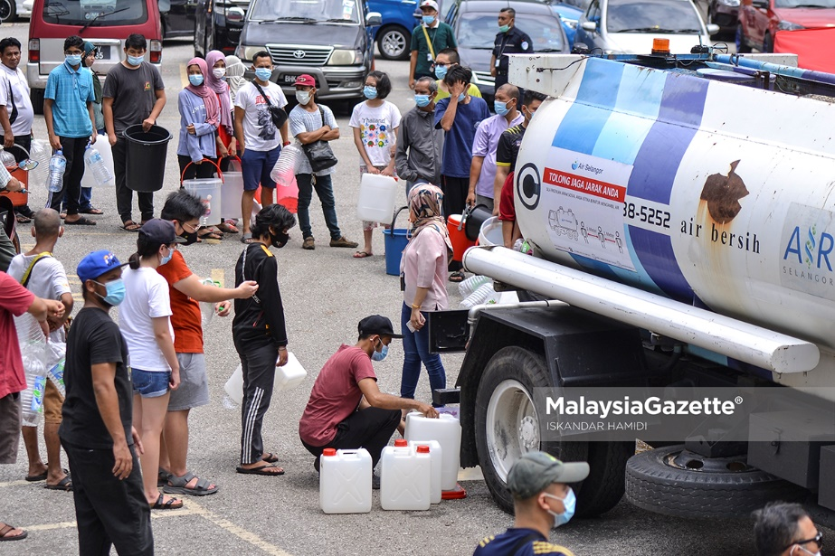
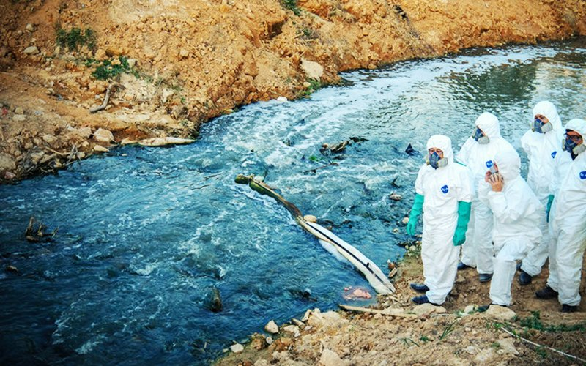
Urban water challenges manifest as urban challenges
Source: Paultan.org
cities are complex systems, not designed to be water-friendly
gather large amounts of humans in a small place
throw off nature’s built-in balances
determine by economic priorities, social and environmental values and ecological understanding
Source:wallpapersdsc.net
Source:channelsnewsasia.com
Source:Paultan.org
Source:freemalaysiatoday.com

Slide 5
The main water challenges discussed
1
Demand, availability and accessibility
6
Climate change
Increasing/uncertainty on demand, competing demand, water availability/scarcity, lack access to water services, slums issues, underutilisation of water resources
Extreme weather events and climate change impacts, increased vulnerability of water assets/ reduce systems efficiency, GHG emission from water sector
2
Water Pollution
7
Over-exploitation
Water pollution, drinking water quality, bathing water quality, illnesses due to polluted water, land-use change/ecosystem degradation, adverse impacts of water infrastructure on environment
Over-abstraction (lead to depletion, land-subsidence, saltwater intrusion), lack of diversification of water resources and resource recovery initiatives,
Infrastructure
3
Ageing infrastructure, leakages, combined sewer overflow, insufficient/inefficient systems, non-connected dwellings, metering issues, underutilisation of existing infrastructure, high dependency on large scale/centralized grey infrastructure
8
Stakeholder participation and attitudes
Increasing demand/expectation from the public, lack of stakeholder participation/ ownership, low appreciation/ poor attitude towards water
4
Governance/regulation
9
Technology innovation/ research
Governance issues, systems/services inefficiency/ resiliency, transboundary water issues, changes/more stringent regulation/health standards
Lack appropriate/efficient technology research /technology innovation, skilled/competent workers, ageing workforce, technical difficulties to replace/retrofit old infrastructure
5
Finance
10
Inadequate financing sources/investment, unsustainable financial situation of operators, incompatible water value/pricings/low tariffs, increasing costs, poverty
Emerging Concerns
Effects of fragility, conflict, violence on water systems

Slide 6
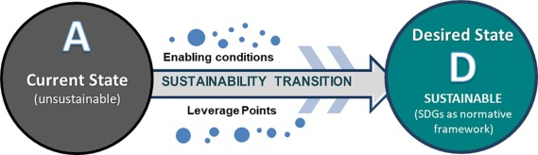
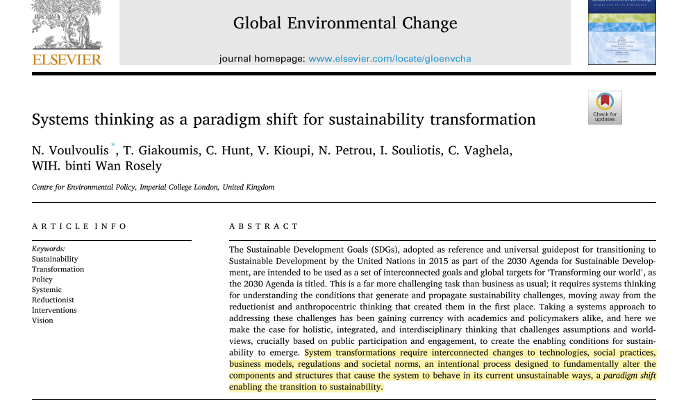
Sustainability Transformation and A Whole Systems Approach
SUSTAINABILITY TRANSFORMATION of
URBAN WATER SYSTEMS through THE WHOLE SYSTEMS APPROACH
Availability and security of water and environment in urban areas today and in the future
Complexities
Methodologies
Root causes
Leverage points
Transdisciplinary
Inclusive participation
Social learning/empowering
Increase buy-ins/reduce conflicts

Slide 7
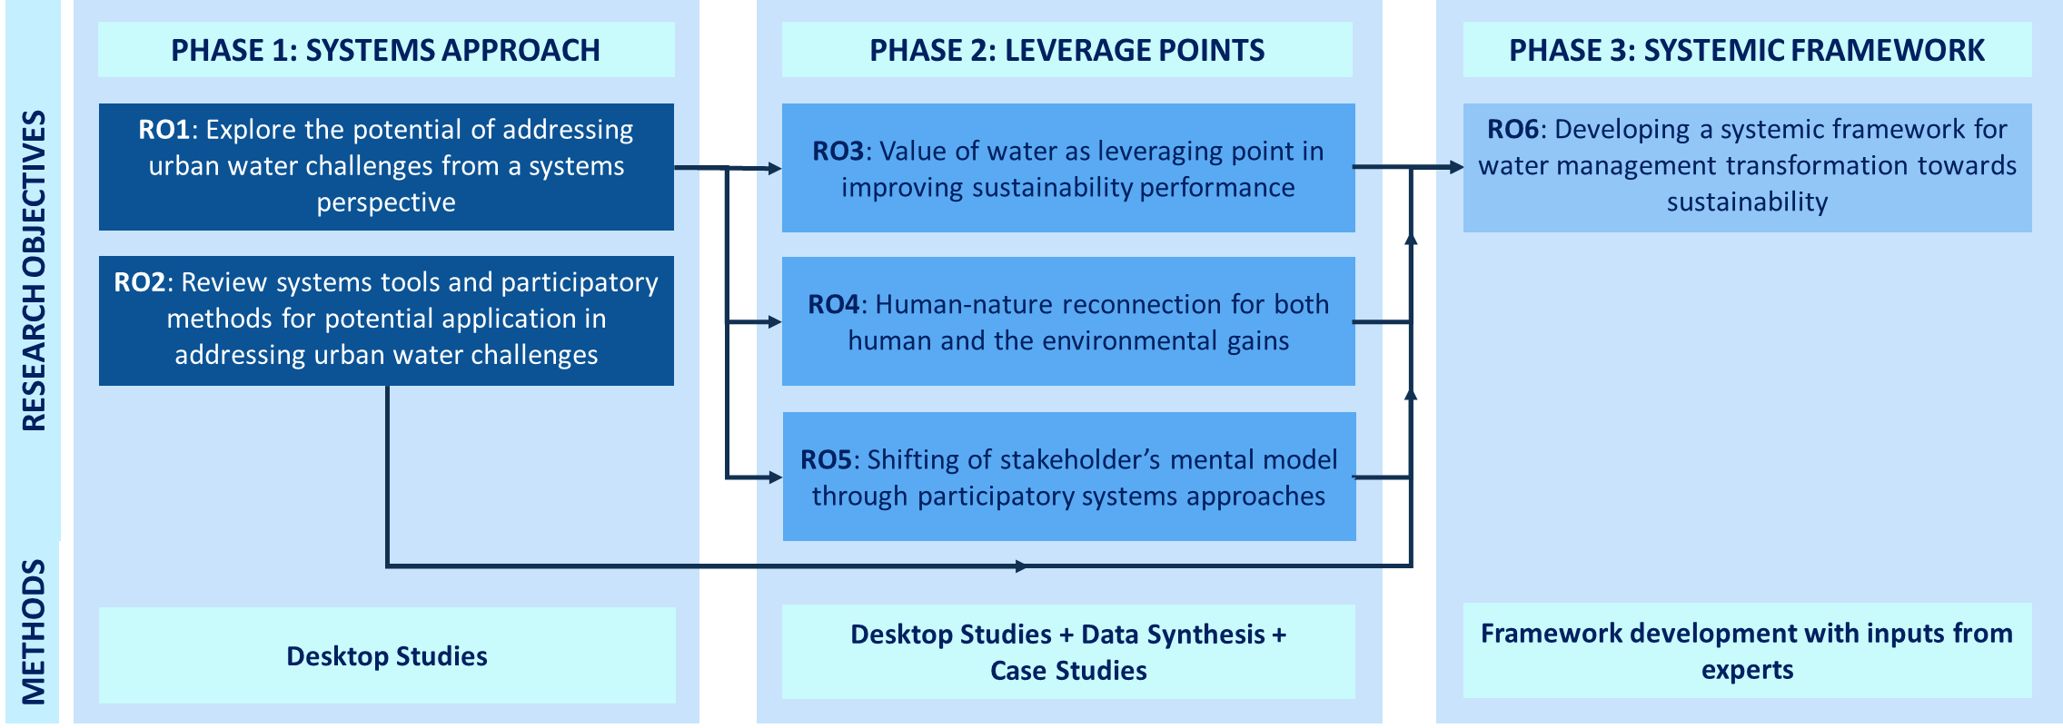

Applying the whole systems approach to achieve sustainable urban water systems

Slide 8
Urban water systems from the natural water cycle perspective
Atmosphere
Rainwater
Treated wastewater
Municipal wastewater treatment plant
Stormwater
Stormwater
Rainwater
Wider catchment area
Combined sewer
in-silo, fragmented management, lead to complex/wicked problems, unintended consequences
integrated management approach introduced
Stormwater & other discharges
Treated wastewater
Storm drains
Industrial wastewater treatment facility
Wastewater
Industrial wastewater treatment facility
Rainwater
Treated wastewater
Freshwater
Untreated stormwater
Residential
Commercial/Government
Industrial
Freshwater
Drinking water
 | Water bodies Stormwater runoff Water supply (treatment & distribution) Wastewater (collection & treatment)
Drinking water treatment plant
Dam/reservoir
Freshwater
Rivers/ lakes
Freshwater
Freshwater
Freshwater
Freshwater
Drinking water wells
Groundwater aquifers
Freshwater
Freshwater

Slide 9
Existing systems research in addressing urban water challenges
Aims
Improve understanding of systems complexity-descriptive
Enhance methodological approach applied in researching complex systems
Improve modelling/scenario planning (including participatory modelling)
Social learning tools, enhance stakeholder’s buy-ins, resolve conflicts
Improve water management (frameworks, concepts, decision-making, assessment)
Systems methodology
Multi-criteria Decision Analysis (MCDA)
System Dynamic Modelling (SDM)
Agent Based Modelling (ABM)
Driver-Pressure-State-Impact-Response (DPSIR)
Social Network Analysis (SNA)
Bayesian Belief Network (BBN)
Backcasting
Soft Systems Methodology (SSM)
Socio-Technical Analysis (STA)
Critical Systems Heuristics (CSH)
Vanguard Method (VM)
Gaps
Lack empirical evidences in the practical application
Solutions focus more on infrastructure than people
Research overemphasis on systems engineering and computational efforts
Systems interventions to address water challenges have not been truly systemic
Research Processes
Problem scoping
Boundary setting
Systems mapping
Computer modelling
Scenario analysis
Recommendation

Slide 10
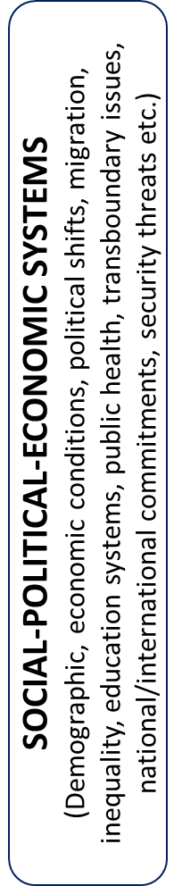

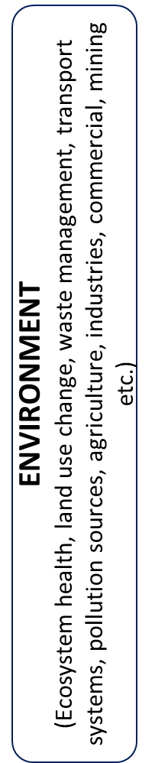
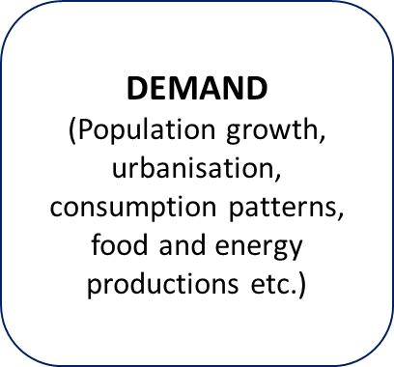
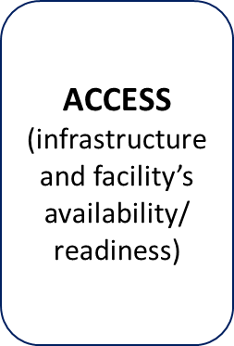
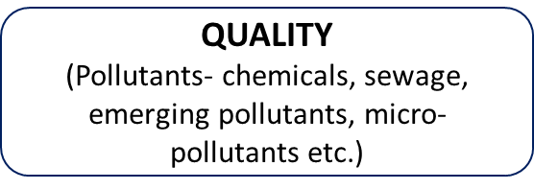
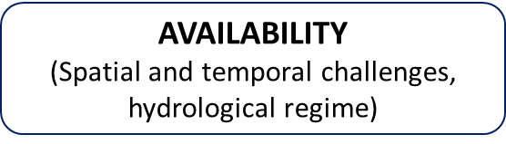

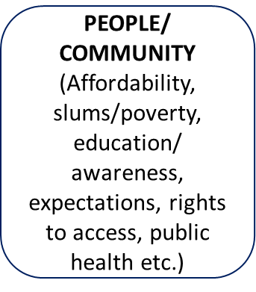
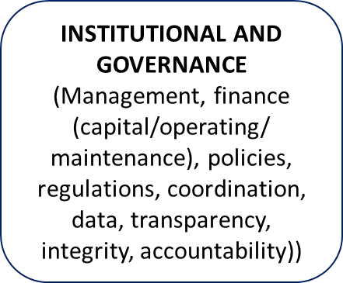
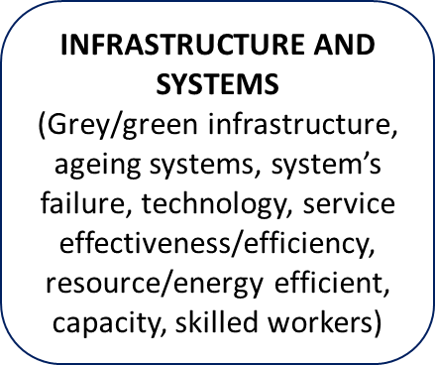
Urban water systems from the systems perspective

Slide 11
Potential root causes and enablers to sustainability
Social practices
the value of water
Technologies
Societal norms
UWS
people-nature disconnection
institutions and political choices
Regulations
Business models

Slide 12
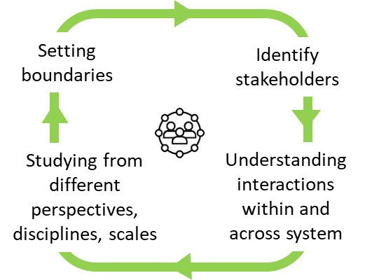
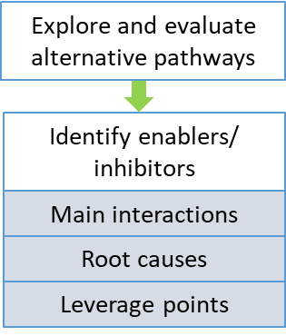

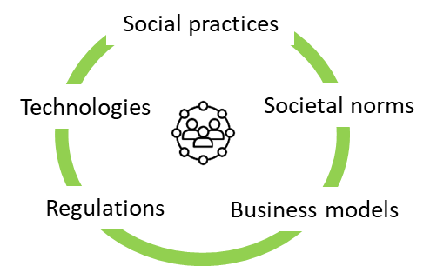
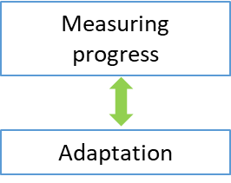

Conceptual framework for systemic transformation of the urban water system
1. Systems understanding | 2. Problem conceptualisation | 3. Pathways | 4. Implementation | 5. Monitoring and evaluation
Systems mapping, Stakeholder Analysis, SNA, CSH | DPSIR, Gap analysis, SSM, Back casting | Back casting, SSM, MCDA, Systems Modelling (SDM, ABM, SNA, BBN) | SSM, MCDA | DPSIR
Potential systems tools
Interventions to breach the gap, Enablers, Leverage points
Interconnected changes to:
Ensuring progress
How things work
“Problem”
as the gap between:
Participatory
process

Slide 13
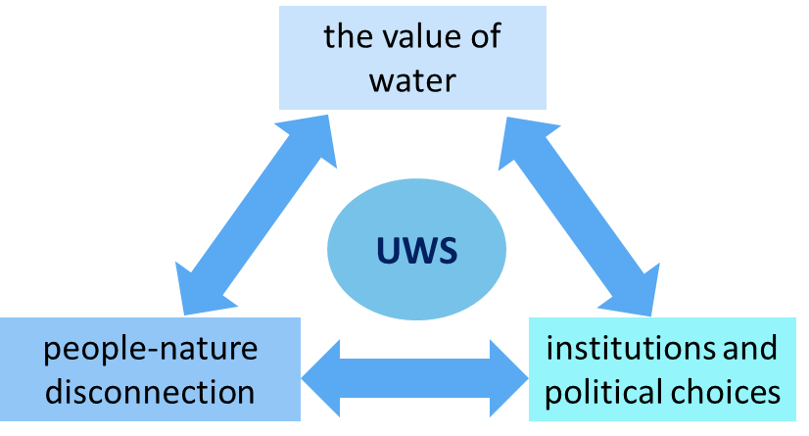
Investigating leverage point

Slide 14
Conclusion
  Systemic transformation towards sustainability of urban water systems requires a shift of paradigm to rethink challenges and redesign solutions, and to determine appropriate participatory tools to facilitate system change through leverage points

Slide 15
Abson, D. J., Fischer, J., Leventon, J., Newig, J., Schomerus, T., Vilsmaier, U., von Wehrden, H., Abernethy, P., Ives, C. D., Jager, N. W., & Lang, D. J. (2017). Leverage points for sustainability transformation. Ambio, 46(1), 30–39. https://doi.org/10.1007/s13280-016-0800-y
Dunn, G., Brown, R. R., Bos, J. J., & Bakker, K. (2017). Standing on the shoulders of giants: Understanding changes in urban water practice through the lens of complexity science. Urban Water Journal, 14(7), 758–767. https://doi.org/10.1080/1573062X.2016.1241284
Economic Planning Unit of The Malaysian Government. (2021). Executive Summary of The Twelfth Malaysia Plan 2021-2025. Economic Planning Unit Malaysia, 2021, 16.
Franco-Torres, M., Rogers, B. C., & Harder, R. (2020). Articulating the new urban water paradigm. Critical Reviews in Environmental Science and Technology, 1–48. https://doi.org/10.1080/10643389.2020.1803686
Voulvoulis, N., Giakoumis, T., Hunt, C., Kioupi, V., Petrou, N., Souliotis, I., Vaghela, C., & Rosely, W. (2022). Systems thinking as a paradigm shift for sustainability transformation. Global Environmental Change, 75(August 2021), 102544. https://doi.org/10.1016/j.gloenvcha.2022.102544

Slide 16
Thank you
w.binti-wan-rosely20@imperial.ac.uk

