Slide 1
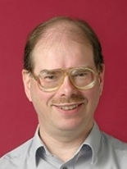
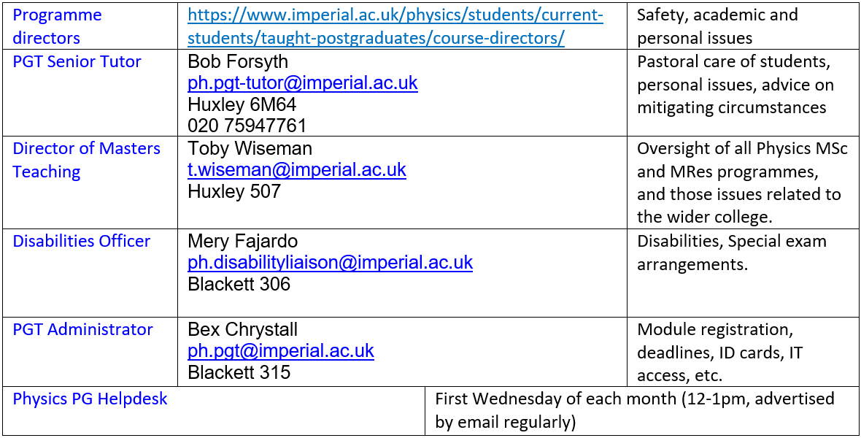
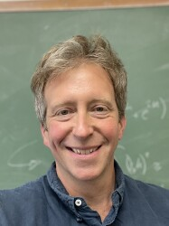
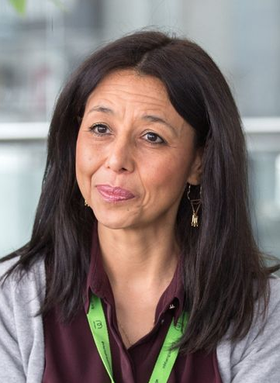
PG welfare in Physics: MSc & MRes
(Profs Lesley Cohen, Ji-Seon Kim or Dr Yvonne Unruh if you’d prefer to talk to a female member of staff)

Slide 2
Highlights
Helpdesk: co-run with Jess Popplewell from career office and current RAs. First Wednesday of every month 12-1pm. Exception: First session will be Wednesday 9th October 12-1pm
List of useful student support contacts: imperial.ac.uk/physics/students/current-students/taught-postgraduates/ and select Quick Contacts
Student wellbeing advice team (see next slide) and Student mental health intervention officers (concernedaboutastudent@imperial.ac.uk)

