Slide 1
How neonatal data are used in the UK
A neonatal healthcare professional teaching resource
National Neonatal Research Database,
Imperial College London
Notes:
Explanatory Notes:
These slides are for use in neonatal units in the UK for staff education and training; for example as part of trust induction for new starters.
These slides can be adapted, for example omitting some slides for shorter presentations, but we request that the slides are acknowledged, and that content is not altered.

Slide 2
Developed by
Dr Tim van Hasselt (NNRD Board trainee representative)
Dr T’ng Chang (BAPM Data and Informatics Steering Group trainee representative)
Dr Philippa Rees (NNRD Board trainee representative)
With help from
Dr Cheryl Battersby (BAPM Data Lead; Clinical Senior Lecturer in Neonatal Medicine, Imperial College London)
Dr Vimal Vasu (NNRD Board UK Neonatal Collaborative representative; Consultant Neonatologist, East Kent Hospitals NHS Trust; Honorary Senior Lecturer, University of Kent)
Professor Neena Modi (NNRD lead; Professor of Neonatal Medicine, Imperial College London)
Notes:
Please acknowledge the authors of these slides when using them.

Slide 3
Why do neonatal data matter?
High quality neonatal care is important
Neonatal care is a specialised, technical, fast-changing field, with a unique population and has lifelong implications
Neonatal data are important to understand the quality of neonatal care
National neonatal data can be used for multiple purposes, providing a world-leading opportunity for service development and research
The UK neonatal community is leading the way
Neonatal medicine is leading the way for electronic data within UK medical specialities, with national data collection from routine healthcare records
Notes:
This slide sets out the importance of data in neonatal care.
Neonatology is a field of medicine which uses high levels of technology, and considerable amounts of data are generated from patient care.
These data can be used to develop our services, audit our practice, and for world-leading research.
Neonatal medicine has been at the forefront of collection of national healthcare data in the UK.

Slide 4
Challenges of learning about neonatal data…
Lots of acronyms!
Lots of organisations!
Changing all the time!
NDAU
(Neonatal Data Analysis Unit)
UKNC
(UK Neonatal Collaborative)
NNRD
(National Neonatal Research Database)
NNAP
(National Neonatal Audit Programme)
Notes:
However, for neonatal staff there are challenges in understanding the complexities of neonatal data, and how it moves around and can be used.
There are many acronyms, some of which sound similar, and many organisations involved in data flow and data use e.g NNRD, NDAU, UKNC and NNAP.
The NHS is subject to constant change and reorganisation, as technology develops and structures change, so it can be challenging to keep up to date.

Slide 5
Aims and objectives
How neonatal data are shared in the UK
Some of the organisations involved in neonatal data
How neonatal data are making a difference
The rights of patients and their families
The future for neonatal data
Notes:
This slide sets out the aims and objectives of the educational presentation.

Slide 6
Neonatal data: Data entry
Neonatal healthcare professionals enter patient data using electronic systems such as Badger, Cerner and EPIC
Routine data include e.g. birth weight, gestational age, admission temperature, daily care summaries
Different systems have different approaches to storing equivalent data
Routine clinical work generates important national data
Notes:
Staff in neonatal units may use various electronic patient record systems from different companies as a record of clinical care.
All of these can provide neonatal data and show ability to capture the NHS England Neonatal Data Set.
Data can be entered when a baby is admitted to a neonatal unit, and in daily care records.
The work that neonatal staff do to enter routine clinical data about their babies may be used for a number of different outputs including:
payment for neonatal services, audit, research, service development and quality improvement.

Slide 7
Neonatal data: Funding neonatal units
The Neonatal Critical Care Minimum Dataset is a list of data variables used to assign Healthcare Resource Group codes
These determine payment for neonatal care (the National Tariff Payment System)
For example, recording that a baby is ventilated by endotracheal tube identifies that baby as receiving neonatal intensive care, which will be funded accordingly
Accurate data are essential to ensure that neonatal units are funded for their work
www.bapm.org
Notes:
Neonatal units are funded for the work they do, for example providing days of intensive care for babies, The National Tariff Payment System.
These are described by Healthcare Resource Group codes, which use data variables included in the Neonatal Critical Care Minimum Dataset and Neonatal Data Set.

Slide 8
Neonatal data: Data sharing
UK neonatal units share neonatal data with bodies such as the National Neonatal Research Database (NNRD) and the National Neonatal Audit Programme (NNAP)
Parents have the right to opt-out of sharing their baby’s data
400+ data items that make up the Neonatal Data Set are sent to the Neonatal Data Analysis Unit to form the NNRD
The Neonatal Data Set is an NHS Information Standard (DAPB1595)
Prior to incorporation into the NNRD, data are quality-assured and curated
National data are shared, and transferred securely
Notes:
Data are shared with the National Neonatal Research Database (NNRD), and the National Neonatal Audit Programme (NNAP) which is currently hosted by the Royal College of Paediatrics and Child Health.
Parents can opt out of sharing data via their neonatal unit, or use the NHS opt-out (England only). Trusts are legally required to comply with the latter since 2022.
The Neonatal Data Set are the data items that are shared with the Neonatal Data Analysis Unit to form the National Neonatal Research Database (NNRD), after data cleaning and preparation.
The Neonatal Data Analysis Unit team review data and look for implausible entries (e.g. a birthweight of 5000g for a 24 week baby), and contact neonatal units to request this is checked. If neonatal units amend and correct their data, the NNRD will be updated to reflect this, ensuring accuracy.

Slide 9
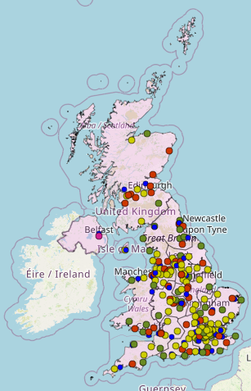
The UK Neonatal Collaborative (UKNC)
All UK neonatal units that provide data to the NNRD make up the UK Neonatal Collaborative (UKNC)
For more information on the UK Neonatal Collaborative please visit: https://www.imperial.ac.uk/neonatal-data-analysis-unit/neonatal-data-analysis-unit/list-of-national-neonatal-units
Your UK NNC representative on the NNRD Steering Board is Dr Vimal Vasu (Consultant Neonatologist).
If you have any matters that you wish to raise with the NNRD please feel free to contact him at vimal.vasu@nhs.net
Notes:
All neonatal units within the UK that contribute data to the NNRD form the UK Neonatal Collaborative (UKNC).
The website contains a list of all the neonatal units within the UKNC across all the countries of the UK, and an interactive map is also available
Please contact Dr Vimal Vasu for further details, he is the representative of the UKNC on the NNRD board.

Slide 10
National Neonatal Research Database (NNRD)
Established in 2007 with the support of BAPM and funding through grants and donations, including start-up funding from the Department of Health
Based on the principle of “enter high quality data once and use for multiple outputs”
Receives and quality-assures Neonatal Data Set items (400+ per baby) from UK neonatal units within the UK Neonatal Collaborative (UKNC)
Over one million babies and 10 million days of care data in database to date; 100,000 new patients added each year
Data undergo quality-assurance and curation; this is important as data from electronic patient records are “dirty”; i.e. they contain errors, and vary from day to day as they are real-time
Run from the Neonatal Data Analysis Unit (NDAU) at Imperial College London
NNRD Board has representation from parents, paediatric trainees, neonatal units from across the UK, neonatal nurses, Neonatal Specialised Commissioning, BAPM, and Bliss
Notes:
The NNRD is held at Imperial College London, and is self-funding, with data access costs to retain staff and maintain the database.
The UK Neonatal Collaborative is formed of neonatal units that share their data with the NNRD.
This has allowed huge amounts of data to be available for research and other purposes. This data is cleaned and prepared for audit and research projects.
The NNRD Board has representation of all key stakeholders to ensure it reflects the wider neonatal community.

Slide 11
Patient and family rights
Babies’ data stored in NNRD are de-identified, so effectively anonymous to researchers; individual babies are not identifiable
Families are offered the opportunity to opt out of their baby’s data being shared, stored, and used for research and audit
Families should approach their neonatal unit to opt out or use the national opt-out (England only)
A parent information leaflet is available from the NNRD website
Information on neonatal data should be included in family information packs
Notes:
Users will only receive data with a unique ID number generated for the NNRD, which cannot be linked to other data. Therefore researchers cannot identify any individual unless specific permission has been received from the infant’s parent/carer.
Opt-out can be arranged through the staff on the their baby’s neonatal unit, or by using the NHS National Data Opt-Out (legally enforced in England since 2022).
Neonatal units should provide families with written information, and patient information leaflets are available from the NNRD, see link.

Slide 12
Patient and family information
The NNRD team has produced a poster for parents and families explaining how neonatal data helps improve care for babies
To obtain an electronic copy of this poster for your unit, please contact the UKNC or NNRD team, or access the NNRD website
Notes:
This poster explains how neonatal data are used to help improve care for all babies, and can be put up in neonatal units for parents and families.
Electronic copies can be obtained from the NNRD website; you can print these and post up in your neonatal unit.

Slide 13
How neonatal data are improving care for our patients
You:
The UK Neonatal Collaborative
Shared data: NNRD
Helping improve neonatal outcomes
UK Neonatal Collaborative
all neonatal units in England, Wales, and Scotland
National Neonatal Research Database (NNRD)
Cleaned, verified, secure data
Board representation
including parents, neonatal staff, trainees, and academics
Neonatal research
Audit
Benchmarking
Quality improvement
You enter routine electronic clinical data
Efficient data: Entered once,
Multiple outputs
Find out more at:
www.imperial.ac.uk/neonatal-data-analysis-unit
Neonatal Medicine Research Group Lead: Professor Neena Modi Email: ndau@imperial.ac.uk
Notes:
This infographic describes how data flow from neonatal units in the UK Neonatal Collaborative, where staff enter clinical data, to the NNRD to be cleaned and prepared, to be used in a variety of important outputs at regional and national level, including research, audit, benchmarking, and quality improvement.
This process means data are recorded once, and then can be used for multiple outputs.

Slide 14
Important outputs from neonatal data that benefit patient care
Audit, governance, benchmarking and policy
Research
Notes:
National neonatal data can be used to improve care of babies. The following slides give examples of these under the headings of audit, governance benchmarking and policy, and research

Slide 15
Audit, governance, benchmarking & policy
National Neonatal Audit Programme (NNAP)
Uses EPR data for national audit of key neonatal care process and outcome measures
National PReCePT Programme Evaluation
Uses NNRD data to evaluates whether the PReCePT Quality Improvement intervention improves uptake of antenatal Magnesium Sulphate
National Pregnancy in Diabetes Audit
Uses NNRD data to examine outcomes of babies born to women with pre-existing diabetes
National Maternal and Neonatal Policy Research Unit at the National Perinatal Epidemiology Unit, University of Oxford
Uses NNRD data for policy research and development for the Department of Health
Notes:
This slide describes the wider uses of neonatal data.
The National Neonatal Audit Programme is currently managed by the Royal College of Paediatrics and Child Health, and allows for unit-level and regional level audit of selected key processes and outcomes.
Neonatal data within the NNRD has been used in national quality improvement projects such as PReCePT for magnesium sulphate, the National Pregnancy in Diabetes Audit, and to develop healthcare policy at the University of Oxford.

Slide 16
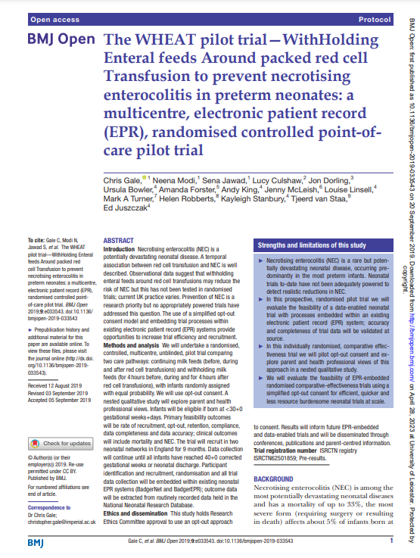
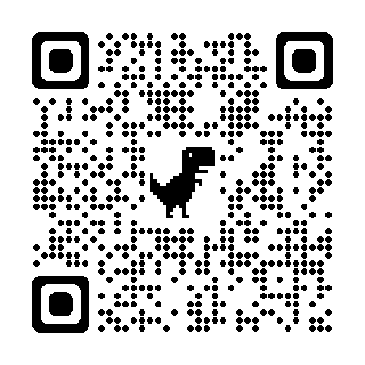
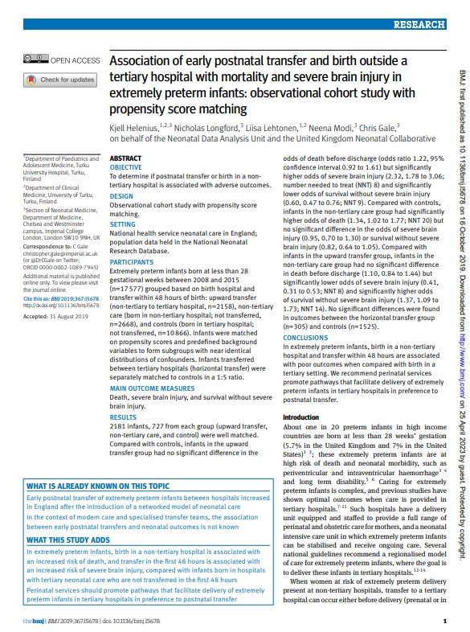
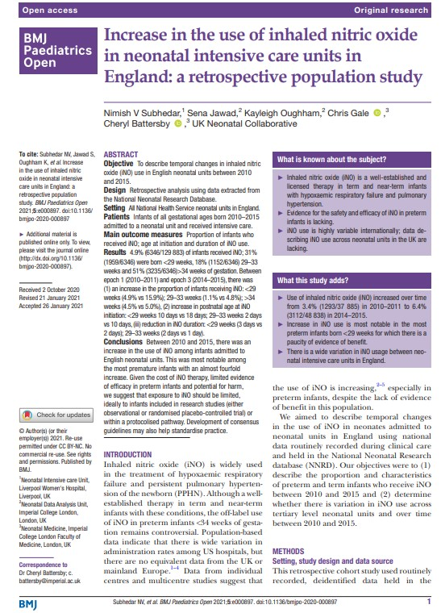
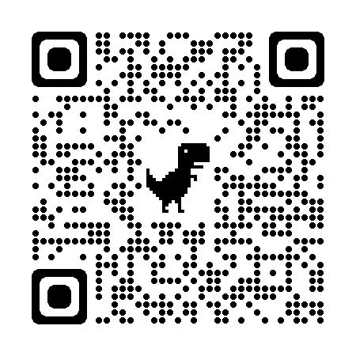
Research
WHEAT Trial - WithHolding Enteral feeds Around packed red cell Transfusion
Pilot trial, showed a clinical trial can be completed using only routinely collected data
The impact of inter-hospital transportation: Neonatal outcomes and implications for families
NNRD data examining patterns and trends in neonatal unit transfers in a centralised network system, and the potential impact on families
Inhaled nitric oxide (iNO)
National data exploring trends in iNO usage among preterm infants
Notes:
The NNRD is a key enabler of neonatal research, for example the innovative WHEAT Trial, a clinical trial using only routine healthcare data which is ongoing, as well as epidemiological studies examining a range of topics such as neonatal transport and use of inhaled nitric oxide which have been published in recent years.
The QR codes link to the details of studies.

Slide 17
How can I use neonatal data?
Local neonatal unit data: download directly from your electronic patient record system, speak to your neonatal unit lead, no cost
Regional neonatal network data: speak to your network data lead, no cost
National neonatal data: Apply to NNRD, this will require research ethics approval for research use and funding to cover NNRD costs for data transfer, storage, regulatory approvals, management, and processing
Notes:
Local data is available to neonatal units from your electronic patient record system; this can be used for local or regional audit, governance and service development.
To access NNRD data for research, ethics approval is required, in addition to funding to cover costs to maintain the NNRD and support researchers.

Slide 18
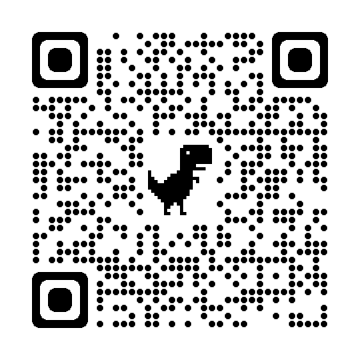
How can I use the NNRD?
NNRD access applications are through the Health Data Research UK (HDR-UK) Innovation Gateway
The HDR-UK Gateway provides a search engine for UK health datasets
NHS England (previously NHS Digital) can link datasets, and provide researchers with anonymised data; there is a cost for this service
Notes:
All applications to the NNRD are through the online Health Data Research UK Gateway.
NHS England (which incorporated NHS Digital) is able to link NNRD data to other datasets, for example other healthcare datasets.

Slide 19
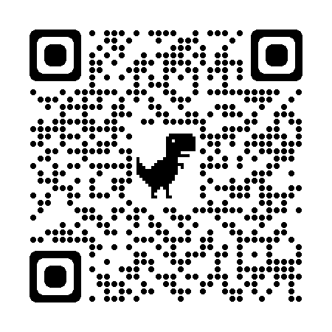
Why link datasets?
For example:
neoWONDER: Neonatal whole population data linkage approach to improving long-term health and wellbeing of preterm and sick babies
Linking NNRD with education and health data
‘Understanding the impact of preterm birth and neonatal care on childhood physical, mental health, and educational outcomes’
Notes:
An example of the benefits of data linkage using the NNRD is the neoWONDER project, which will examine educational outcomes of children born preterm who received care on neonatal units.

Slide 20
Organisations advocating the benefits of well-governanced use of quality assured neonatal data
UK national charity for babies born premature or sick and their families
Supports families on neonatal units, supports families involved in research, provides online resources
Professional association and registered charity that aims to improve standards of perinatal care
BAPM produces important reports, guidelines, runs conferences and educational events
Data and Informatics Steering Group advocates for using neonatal data to benefit babies and families
Notes:
The wider neonatal community has interests in the best use of neonatal data.
Bliss is the charity for babies born preterm or sick, and supports families whose children require neonatal care. Bliss supports families’ involvement in research including projects using NNRD data.
The British Association of Perinatal Medicine (BAPM) is involved in creation of important reports and guidelines, and is producing material around the use of neonatal data as part of the Data and Informatics Steering Group workstream, for example a Frequently Asked Questions section on neonatal data available on their website.

Slide 21
The near-future of neonatal data
Changing NHS bodies, regulatory and political changes across UK nations
More electronic health record systems entering the NHS
Streamlining application process (Health Data Research-UK portal) to access data
Increasing use of data linkage
Use of Trusted Research Environments allowing secure access to data for research in a virtual environment; avoids need to transfer data to researchers
Notes:
As the structure of the NHS changes and technology develops, there will be changes in the landscape of neonatal data.
However, the principles of single data input and multiple outputs will remain.
Research and governance projects using national neonatal data are likely to become increasingly important.
Access to the NNRD has been streamlined through the Health Data Research-UK portal. It is also likely that there will be further data linkage projects using the NNRD.
The use of Trusted Research Environments may simplify regulatory processes to access neonatal data.

Slide 22
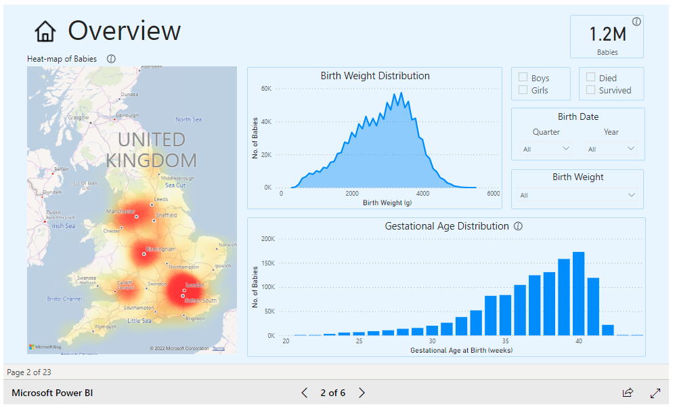
Sharing data outputs with the public
Data visualisation tools are available on the NNRD website
Censoring of small numbers to avoid patient identification
Notes:
The NNRD has created publicly available data visualisation tools, which allow anyone to examine national-level data, while maintaining anonymisation.
In the future the general public may have access to other data tools to examine neonatal care and outcomes.

Slide 23
How to get in touch
To contact the NNRD email: ndau@imperial.ac.uk
To contact the UK Neonatal Collaborative representative email Dr Vimal Vasu: vimal.vasu@nhs.net
To contact the NNRD trainee representatives email Dr Tim van Hasselt: t.vanhasselt@nhs.net

Slide 24
Links: key websites
The Neonatal Data Analysis Unit and National Neonatal Research Database: https://www.imperial.ac.uk/neonatal-data-analysis-unit/neonatal-data-analysis-unit/
The Neonatal Data Set: DAPB1595: Neonatal Data Set - NHS Digital
Health Data Research UK: https://www.hdruk.ac.uk/
National Neonatal Audit Program: https://www.rcpch.ac.uk/work-we-do/quality-improvement-patient-safety/national-neonatal-audit-programme
British Association of Perinatal Medicine, Data FAQs: https://www.bapm.org/pages/data-faqs
Bliss: For babies born premature or sick: https://www.bliss.org.uk/
Notes:
This is a list of key websites to be aware of for staff with an interest in neonatal data.

