Slide 1
Drug-target Mendelian randomization and dementia risk (opportunities and challenges)
James Yarmolinsky, PhD
Advanced Research Fellow,
Department of Epidemiology and Biostatistics, Imperial College London
Notes:
I’m going to be presenting on drug-target Mendelian randomization and some of the unique strengths and challenges that exist when applying this method to dementia risk

Slide 2
Conventional pharmaco-epidemiological studies
Numerous cardio-metabolic medications (e.g. lipid-lowering, anti-diabetic, anti-hypertensive) have been linked to dementia risk
Vulnerability of conventional observational studies to confounding (residual, unmeasured) and reverse causation preclude robust causal inference
Causal nature of associations often unclear
Notes:
To provide a bit of background, ementia and CVD appear to share some important cardiometabolic risk factors and approved drugs targeting these risk factors have been linked to dementia risk in conventional observational studies.
This suggests the exciting possibility of repurposing commonly prescribed medications as a pharmacological strategy for dementia prevention.
However, as we all know, though attempts can be made to minimize sources of bias and confounding in these studies, these can frequently persist
Thus the causal nature of associations between medication use and dementia risk, and thus, the efficacy of these medications as repurposing agents remains unclear.

Slide 3

Drug-target Mendelian randomization
Naturally occurring variation in genes encoding drug targets can be used to instrument (“proxy”) these targets to examine their effects on disease outcomes
Germline genetic variants are:
Randomly assorted at meiosis
Fixed at conception
Relatively precisely measured
Notes:
One alternative approach that we can use to try to infer causal relationships between medications and dementia risk is drug-target Mendelian randomization.
In Drug-target MR, we use one or more germline genetic variants located in/within proximity to genes encoding targets of genes as proxies or instruments to estimate the effect of the perturbation of these targets on disease outcomes
…is because of various favourable properties governing their inheritance, particularly for more molecular traits like protein targets of genes

Slide 4
Drug-target Mendelian randomization
HMGCR
SNP 1
SNP 2
SNP 3
SNP 4
SNP 5
“Cis-acting” variants in or within proximity to gene encoding target selected
SNP effects weighted by protein levels or downstream biomarkers or gene expression
Notes:
How does drug-target MR work in practice?
We usually select variants in or within..
We then weigh the effect estimates by levels of either the drug target itself which is often a protein or a downstream biomarker of perturbation of that target or expression of the gene encoding the target

Slide 5
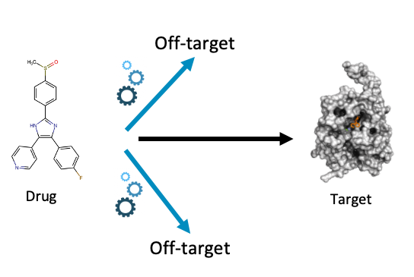
Instrumenting drug targets
e.g. HMG-CoA reductase (target of statins) and not statin medication
In drug-target MR, we are instrumenting the target of the drug and not the compound itself
HMG-CoA reductase
Statin
HMGCR
https://www.pharm.ai/off-target-identification/
Notes:
A key thing to note in drug-target MR analyses is that in these studies we are no instrumenting a medication per se but the target of that medication.
So in such a study if we’re interested in looking at the effect of statins which are cholesterol-lowering medications, we would look at the target of statins which is a protein called HMG-CoA reductase encoded by the gene HMGCR, and not statins themselves
This means that these analyses usually do not tell us about off-target effects of medications

Slide 6
Drug-target MR and non-dementia outcomes
Drug-target MR/human genetics studies have helped to prioritise …
PCSK9, IL6R, TYK2…
Helped to deprioritise
CRP, HDL cholesterol, vitamin D…
as pharmacological targets for CVD, autoimmune disease, incident cancer, type 2 diabetes…
Notes:
Drug-target MR and related genetic approaches have been helpful historically in telling us about which targets should be prioritized and also deprioritized for subsequent pharmacological development for various non-dementia outcomes such as…

Slide 7
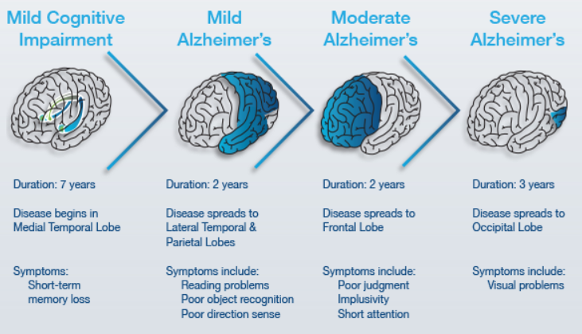
Dementia: Long-term drug target perturbation
Drug-target MR fills important RCT gap on long-term effects of drug target perturbation
Essential for diseases with long induction and latency periods (e.g. dementia) where few emerging drugs have long-term data on efficacy and adverse effects
Notes:
Drug-target MR analysis has also increasingly been applied to dementia-related outcomes. It’s in dementia where I think drug-target MR offers a particular strength as the use of germline genetic variants that are fixed at conception and studied across the lifecourse can fill in important gaps on long-term effects of drug target perturbation given the possibility of long induction periods for many medications and known long latency periods of dementia.
####This can be helpful where unclear if lack of effect of a drug in clinical trials is because of limited follow-up or the particular stage of dementia of participants. However, this does introduce a new complication in that if there is evidence of an association, it can then be unclear over what period of time a drug needs to be given or what period in the lifecourse it needs to be given to confer an effect

Slide 8
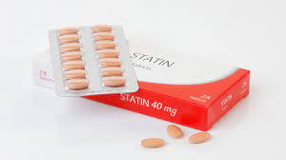
LDL cholesterol, statin use and AD risk
In vitro/vivo support for adverse effects of elevated LDL cholesterol (e.g. via increased oxidative stress, local inflammation, tau metabolism)
Circulating LDL cholesterol associated with increased risk of AD (RR per SD increase 1.05, 95% CI 1.03-1.06), N=1.8M participants in CPRD
Statin use associated with lower AD risk (OR 0.68, 95% CI 0.56-0.81, 21 studies)
Olmastroni et al. Eur J Prev Cardiol 2022;29:804-814
Iwagami et al. Lancet Healthy Longev . 2021;e498-e506
Notes:
OK so I now wanted to highlight some studies that have applied…
Preclinical…
This is supported by
Lipophilic statins cross more readily into the central nervous system in animal and in vitro studies

Slide 9
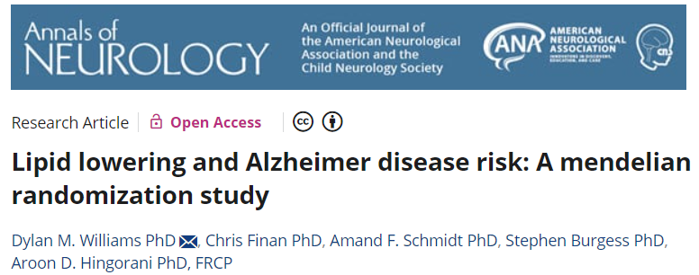
LDL cholesterol, statin use and AD risk
LDL cholesterol: 55 SNPs associated with LDL cholesterol (P<5x10⁻⁸) agnostic to genomic position
HMG-CoA reductase: 14 SNPs in/in proximity to HMGCR associated with LDL cholesterol (P<5x10⁻⁸)
24,718 AD cases; 56,685 controls
(IGAP + PGC)
Notes:
Positive control analyses were performed…

Slide 10
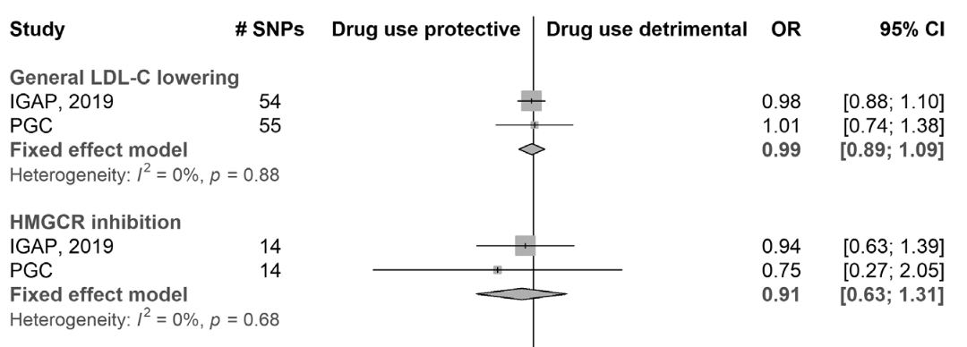
LDL cholesterol, statin use and AD risk
Consistent with large (5-year) RCTs showing no effect of statin intervention on dementia risk (MRC/BHF HPS. Lancet, 2002)
Williams et al. Ann Neurol 2020;87:30–39

Slide 11
LDL cholesterol, statin use and AD risk
Consistent with large (5-year) RCTs showing no effect of statin intervention on dementia risk (MRC/BHF HPS. Lancet, 2002)
Williams et al. Ann Neurol 2020;87:30–39
Notes:
Importantly, consistent
MR analyses provide complementary evidence to trials in that they suggest that this null effect is unlikely to be related to the limited follow up in this trial

Slide 12
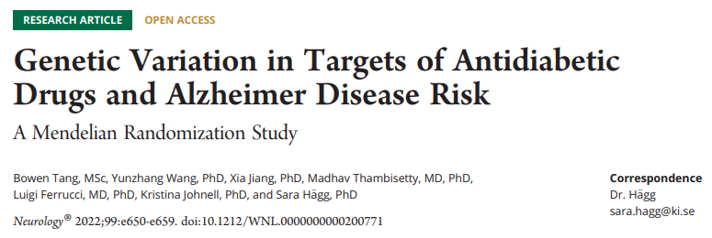
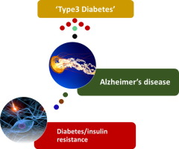
Type 2 diabetes linked to a 53% higher risk of AD (Zheng et al.
Diabetes Res Clin Pract. 2017, 124:41-47)
AD proposed as “type 3 diabetes”
Inconclusive findings from clinical trials of anti-diabetic drugs (early or mild-to-moderate AD patients)
Notes:
Because of the potential role of insulin resistance and impaired glucose regulation in the brain… This suggests the possibility that anti-diabetic medications could be used to prevent or treat dementia. Inconclusive findings…on cognitive outcomes

Slide 13
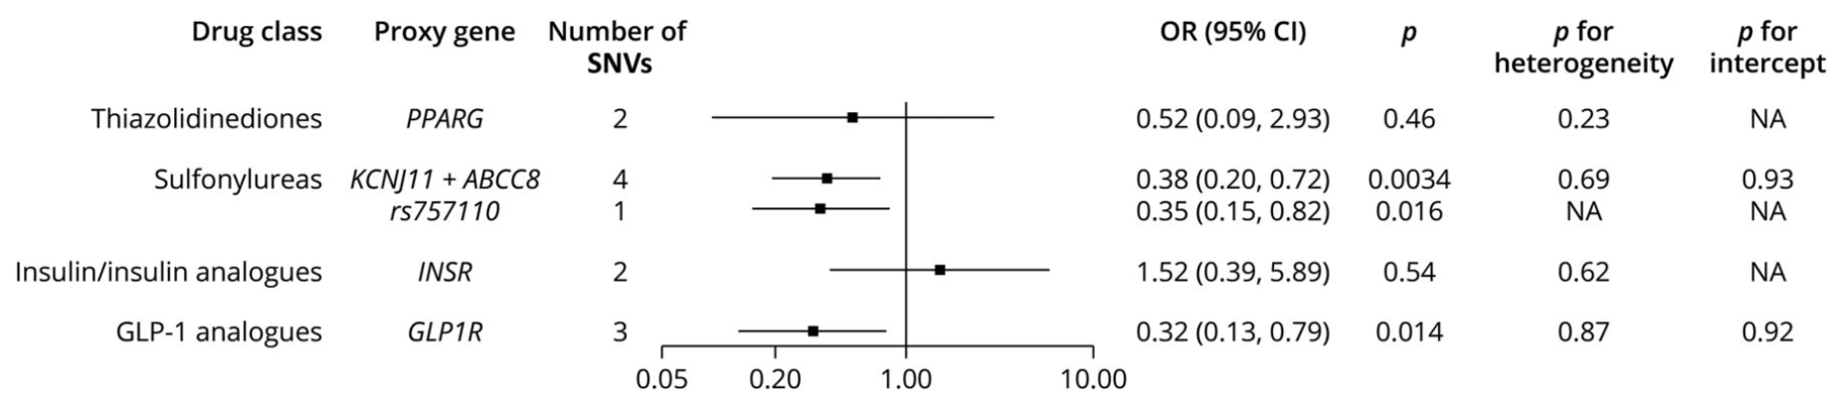
Anti-diabetic drug targets and AD risk
Tang et al. Neurology. 2022;99:e650-e659.

Slide 14
Anti-diabetic drug targets and AD risk
Tang et al. Neurology. 2022;99:e650-e659.

Slide 15
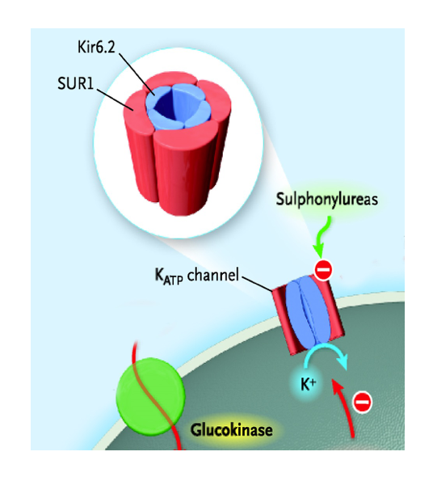
Interpretative challenges?
Sulfonylureas block ATP-sensitive potassium (K_{ATP}) channels
K_{ATP} abundantly expressed in brain
Poor penetration of sulfonylureas across the blood-brain barrier
“…caution is warranted in repurposing the existing sulfonylurea agents for AD…”
Tang et al. Neurology. 2022;99:e650-e659.
Notes:
Sulfonylureas work by blocking ATP-sensitive potassium channels which are widely expressed across many tissues and highly expressed in the brain.
However, there is poor penetration of sulfonylureas across the blood brain barrier, which was cited by the authors…

Slide 16
Interpretative challenges?
Poses an interpretative challenge only if presumed MOA of AD effect is via central nervous system
If sulfonylureas influence circulating biomarkers downstream of K_{ATP} that can pass through BBB, not an issue
Importance of understanding mechanisms for drugs with poor/no penetration of blood-brain barrier
Tang et al. Neurology. 2022;99:e650-e659.
Notes:
I wanted to flag this because drugs being explored for repurposing that do not pass the blood brain barrier can indeed be an important issue that is somewhat unique when applying drug-target MR to dementia
The issue here is that these drugs not passing through the BBB…
I just wanted to highlight this as it’s a good example of some of the unique issues that drug-target MR analyses of dementia need to think about relating to the blood brain barrier and the need to better understand alternate mechanisms that could confer an effect where drugs clearly do not penetrate the blood brain barrier…

Slide 17

Antihypertensive medications
Mid-life hypertension linked to increased dementia risk (Livingston et al. Lancet. 2020; 396:413-446)
Meta-analyses of clinical trials of antihypertensive medications suggest blood pressure lowering reduces dementia risk (OR 0.93, 95% CI 0.88-0.98, (12 trials, 92,135 participants, I²=0.0%) Hughes et al. JAMA. 2020; 323:1934-1944
Notes:
Findings from the Lancet Commission on Dementia Prevention

Slide 18
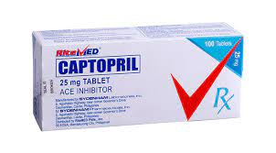
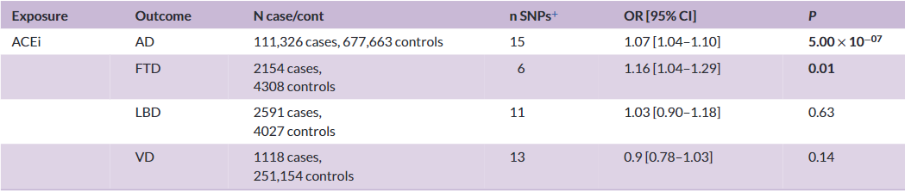
Antihypertensive drug-target MR
Drug-target MR analysis suggests genetically-proxied ACE inhibition is associated with increased risk of AD dementia
Nassan et al. Alzheimers Dement. 2023;19:3894-3901.
Notes:
ACE inhibitors are commonly prescribed antihypertensive medications
When thinking about these findings…Could be possible, though perhaps not plausible that ACE inhibitors somehow uniquely increase ALZ risk in contrast to other antihypertensives….also differences between the effect ACE inhibition across the life-course as compared to the effect of blood pressure lowering in individuals with hypertension in mid/later life for a shorter period of time

Slide 19
Antihypertensive drug-target MR
Drug-target MR analysis suggests genetically-proxied ACE inhibition is associated with increased risk of AD dementia
Survivor bias?
Nassan et al. Alzheimers Dement. 2023;19:3894-3901.
Notes:
ACE inhibitors are commonly prescribed antihypertensive medications
When thinking about these findings…Could be possible, though perhaps not plausible that ACE inhibitors somehow uniquely increase ALZ risk in contrast to other antihypertensives….also differences between the effect ACE inhibition across the life-course as compared to the effect of blood pressure lowering in individuals with hypertension in mid/later life for a shorter period of time

Slide 20

Survivor bias in MR studies of AD risk?
Genetically-proxied ACE inhibition
Cardiovascular disease
Dementia
Notes:
When thinking across the life-course, individuals with a genetic predisposition to having lower ACE levels would be expected to have a lower risk of cardiovascular disease which tends to occur earlier in life than dementia. Consequently, these individuals are simply more likely to be alive and live long enough to subsequently develop dementia.

Slide 21
Survivor bias in MR studies of AD risk?
Genetically-proxied ACE inhibition (SD) lowers risk of CVD
(OR 0.96, 95% CI 0.94-0.97, P=3x10⁻⁹ )
Notes:
I was curious to explore this further myself…

Slide 22
Survivor bias in MR studies of AD risk?
Genetically-proxied ACE inhibition (SD) lowers risk of CVD
(OR 0.96, 95% CI 0.94-0.97, P=3x10⁻⁹ )
Replication of analyses using multivariable drug-target MR to adjust for liability to CVD
Crude MR: OR 1.07 (95% CI 1.04-1.10, P=5x10⁻⁷)
Notes:
Remains to be seen but should be explored given other studies showing inverse associations…

Slide 23
Survivor bias in MR studies of AD risk?
Genetically-proxied ACE inhibition (SD) lowers risk of CVD
(OR 0.96, 95% CI 0.94-0.97, P=3x10⁻⁹ )
Replication of analyses using multivariable drug-target MR to adjust for liability to CVD
Crude MR: OR 1.07 (95% CI 1.04-1.10, P=5x10⁻⁷)
Adjusted MVMR: OR 1.03 (95% CI 0.98-1.07), P=0.22
Notes:
This is plausibly consistent with at least part of the adverse effect of ACE inhibition from this prior paper being driven by survivor bias

Slide 24
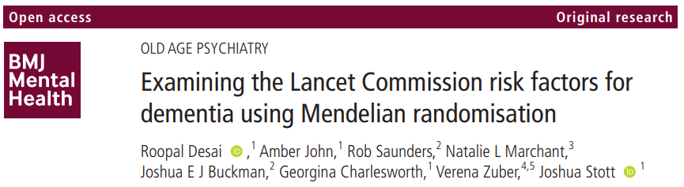
Crude MR:
Smoking: OR 0.80 (95% CI 0.69-0.92)
Obesity: OR 0.87 (95% CI 0.82-0.92)
Blood pressure: OR 0.90 (0.82-0.99)
Notes:
And indeed this is consistent with findings from some other work published earlier this year…This was a systematic MR analysis which evaluated effects of 10 of 12 modifiable risk factors for dementia identified by the The Lancet Commission.
Contrary to findings from the Lancet Commission study, evidence that obesity, blood pressure, smoking were protective in the risk of developing AD

Slide 25
Crude MR:
Smoking: OR 0.80 (95% CI 0.69-0.92)
Obesity: OR 0.87 (95% CI 0.82-0.92)
Blood pressure: OR 0.90 (0.82-0.99)
Adjusted MVMR:
Smoking: OR 0.90 (95% CI 0.77-1.06)
Obesity: OR 0.90 (95% CI 0.84-0.96)
Blood pressure: OR 0.95 (0.84-1.06)
Adjustment for liability to CAD
Notes:
Evaluated 10 of 12 modifiable risk factors for dementia identified by the The Lancet Commission.
Contrary to findings from the Lancet Commission study, evidence that obesity, blood pressure, smoking were protective in the risk of developing AD
*obesity is still “significant” but doesn’t change below:
Upon adjustment for liability to CAD, likewise all 3 estimates were attenuated…suggesting possible effects of survivor bias which could persist in MR models
Importantly this is a measure of disease liability and not CAD development per se meaning that there could be residual survivor bias in these estimates…
Also if these drugs protect against other diseases eg in midlife that have shared pathways with CVD, this could also present another source of survivor bias

Slide 26
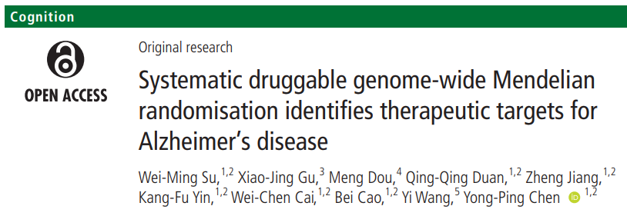
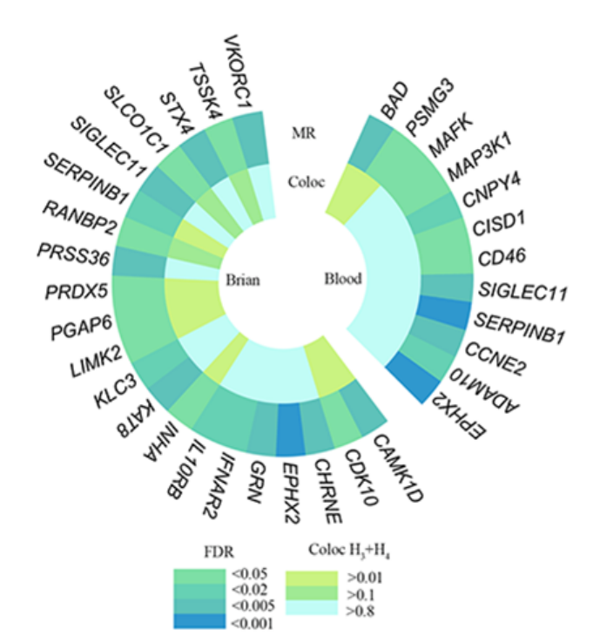
Identification of novel pharmacological targets for AD
Consistent cis-MR/ colocalisation evidence in blood and brain tissue for EPHX2, SERPINB1, SIGLEC11
Combined blood and brain cis expression quantitative trait loci (eQTL) for 5,883 druggable genes
Notes:
These potential issues and caveats aside when interpreting MR analyses in dementia, I wanted to briefly highlight some more recent work that has aimed to identify potential novel pharmacological targets for AD. They found consistent MR and colocalization evidence…which can help to resolve some of the issues mentioned previously re the blood brain barrier.
So for example EPHX2 encodes soluble epoxide hydrolase which increases neuroinflammation in mouse models of alzheimers

Slide 27
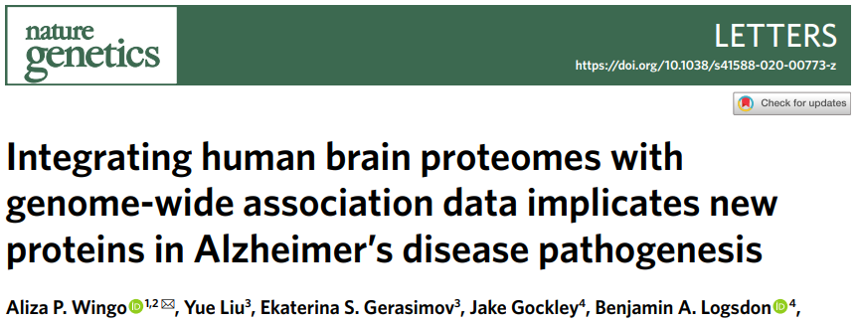
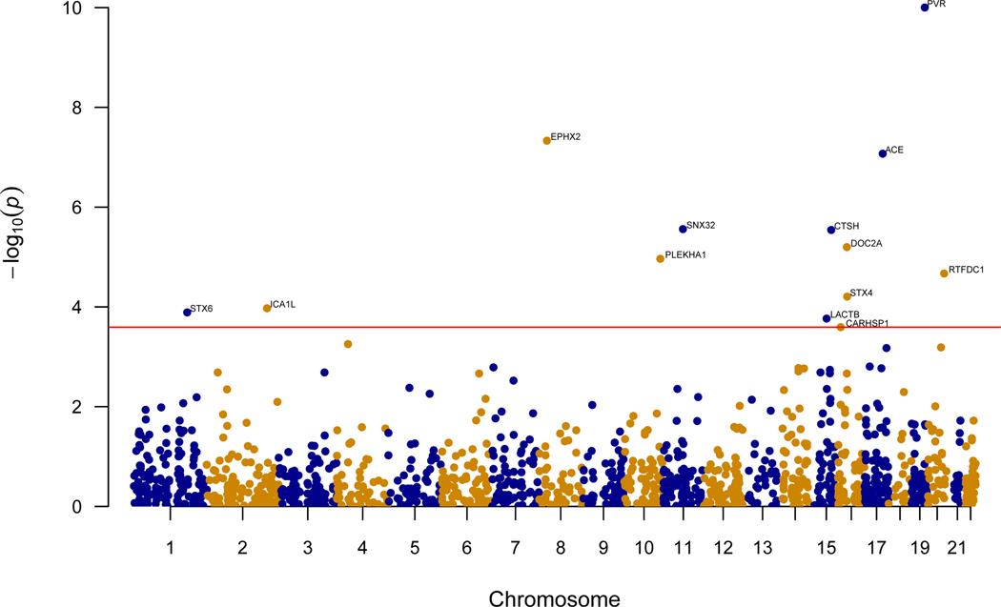
Identification of novel pharmacological targets for AD
Cis-MR/colocalisation: 11 proteins in brain associated with AD risk (e.g. CTSH, DOC2A, ICA1L)
376 human brain proteomes profiled from the dorsolateral prefrontal cortex
71,880 cases (clinically diagnosed + AD-by-proxy)
383,378 controls
Notes:
This is another paper using relatively novel measures of brain protein concentrations

Slide 28
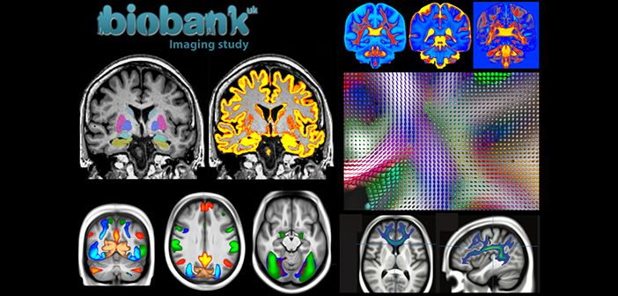
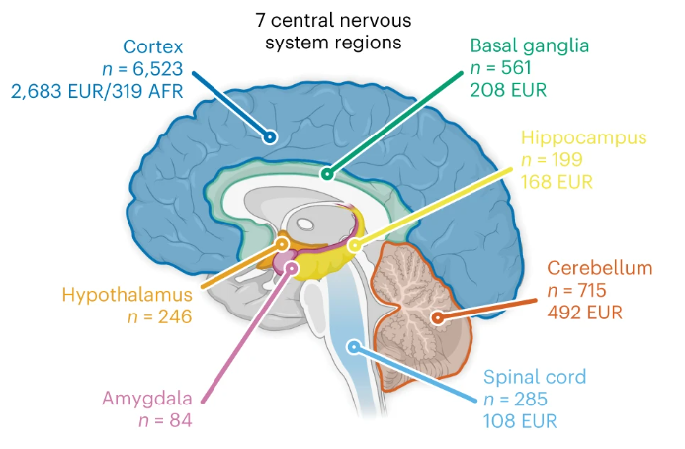



Future directions: Leveraging brain gene and protein expression data
Single-cell and brain region-specific gene expression, neuroimaging, and exome sequencing data increasingly permit more refined molecular hypotheses to be tested at greater resolution
Notes:
I just wanted to touch upon some future directions of relevance to drug-target MR and dementia. Beyond brain based bulk gene expression and protein expression data,
Integrating this data into a drug-target MR framework will allow us to test increasingly more refined causal questions relating to approved and novel drug targets at the molecular level

Slide 29
Conclusions
Drug-target MR can guide appraisal of repurposing opportunities for approved medications and identify novel targets for dementia prevention
Increasing availability of high-resolution omics data can permit more refined molecular hypotheses to be tested
Careful consideration of unique issues when evaluating dementia as an outcome (eg blood brain barrier, survivor bias) required to increase confidence in causal conclusions obtained
Notes:
Despite possible limitations and caveats, Drug-target MR offers promise in terms of informing us about drug repurposing opportunities and the identification of novel targets for dementia
This will likely be facilitated by increasingly more refined omics data along with neuroimaging and sequencing data coming out
However, careful consideration of some of the issues mentioned before is required in order to be more confident in the robustness of our results and our interpretation of our findings.

Slide 30
Thanks for listening

