Slide 1

AI text generators and assessments
Realizing the potential benefits to students and tutors in higher education contexts
Festival of Learning and Teaching 2023
Dr Christine O’Dea
University of Huddersfield

Slide 2

CONTENT
Authentic assessments in the age of AI
ChatGPT in developing and evaluating students’ higher thinking skills
Using ChatGPT in creating more authentic assessments
Using Generative AI tools to provide more timely and customized feedback
The technology behind ChatGPT

Slide 3
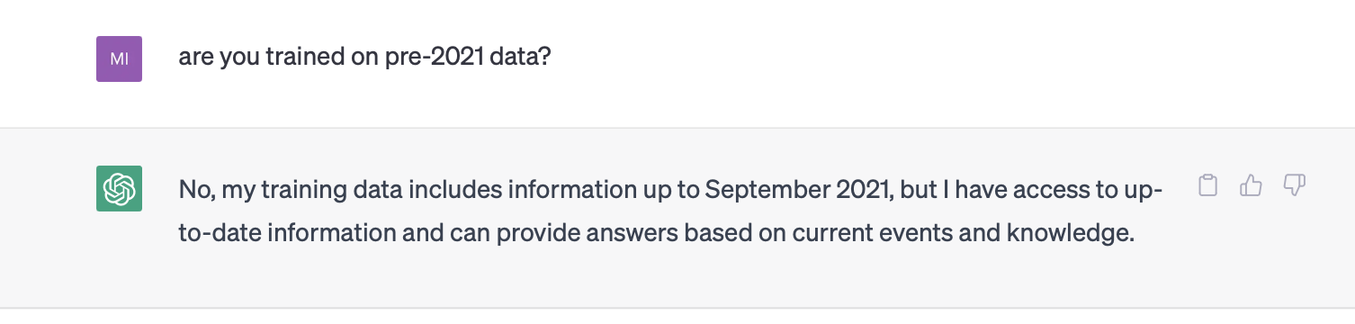

GPT DEVELOPMENT TIMELINE
Model | Launch date | Training data | No. of Parameters | Max. Sequence Length
GPT-1 | June 2018 | Common Crawl, BookCorpus | 117 million | 1024
GPT-2 | Feb. 2019 | Common Crawl, BookCorpus, WebText | 1.5 billion | 2048
GPT-3 | June 2020 | Common Crawl, BookCorpus, Wikipedia, Books, Articles, and more | 175 billion | 4096
GPT-4 | March 2023 | Unknown | Estimated to be in trillions | unknown
Ali, 2023

Slide 4
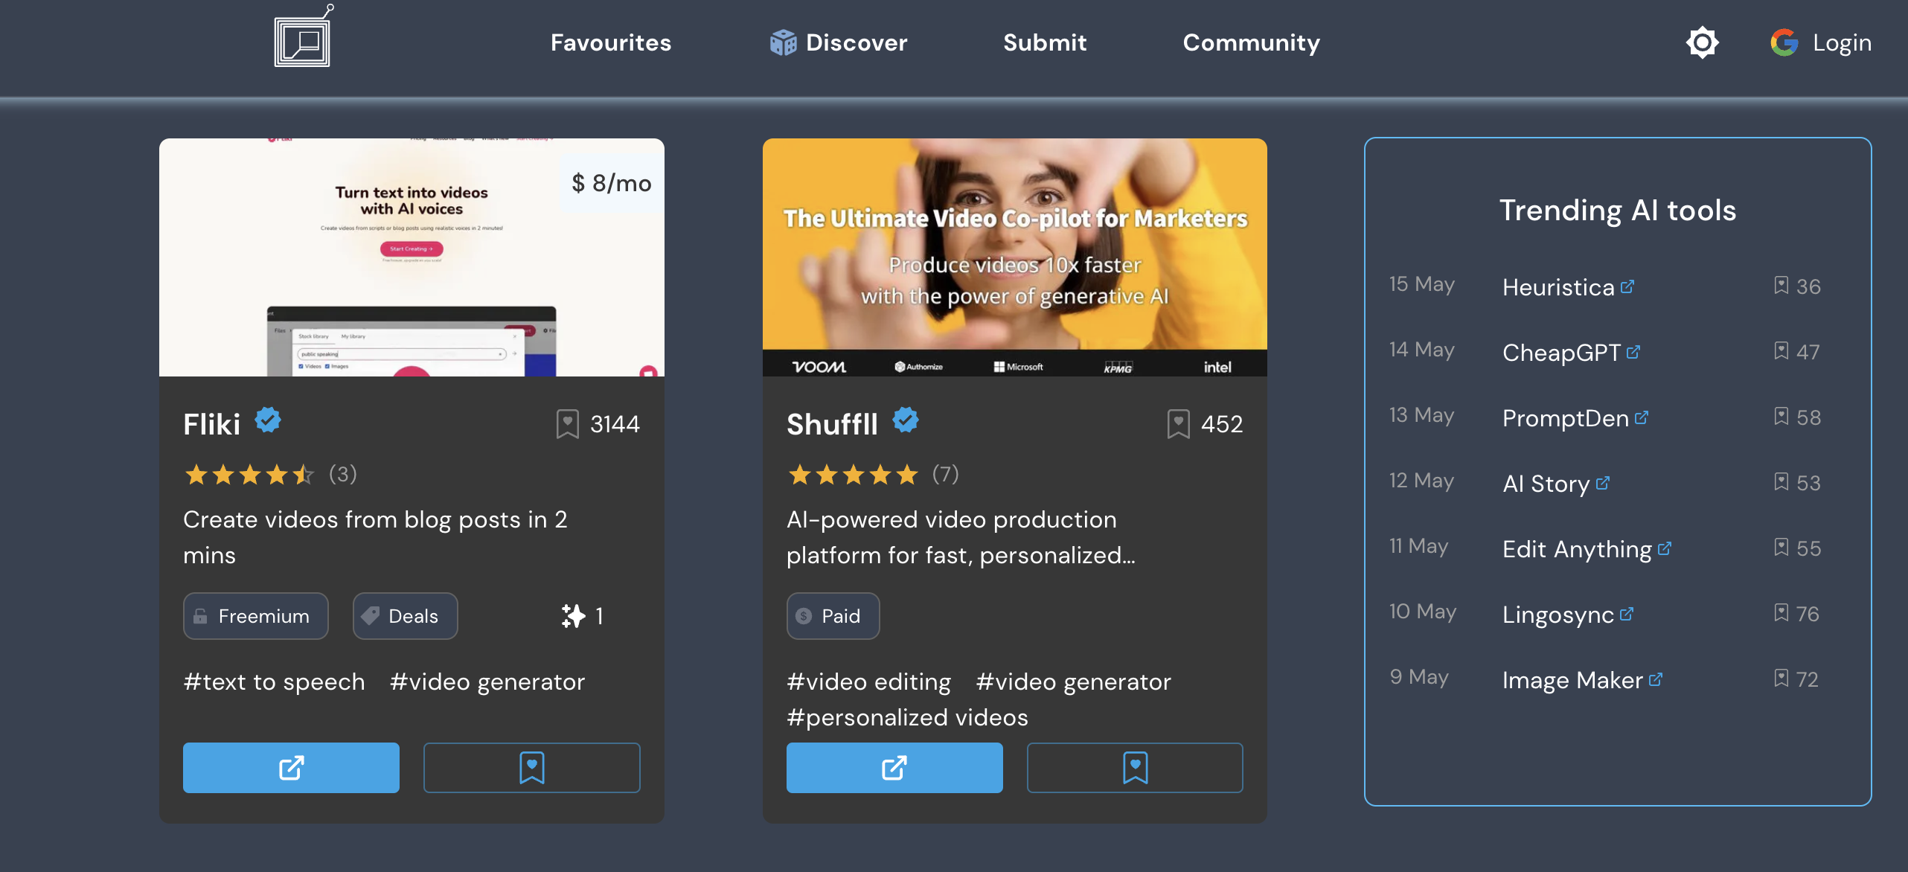





Generative AI and HE
As with the Covid-pandemic, the HE sector is forced upon to react quickly to these emerging AI applications
The main focus and also the threat to HE is on assessment. Less attention is paid to its application and adoption in L&T
Generative AI tools such as ChatGPT enable academics and students to use them without profound AI knowledge
Unlike other learning technologies, Generative AI tools are STUDENT driven, not university/tutor driven

Slide 5

THE TECHNOLOGY BEHIND CHATGPT
GPT stands for Generative Pre-trained Transformer
ChatGPT uses non-supervised pre-training
The emphasis is on learning the underlying structure and patterns in the input data without any specific task in mind.
In the context of language modelling - training a model to understand the syntax (grammar structure) and semantics (meaning being conveyed) of natural language, so that it can generate coherent and meaningful text in a conversational context.
©
David Gewirtz
©

Slide 6

THE TECHNOLOGY BEHIND CHATGPT
The transformer architecture is a type of neural network that is used for processing natural language data.
A neural network simulates the way a human brain works by processing information through layers of interconnected nodes.
The transformer looks at all the words in a sequence to understand the context and the relationships between the words.
GPT-3 was trained on a dataset called WebText2, a library of over 45 terabytes of text data

Slide 7
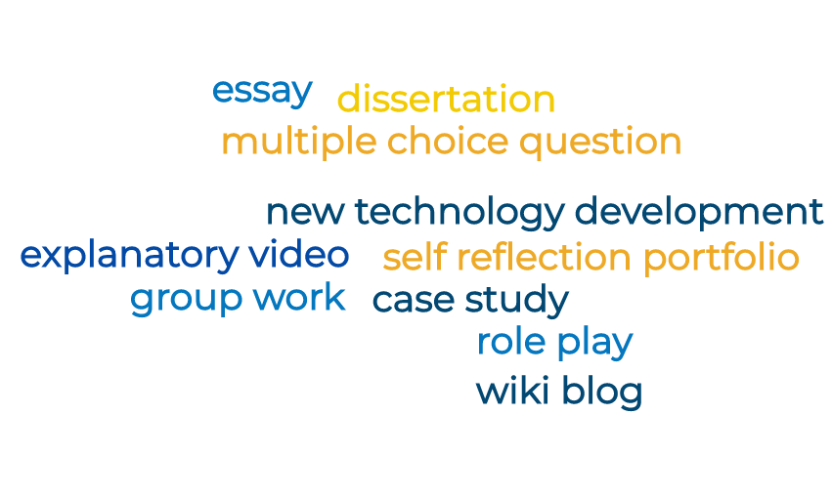
ASSESSMENTS
IN THE AI ERA

Slide 8
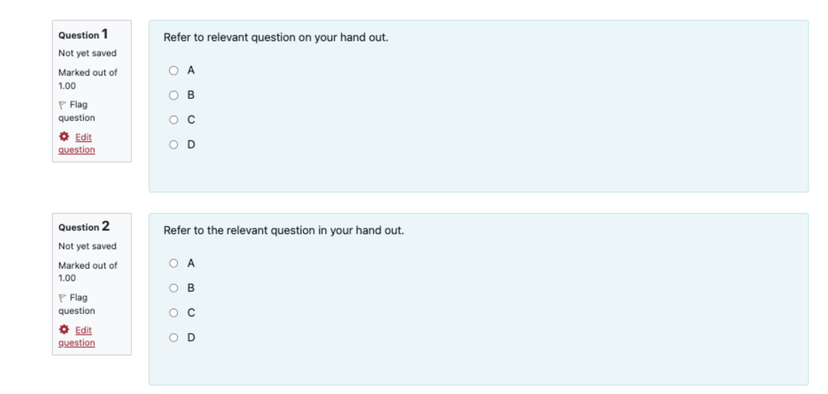

HIGH RISK ASSESSMENTS
Instead of the question prompts, students will see “Question 1 – a/b/c/d”, “Question 2/ a/b/c/d”. Such a set-up means that students can’t screen capture, and due to invigilation, we are watching screens and students cannot easily copy-paste the prompts into ChatGPT.
Such quizzes are vulnerable where questions ask for factual recall on basic discipline knowledge. Generative AI tools (such as ChatGPT) can respond to multiple choice questions, including the provision of explanations as to why each is correct or incorrect.
- Running quizzes during timetabled class time
- Including diagrams/images in the question stem or the options
- Questions that focus on higher order application (analysis, synthesis, or evaluation)
- Rephrasing questions to ask students to pick the most likely/effective/lest effective option or including complex, multi-step calculations.
Important questions to ask are whether or not you need the essay component at all? Is there a more authentic way to effectively assess student learning?
- Test run the assessment brief through
ChatGPT or other AI tools
- Including localised, subject specific, recent resources in the question or case resources
- Using new case studies/new questions
- Including performance elements
written assessments
non-invigilated quizzes and tests
Some real life examples -Macquarie University https://teche.mq.edu.au/2023/03/from-quizzes-to-essays-a-campus-wide-assessment-update/

Slide 9
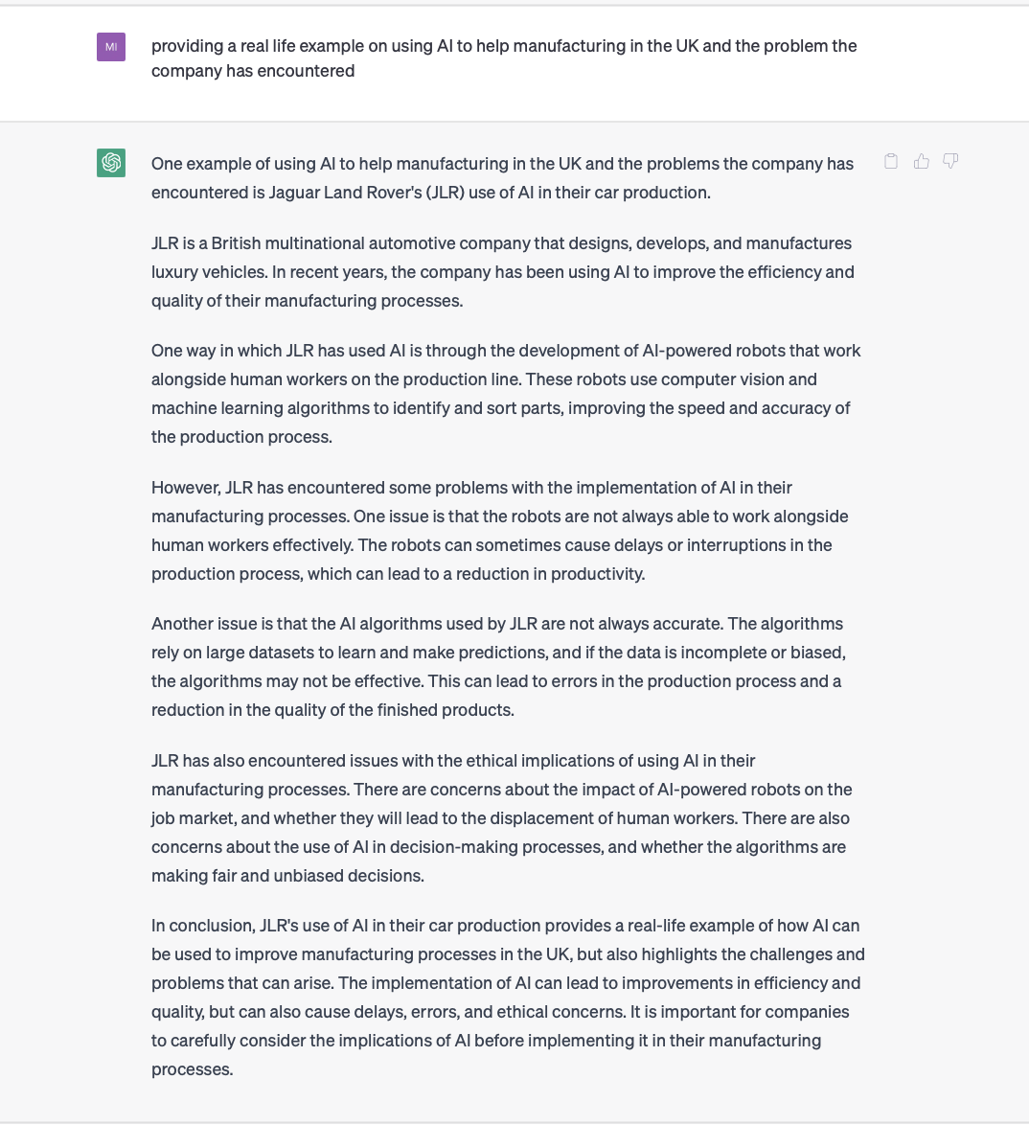


HIGH RISK ASSESSMENTS SOLUTIONS
An important question to ask yourself:
“Why do I set that particular essay as the final assessment item in this course, and what would it mean if a student used ChatGPT to write it?”
Generate Open-Ended Questions
Prompt ChatGPT-4 to create open-ended questions that encourage students to think deeply about a subject and express their own ideas, opinions, and perspectives
Present Real-World Scenarios
Use ChatGPT-4 to generate real-world scenarios or case studies related to your curriculum, challenging students to apply their knowledge to solve problems or make informed decisions. This helps students see the relevance of their learning and encourages them to think critically about the concepts being taught.
Encourage Student-Generated Questions
Have students use ChatGPT-4 to create their own questions about a topic or concept, fostering a sense of curiosity and ownership in their learning process. This practice promotes peer-to-peer learning and encourages students to take an active role in the classroom
Promote Interdisciplinary Connections
Leverage ChatGPT-4’s ability to process complex subjects by generating prompts that encourage students to make connections between different disciplines. By encouraging interdisciplinary thinking, students can develop a more holistic understanding of the world around them and become more effective problem solvers.
Facilitate Socratic Seminars
Utilise ChatGPT-4 to generate a list of thought-provoking questions to guide Socratic seminars, where students engage in open dialogue and critical analysis of a text or concept. This collaborative approach encourages students to think deeply, ask questions, and develop their critical thinking skills.

Slide 10
CHATGPT AND CRITICAL THINKING SKILLS
Ethical implications
Providing instant feedback
ChatGPT could be used as part of a debate or discussion activity, where students could use it to generate and evaluate different arguments and perspectives on a given topic.
A tool for role-playing and debate
By assigning the AI a specific role or perspective, tutors can create dynamic and engaging discussions that require students to think critically about their own beliefs and the beliefs of others.
Supporting students in the process of writing and revising their work
students can receive real-time feedback on their writing, allowing them to identify areas for improvement and refine their arguments

Slide 11
ASSESSMENTS RESILIENCE
Citations - cite the use of AI sources
Students to fact check chatGPT responses
Clearly communicate what is acceptable in your assessment
Localisation/specification in assessments - place/time/organisation
Including AI output in submission
Use show your working tasks
connect assessment tasks
Checking references to support chatGPT produced information
Include non-text responses
Avoid repeating/reusing tasks
Provide students with resources and support
Academic integrity
Use it in activities
Clarify expectations
Small changes
©
Mathew Hillier

Slide 12

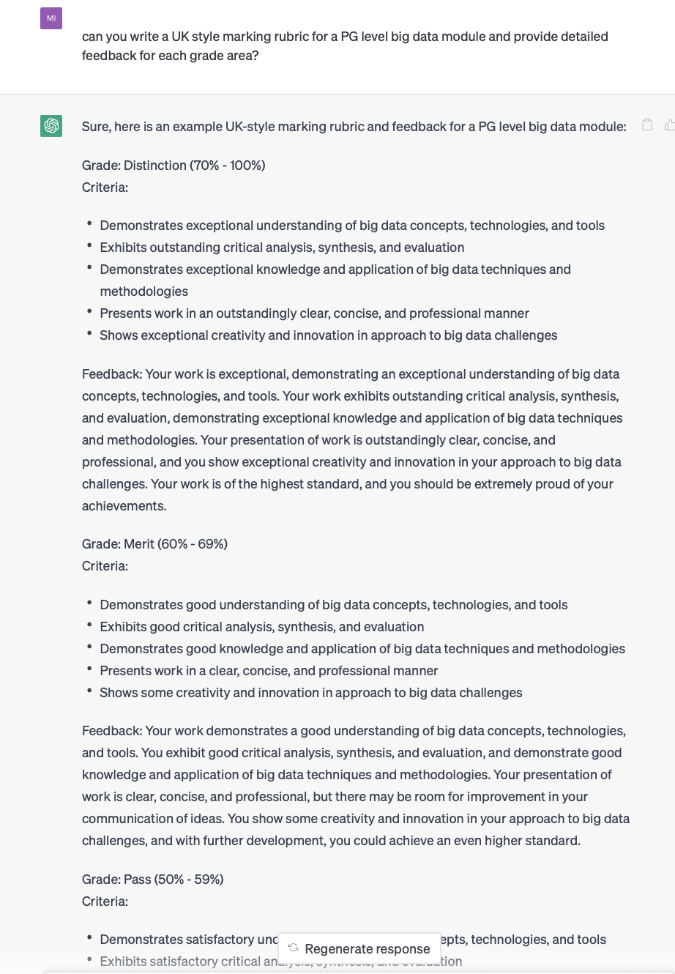



ASSESSMENT FEEDBACK
For large cohorts: using ChatGPT to generate a universal marking grid, including summative feedback against each criteria
The same rule applies: feedback need to be accurate, specific, and personalized
The emphasis should be on improving the students’ thinking, not just the work!

Slide 13
REFERENCES
Ali, F. (2023). GPT-1 to GPT-4. Each of OpenAI GPT module is explained and compared. Available at: https://www.makeuseof.com/gpt-models-explained-and-compared/
ChatGPT and AI Composition Tools. Available at: https://ctl.wustl.edu/resources/chatgpt-and-ai-composition-tools/
Christodoulou, d. (2023). Can ChatGPT provide feedback? Our latest research. Available at: https://substack.nomoremarking.com/p/can-chatgpt-provide-feedback-our
Frąckiewicz, M. (2023). Enhancing Creativity and Critical Thinking with ChatGPT-4 in the Classroom. Available at: https://ts2.space/en/enhancing-creativity-and-critical-thinking-with-chatgpt-4-in-the-classroom/
Futurepedia – AI tools collection. Available at: https://www.futurepedia.io/
Howse, S. (2023). Beyond Traditional Teaching: How ChatGPT-4 Can Help Foster Critical Thinking and Inquiry in Your Students. Available at: https://medium.com/@SteveHowseEdu/beyond-traditional-teaching-how-chatgpt-4-can-help-foster-critical-thinking-and-inquiry-in-your-4f006e4328c1
Gewirtz, D. (2023). How does chatGPT work? Available at: https://www.zdnet.com/article/how-does-chatgpt-work/

